Slide 1

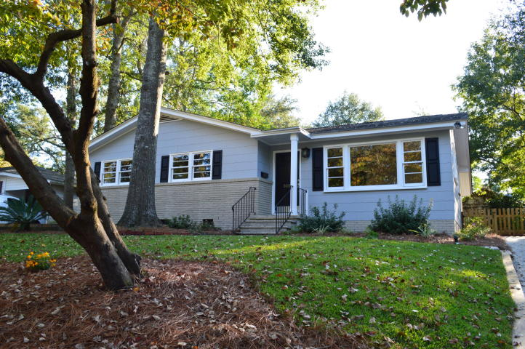
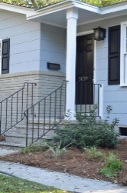
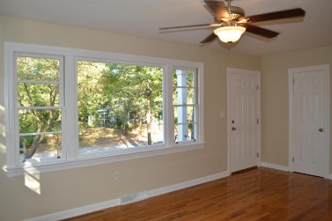
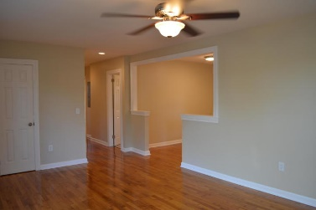
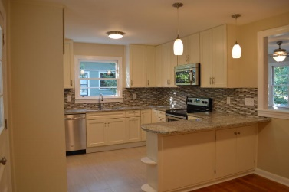
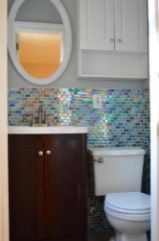
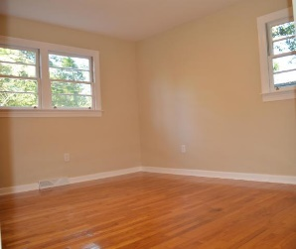
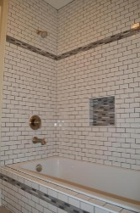
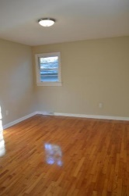
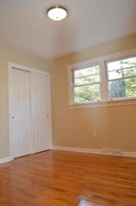
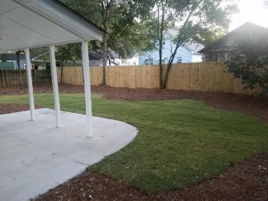
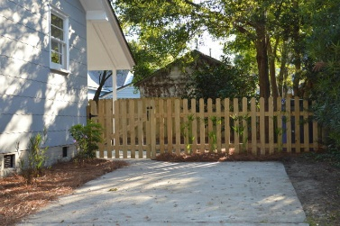



Back On The Market
5039 Draper Street
Park Circle
North Charleston, SC 29405
MLS# 16027534
$265,000
1,258 SF
3 Bedrooms :: 1½ Bath
Stunning Park Circle renovation. The sellers have crossed every t and dotted every i. This home is Awesome! The original hardwood floors have been brought back to pristine condition. You will find hardwoods in the majority of the home with the exception of the kitchen and full bathroom which now boast custom stone tile and the half bath with custom ceramic tile. The kitchen is to die for, it has been reconfigured to maximize space and achieve an open concept with wrap around custom granite counter tops, drop in sink, seated breakfast bar area, stainless steel range and dishwasher, custom cabinets with soft close drawers. The full bathroom has a new drop in tub with subway tile walls accented with custom glass mosiac tile inlay. The walls have white wainscoting. There is so much more.
New interior and exterior paint, complete electrical upgrade, new back porch and slab extended, old chain link fencing has been replaced with wood privacy in the rear and picket fencing with gate at thhe top of the driveway. The original wood windows have been removed, sanded, painted with new jam liners and all new hardware. Custom glass tiled wall in the half bath, all new fixtures, new lighting, new fans, new interior doors, new closet doors, new front door. And all new landscaping in both the front and the back. If you have been looking for the perfect Park Circle Home this one is for you!!
Lizzie H Ray
(843) 452-9298
lizzieray1122@gmail.com
Eric Draper
(843) 442-7118
eric.draper@gmail.com
www.charlestonrealestategroup.com
Charleston Real Estate Group | 792 Folly Rd. C1 | Charleston, SC 29412

