Slide 1
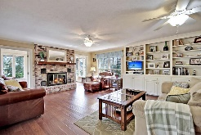
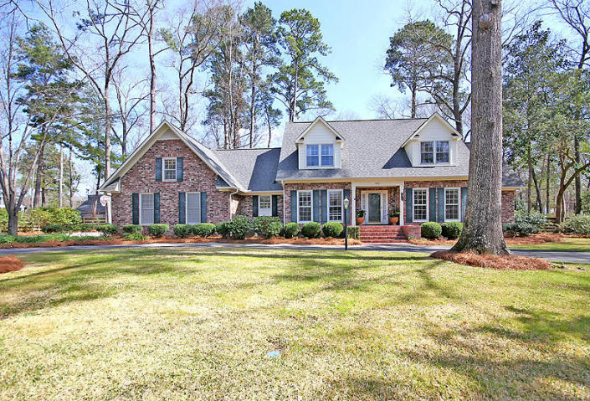
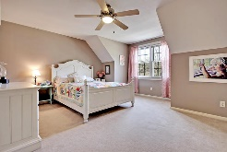
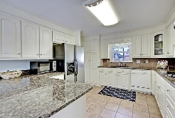
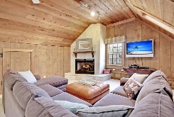
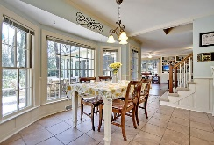
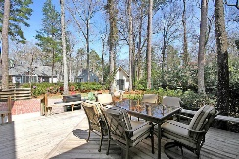
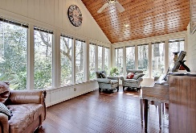
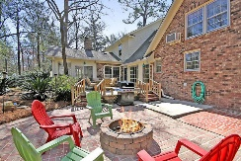
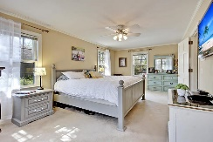
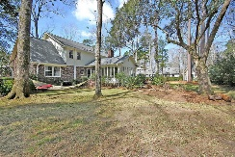

503 Mayfield Street Ashborough · Summerville · MLS# 16006178 · $430,000
Just Listed!
Large GORGEOUS 4 bedroom, 2.5 bath home on a beautifully landscaped ½ acre lot with oak trees, azaleas, camellias, and hydrangeas! The gourmet kitchen has expansive granite countertops with plenty of room for prep work, stainless steel appliances, built-in double ovens, lots of cabinet space for storage, eat-in area and tons of natural light! There is a grand foyer entry way that leads to an office/living room on the right and a formal dining room on the left. Straight through the foyer is a custom solid wood pocket door that opens to an oversized family room with handsome wood floors, crown molding, custom built-in shelving, brick fireplace that has large glass doors on both sides leading to the exquisite sun room. The sun room is showered with light coming from the numerous windows. The large master bedroom is on the main level and has a private bath with dual sinks, jetted tub, and separate shower. The main floor also has a nice guest bath off the kitchen, a spacious laundry room, and mudroom with sink coming off of the garage and back yard (not included in square footage). Upstairs has three additional big bedrooms, a Jack-n-Jill bath, a loft area that is great for a homework or play room, an office or craft area. In addition upstairs has a wonderful king-sized media/man cave with vaulted wood ceilings and a tumbled marble fireplace. This area can be accessed by a back staircase or the main staircase. The fenced backyard is perfect for entertaining family and friends with a large patio area with fire-pit, room to grill, and still enough yard for a volleyball or bocce ball game. Also in the back yard is a quaint storage building that can be used for storage shed or a workroom. Located within walking distance from the home is a private park for leisurely walks after work or the weekend! This home has so much to offer with many rooms having dual purposes, luxurious yard, and is perfect for entertaining! Call and come look, you will not find another home that has as much to offer. Ashborough in Summerville is a wonderfully landscaped community with a play park, tennis courts, two private parks, biking and walking trails and a community pool! The neighborhood is close to local shopping and grocery stores and is a short drive to downtown Charleston with 5-star restaurants, world class shopping and iconic history as well as a short drive to the beaches, the airport, Boeing and Daniel Island.
Stan Huff
843-670-2835 stan.huff@agentowned.com
Jill Marcacci
843-297-5590 jill@agentowned.com
www.agentownedrealty.com
AgentOwned Realty Co. Preferred Group, Inc. | 824 Johnnie Dodds Blvd | Mt Pleasant, SC 29464

