Slide 1
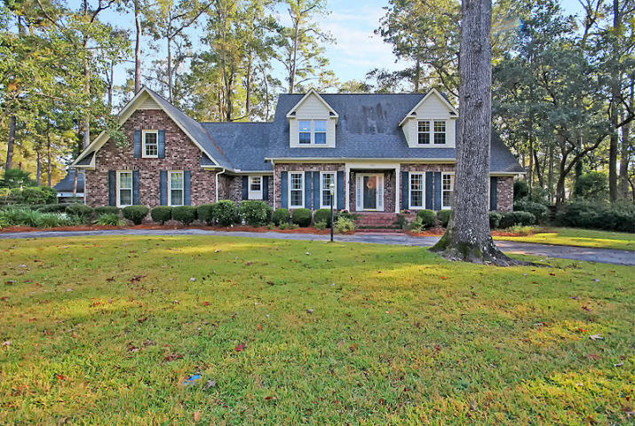
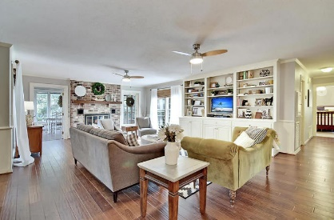
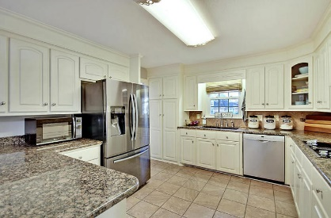
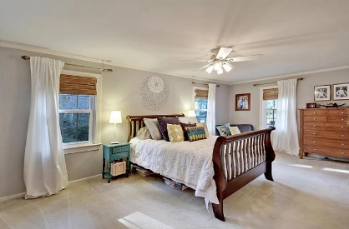
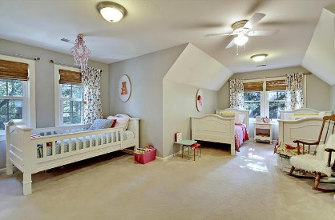
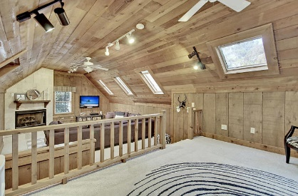
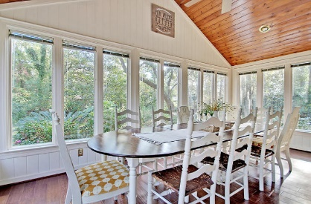
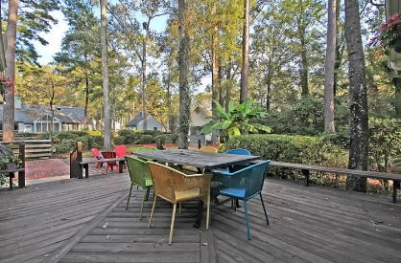
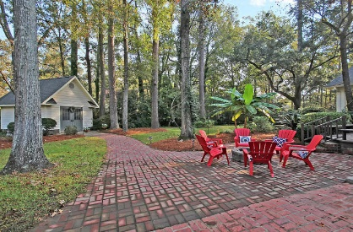


Summerville Beauty in Ashborough!!
503 Mayfield St
Ashborough
Summerville, SC 29485
MLS# 17030444
$439,000
4 Bedrooms | 2½ Baths | 3,842 sf
Get ready to fall in love with this well kept home located on a half acre lot in the established neighborhood of Ashborough. This home is warm and welcoming from the second you pull up to the circular drive. Upon entering the large foyer, you'll notice the formal living or office to your right and the dining room to your left. Straight through the foyer you'll find the large family room. This room has tons of built in storage and gorgeous wood floors. Beautiful Norwegian brick fireplace creates a cozy atmosphere. On either side of the fireplace are large glass doors that lead to the stunning sun room. Tons of natural light and gorgeous cathedral ceiling with stunning wood work. The kitchen is a cook's delight with granite countertops, stainless steel appliances, double ovens and tons of cabinet space! There is a large eat in kitchen area surrounded by a bay window offering tons of natural light and great views of the backyard. Off the kitchen is a half bath, laundry room with cabinetry, and a mud room with an entrance to the backyard and the garage. The master bedroom is on the first floor and offers multiple closets, master bath with dual vanities, separate shower and jetted tub. This home has dual staircases. The main staircase leads to the bedrooms and loft area. There are three great sized bedrooms with large closets, all with built in organizers, as well as a full bath. Continue down the hall to the craft room/office/flex room. Then, over the garage, you'll find a gorgeous bonus room. This room has a stunning wood vaulted ceiling and its own fireplace! This room can also be accessed from the secondary staircase off the kitchen. Head in to the fenced in backyard and find your own little piece of paradise! A storage shed/workroom is in the corner of the yard, complete with attic storage and a utility sink! Gorgeous patio, firepit and newly stained deck area for entertaining! This home has is it all and is conveniently located close to Palmetto Commerce area and the airport! The neighborhood offers a pool, tennis courts, playground, walking trails and a neighborhood dock for kayak/canoe access to the Ashley River! The second and largest park with trails and campsite is located just a few houses down and is wonderful place for the kids to play, or family and friends to gather. Don't miss your chance to live in this great home! Brand new windows throughout the home, new paint, new dishwasher and new bamboo blinds! Come see it today!
Larry & Kathy Mazalatis
Larry Cell 843-693-0529
Kathy Cell 843-693-0159
Office 843-871-9133
AGENTOWNED PREMIERE GROUP | 1800 TROLLEY RD | SUMMERVILLE, SC 29485

