Slide 1
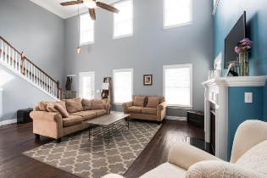
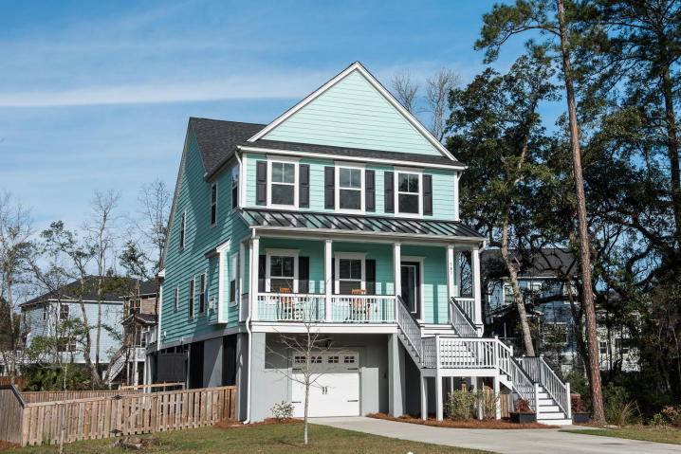
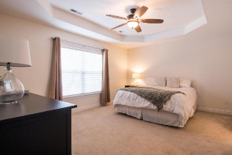
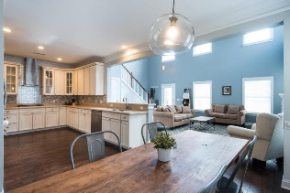
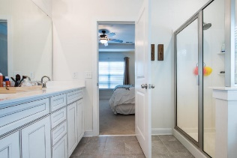
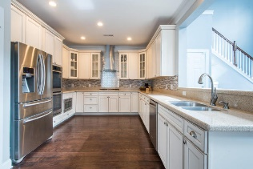
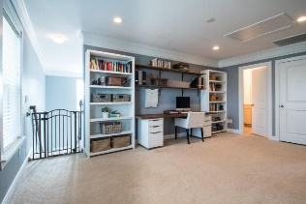
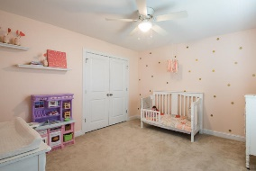
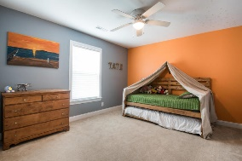
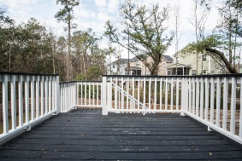
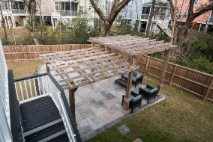
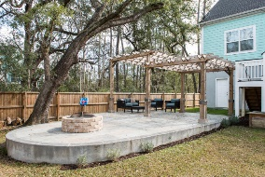
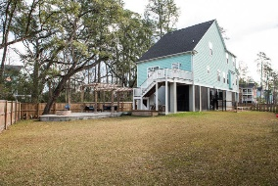

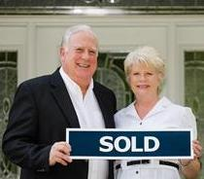
503 Sanders Farm
Retreat at Beresford · Wando · MLS# 17005201 · $439,900
Charleston Style Home in Beresford Subdivision
Better than new Charleston Style Elevated Home with hardwood floors throughout entire first floor except for master bedroom. Very spacious upgraded kitchen with 42" antique white glazed cabinets, Silestone counter tops, tile back splash with all stainless steel upgraded Whirlpool appliances, including gas cook top stove with custom hood, double ovens, microwave and double sink. Custom built-in desk across from kitchen next to open dining area along with a lovely powder room. The First Level master bedroom has tray ceiling with ceiling fan large walk in closet double vanities tub and shower. The great room has vaulted 20 ft ceiling with fan and gas log fireplace with lots of windows and an exposed staircase to enclosed loft area with adjourning bedrooms and a full bathroom. Fenced backyard. Front Porch has great spot for rockers to watch neighborhood activities looking down the cul de sac. Nice wood deck off rear of home with stairs leading to a custom oversized concrete and tiled patio with unique covered wooden structure for shade and outdoor lighting along with a brick fire pit area great for entertaining guest or large enough for neighborhood party. The wood rear fence provides wonderful containment for children and pets plus providing privacy for special occasions with family and friends. The Raised Elevation Plan affords parking for several cars/boat/motor cycles and/or a place for a hobbyist builder to work on whatever he or she wants to out of the weather. Our answer to a basement above ground. This is a great opportunity for a family to get a wonderfully maintained home in a great location for an excellent value.
$550,000
Tommy Lovett
Tommy - (843) 442-1276
tlovett@carolinaone.com
www.tommylovettrealestate.com
Carolina One Real Estate
628 Long Point Rd.
Mt Pleasant, SC 29464-3032

