Slide 1
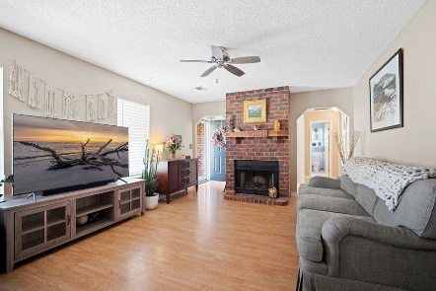
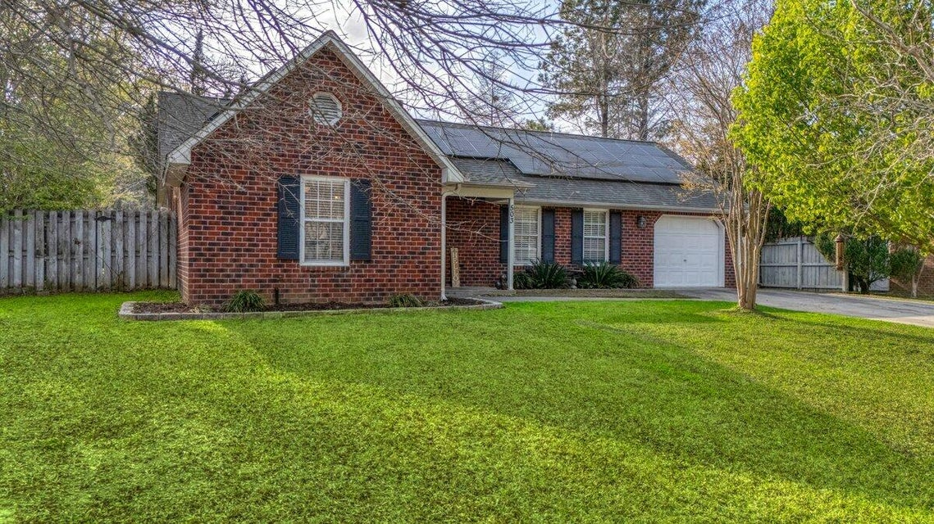
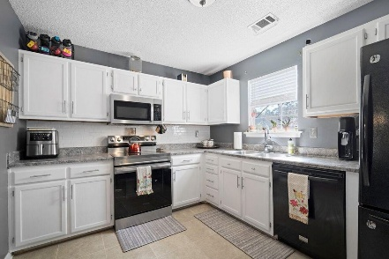
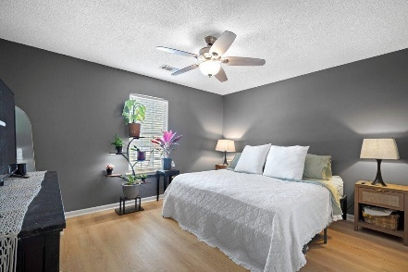
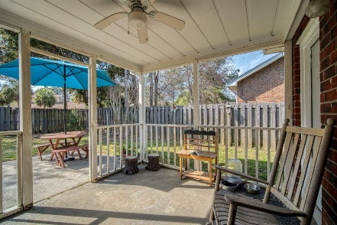

503 Amberjack Way Marlin Estates | Summerville, SC 29485 | MLS# 25008114 | $310,000
Darrell Creek Elevated Home With Elevator & Salt Pool
Co-hosting with Lisa Wood from Crown Home Mortgage
Offering $2500
Lender Credit
JUST LISTED FOR $310,00 IN SUMMERVILLE
Open House Saturday 3/29 from 1-3PM
Welcome to 503 Amberjack Way in the Quiet Pocket Neighborhood of Marlin Estates in Summerville, SC! Nestled in a serene setting where the only sounds you'll hear are the chirping of birds, this adorable 3-bedroom, 2-bath brick ranch offers a peaceful retreat while being just minutes away from shopping and dining, and less than 10 minutes from Historic Downtown Summerville. This well-maintained home exudes charm and character, featuring stunning archways and classic chair-height molding that add a touch of elegance. Energy-efficient solar panels are also included, offering savings on energy bills and the unique benefit of transferring to the next owner. As you enter, the spacious living room invites you to relax or entertain by the cozy wood-burning fireplace.
A separate dining room provides a perfect space for hosting friends and family. The heart of the home is the kitchen, where you'll find updated appliances, freshly painted cabinets, and beautiful granite countertops, making it an ideal space for cooking and gathering.
The home offers two good-sized guest rooms that share a full bath, perfect for family or guests. The large Master Suite is a true retreat, complete with dual closets, a ceiling fan, and a private en suite bathroom.
Step outside to the back patio, which is perfect for grilling and entertaining, while the large fully-fenced backyard provides ample space for outdoor activities. Situated on nearly a 1/4-acre lot, the possibilities are endless to make this your personal oasis.
Don't miss out on the opportunity to make 503 Amberjack Way your home sweet home.
Book your showing today!
House Tour
Elissa Campbell
843-853-1433 | elissa.campbell@agentownedrealty.com
AgentOwned Realty Preferred Group | 824 Johnnie Dodds Blvd | Mt Pleasant, SC 29464

