Slide 1

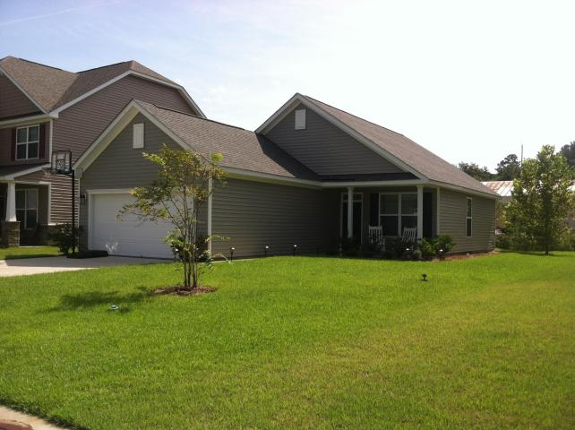
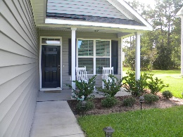


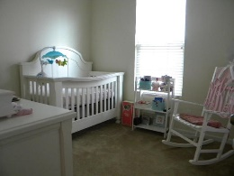
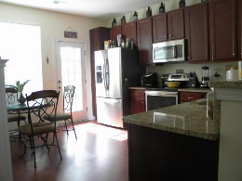
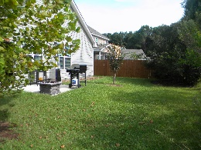


Why wait!?!
5040 Wapiti Way
Deerfield Hall • Hollywood • MLS# 15023348 • $199,999
No need to wait on new construction to be built!
Like new home and still under warranty. Lots of upgrades! Open floor plan with Granite countertops, Stainless steel appliances, surround sound and more. Master bedroom with plenty of room for king sized bed, Large walk in closet and master bath. Enjoy Rural living and still be less than 10 minutes to city amenities, shopping, dining, hospitals etc. 20 minutes to downtown and easy access to Hwy 17 and I526.
Christina Garvin
(843) 270-7667 | cgarvin63@gmail.com
Elaine Brabham and Associates, LLC • 1890 Sam Rittenberg Boulevard, Suite 217 • Charleston, SC 29407

