Slide 1
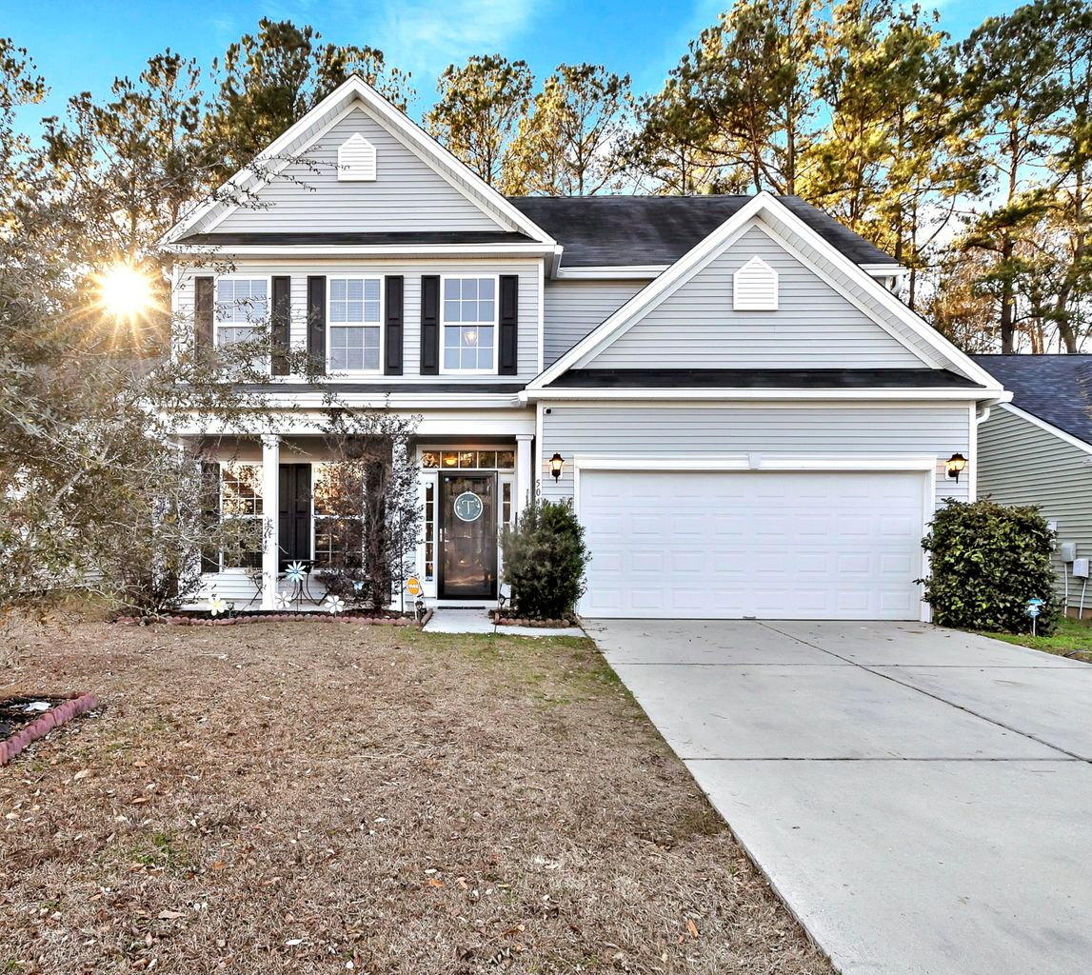
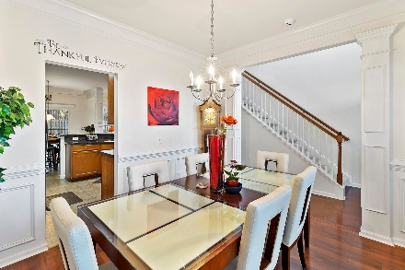
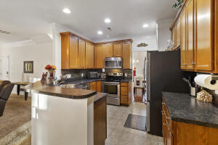
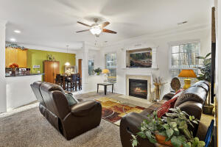
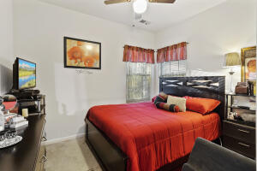
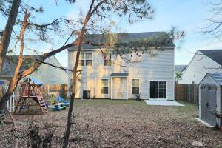
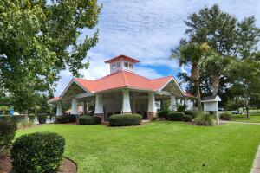



Style & Space
5040 Blair Road
Myers Mill
Summerville, SC 29483
MLS# 23000459
$385,000
WELCOME ! That is the first impression when you enter this home ! Very well designed and easy flow, formal dining room, very nice and open kitchen with breakfast area, living room with gas fireplace. The beautiful trim work throughout this home enhances its style and elegance! - One bedroom and a full bath d'stairs. - An open staircase leads to the upstairs where you find 3 other bedrooms plus the master suite which is large enough for a king size bed, has a garden tub, separate shower and dual vanity. Huge walk-in closet. ++ The backyard is fully fenced and faces the woods for quietness and privacy. ++ This home is elegant and very well maintained. ++ Pls also note that this neighborhood is located in Dorchester II school district!
Virtual Walkthrough: https://my.matterport.com/show/?m=DwrZF5kM2SN
Ute Appleby
843-345-2625
uappleby@gmail.com
https://uteappleby.jpar.com/
JPAR Magnolia Group | 741 Johnnie Dodds Blvd. Ste 10 | Mt Pleasant, SC 29464

