Slide 1
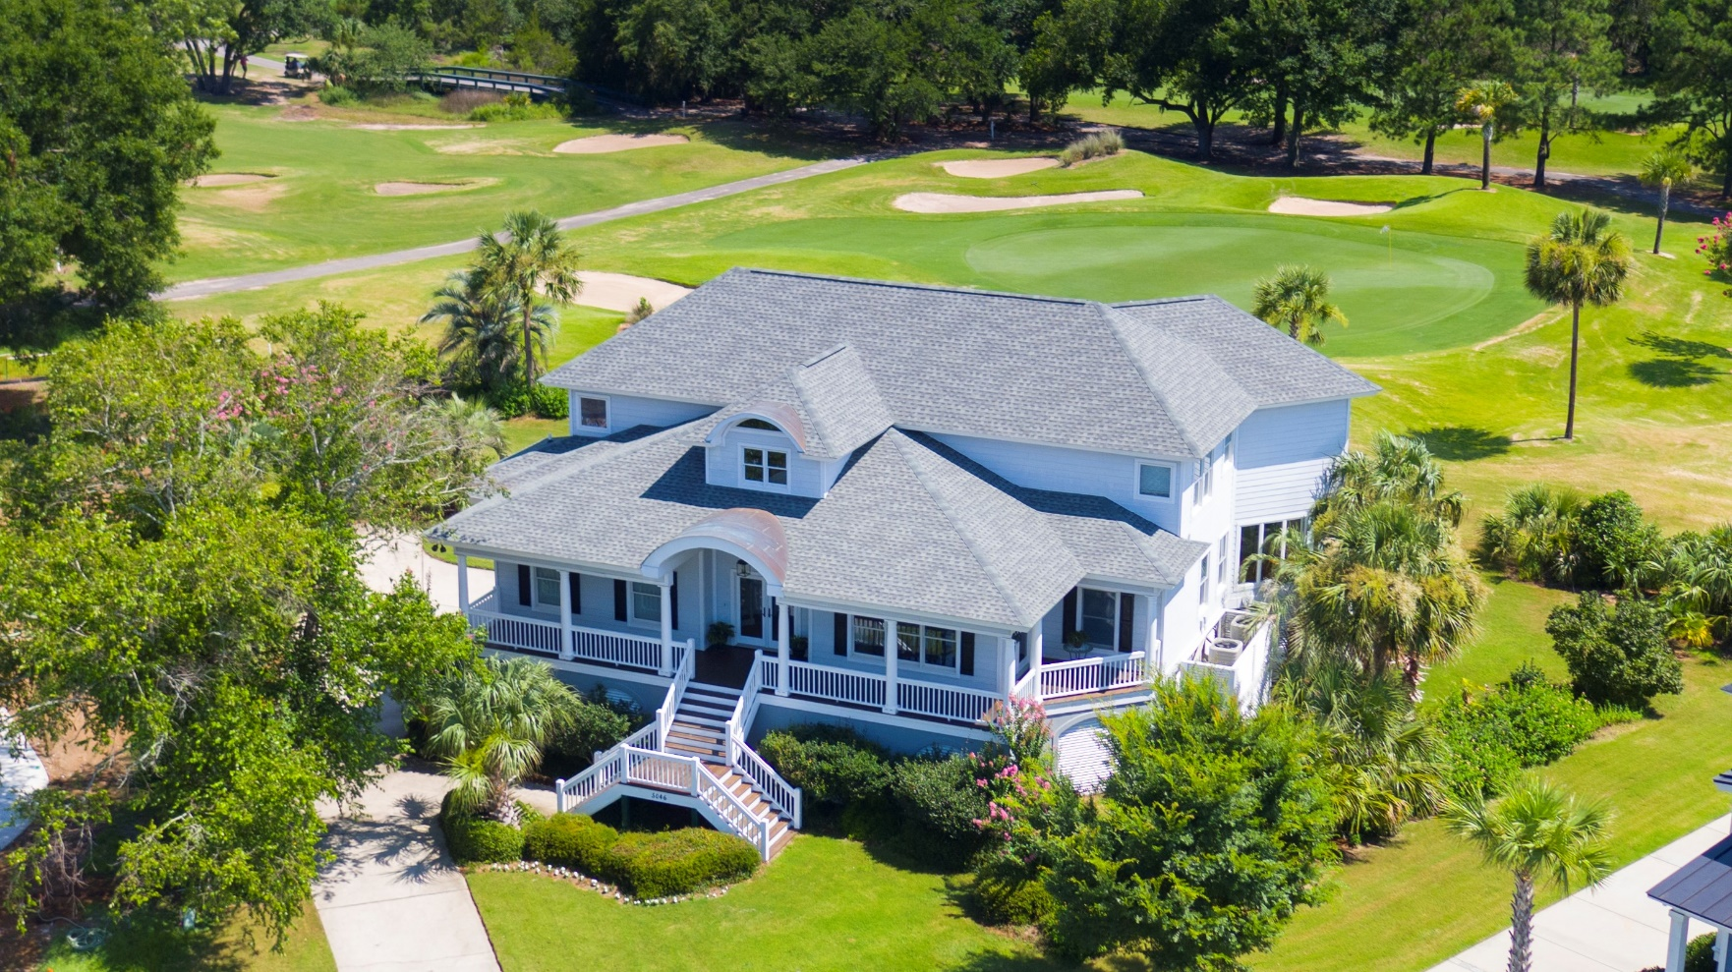
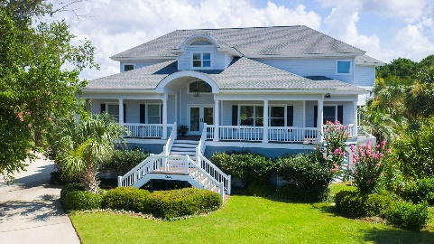
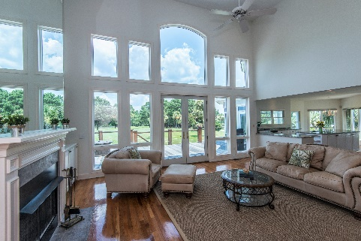
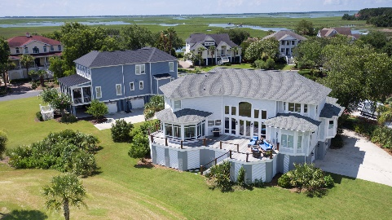


5046 Victory Pointe Court
Charleston National :: Mt Pleasant :: MLS# 18019763 :: $875,000
New
Construction
Lunch and Tour - Million Dollar Home for $875,000!!!
Thursday 9/27 11:00 - 1:00pm ~ Clients Welcome!!
Spectacular Views from Every Room
Don't miss out on this rare opportunity for your clients!!
5046 Victory Pointe Ct. MLS# 18019763
Victory Pointe at Charleston National
Gate Code #4432
Wendy Arnsdorff
843-364-8619 – M :: 843-284-1800 – O
wendy.arnsdorff@carolinaone.com
www.wendyarnsdorff.com
Carolina One Real Estate :: Mt. Pleasant North Office :: 2713 N Highway 17 :: Mt. Pleasant, SC 29466

