Slide 1
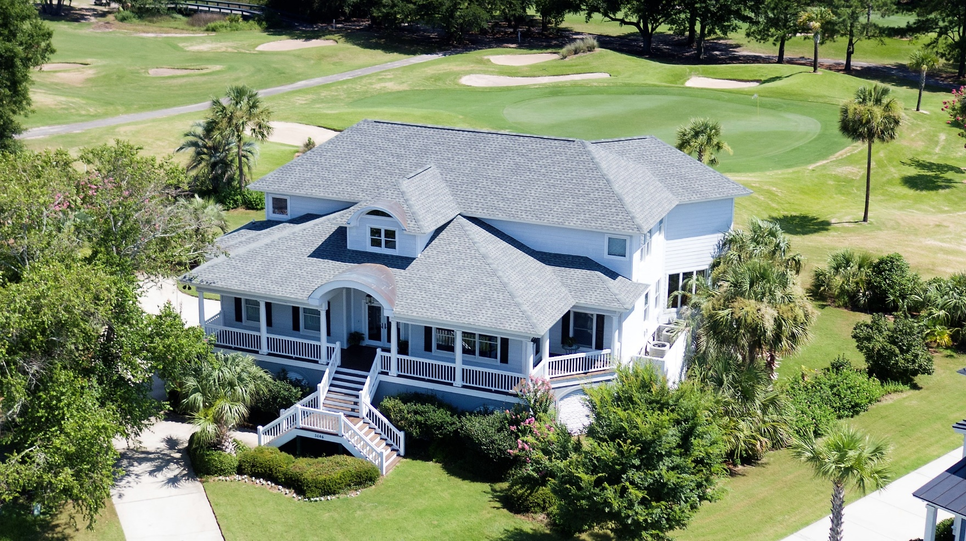
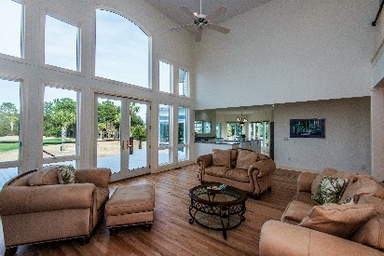
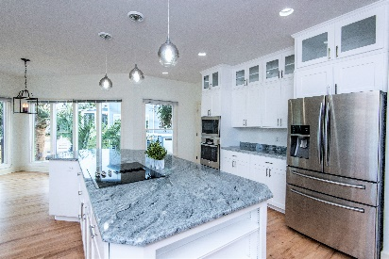
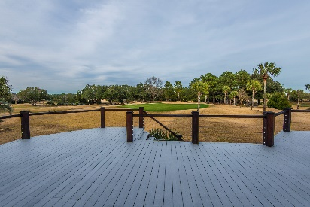


5046 Victory Pointe Court
Charleston National :: Mt Pleasant :: MLS# 19004390 :: $850,000
New
Construction
Newly RENOVATED JANUARY 2019!!!
New Floors! New Kitchen!! Full Bathroom ADDED!!!
THIS AMAZING HOME JUST GOT BETTER!!!
Located in a gated section of Charleston National, nestled between 3 holes of golf, and surrounded by a shimmering lake and the Copahee Sound.
Amazing views from nearly every room in the house!
4 Bedrooms
3.5 Baths
3712 Sqft
Master on the Main level with Dual Vanities
New White Kitchen Cabinets, Lighting, & Subway Tile Backsplash
Beautiful White Oak Flooring - just refinished!
FULL BATHROOM just ADDED
Open Floor Plan with vaulted ceilings
Tons of storage
Wendy Arnsdorff
843-364-8619 – M :: 843-284-1800 – O
wendy.arnsdorff@carolinaone.com
www.wendyarnsdorff.com
Carolina One Real Estate :: Mt. Pleasant North Office :: 2713 N Highway 17 :: Mt. Pleasant, SC 29466

