Slide 1
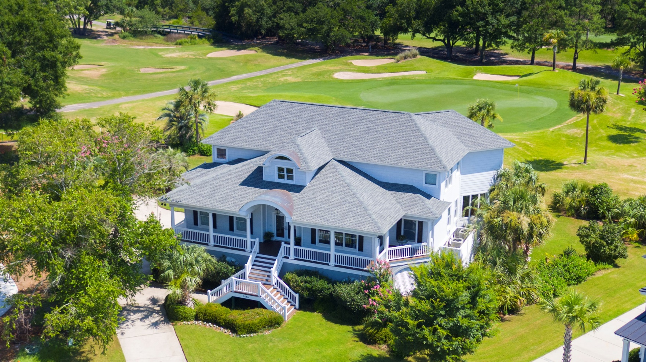
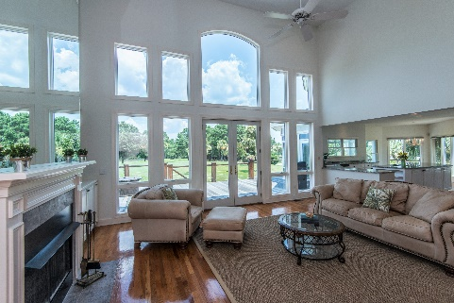
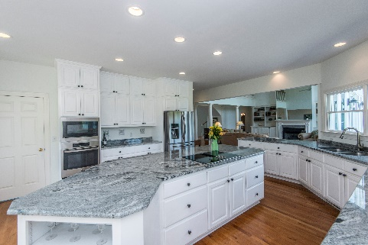
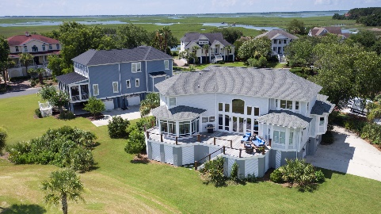


5046 Victory Pointe Court
Charleston National :: Mt Pleasant :: MLS# 18019763 :: $875,000
New
Construction
Spectacular Views from Every Room!
Welcome to Coastal Golf Heaven! This custom home overlooks 3 holes of golf and is surrounded by a shimmering lake and the Copahee Sound. Whether you golf or not, you will be captivated by the amazing views from nearly every room in this house! Located on a quiet cul-de-sac in the gated section of Charleston National, you are greeted by a generous wrap around front porch and double glass doors. Entering, you are spellbound by the view through the massive wall of windows in the 2 story Great Room. French Doors open off the Great Room to the enormous back deck constructed with maintenance free Trex decking and stairs as well as unique cable railing to maximize your view. The Kitchen features all new appliances, a large center island, and ample cabinet space. Just off the Kitchen is a cozy Sun Room and a Pantry/Laundry/Mud room combo with tons of storage space and shelving. The Master Suite on the main level, has a bay window overlooking the golf course, an extended sitting area, and an incredibly large walk-in closet. The Master Bath has dual vanities, new frameless shower surround, jaccuzi tub, and a private water closet. The second floor has 3 bedrooms, a Jack and Jill bath, and 2 walk-in Attic storages. The huge 2 car garage has space for up to 4 cars to tandem park and plenty of space for storage or even a workshop.
Wendy Arnsdorff
843-364-8619 – M :: 843-284-1800 – O
wendy.arnsdorff@carolinaone.com
www.wendyarnsdorff.com
Carolina One Real Estate :: Mt. Pleasant North Office :: 2713 N Highway 17 :: Mt. Pleasant, SC 29466

