Slide 1
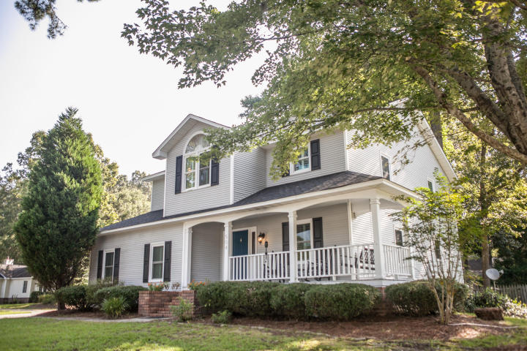
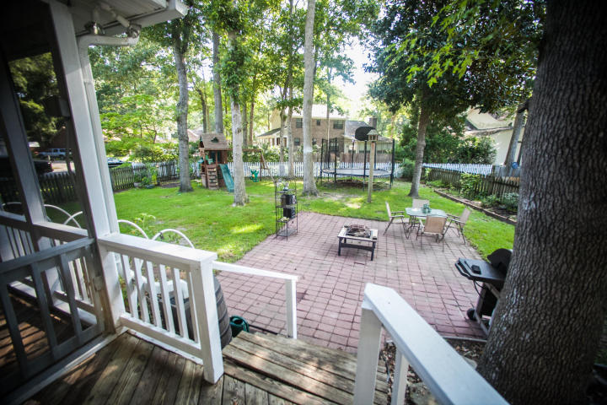
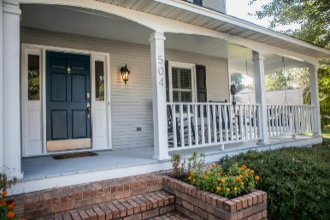
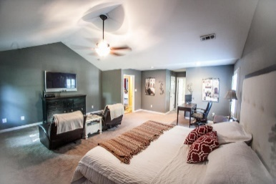
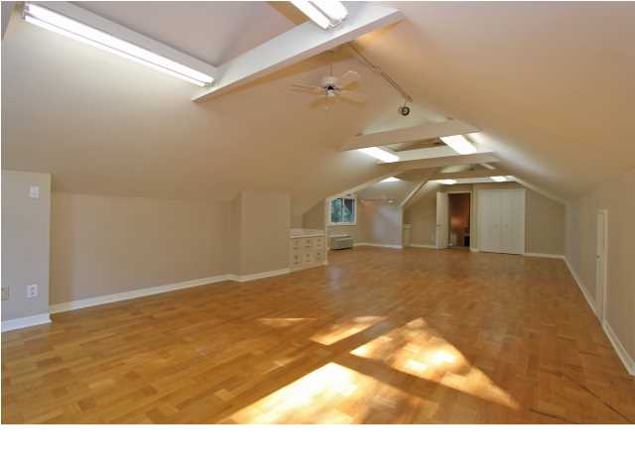
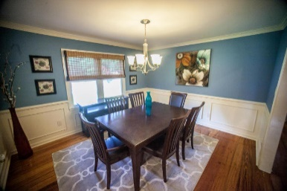
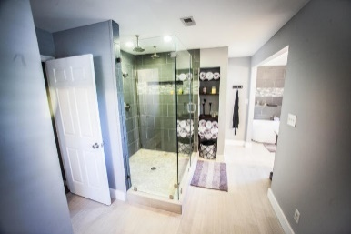
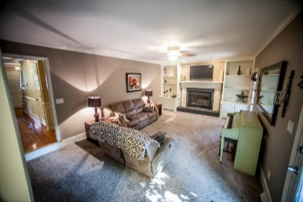
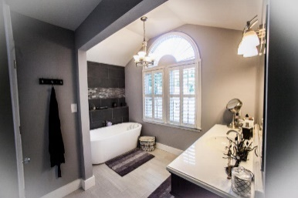
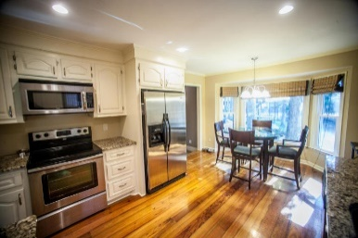
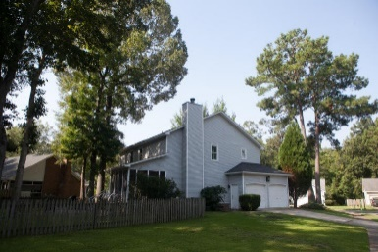


504 King Charles Circle Summerville ~ MLS# 15019232 ~ $255,000
Fresh on the Market in Newington Plantation
Open House Saturday August 1st, from 1:00-5:00
This incredible home is on a large corner lot in the desirable Newington Subdivision! Well kept and freshly remodeled this home is a MUST SEE! Custom Wide plank, Heart Pine wood floors, updated kitchen with Granite and stainless appliances. LARGE master suite, approx 800sqft, Custom glass shower, stand alone tub and 2 60'' vanities! A gorgeous custom bath room! Plantation Shutters! New roof in2011 , windows in2011,& HVAC up in2013 and down in2012.Community Pool and play ground! Buyer may use the lender of their choice, however with the seller's preferred lender buyer may be eligible for lender paid closing costs of 1% of the loan amount. Some conditions apply.
Christopher McCormick
Office - 843-974-6200
Cell - 843-224-3204
cjmccormick@carolinaone.com
Carolina One Real Estate
900 N Main St
Summerville, SC 29483

