Slide 1
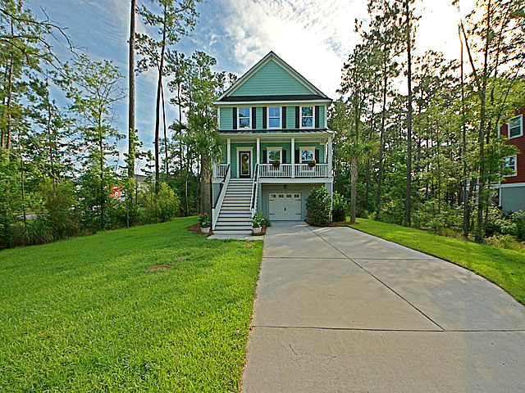
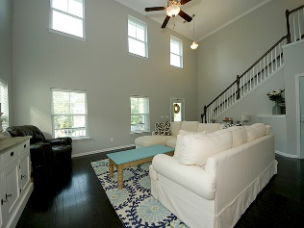
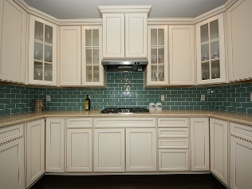
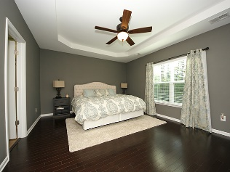
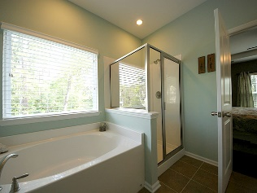
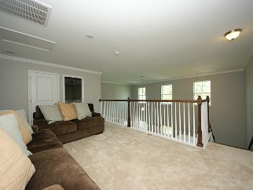
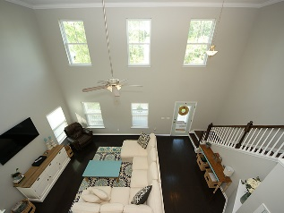

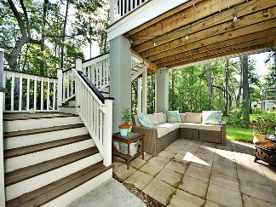

THIS IS A RARE FIND AT THIS PRICE!
504 Sanders Farm Lane
Retreat at Beresford
Wando, SC 29492
MLS# 16017028
$439,000
Within the Daniel Island School District! This home looks like it was taken straight out of the pages of Coastal Living. 2,006 SF elevated home with beautiful finishes. The white kitchen features a gas cooktop, stainless steel wall oven with microwave and glass subway tiled backsplash. Lovely wide plank dark stained wood flooring throughout the first floor looks classy with the white trim. Grand entrance with soaring ceilings and a loft overlooking the living room! The master suite is spacious and on the main floor. This home features tons of extras and space including a drive-under garage!! The large lot features beautiful live oak trees and lots of woods for privacy!!
Chris M Garcia
REALTOR
Mobile - (843) 557-7100
cmcdaid1@yahoo.com
RE/MAX Pro Realty | 9209 University Blvd | N Charleston, SC 29406

