Slide 1
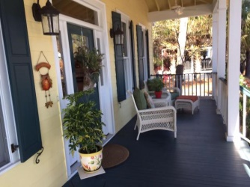
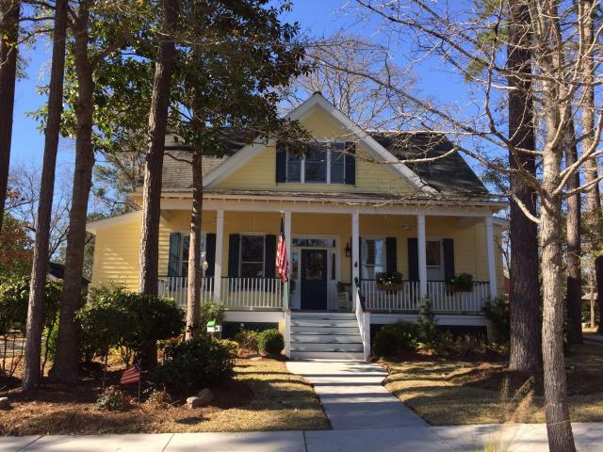
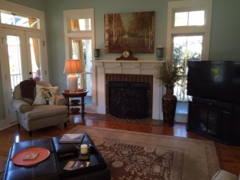
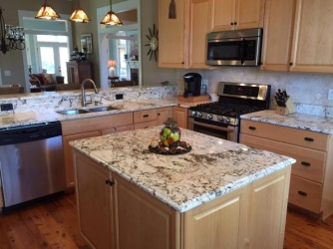
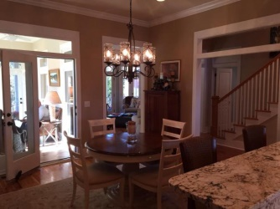
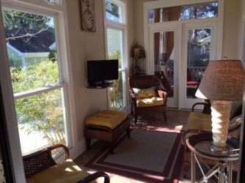
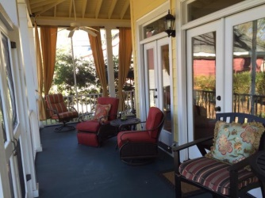
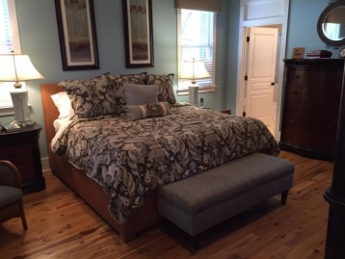
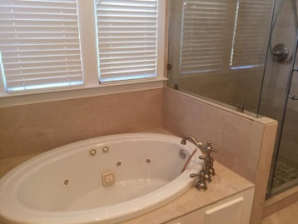
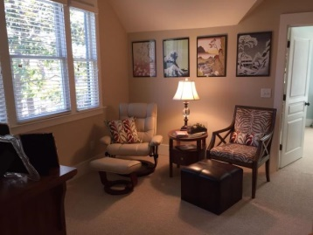
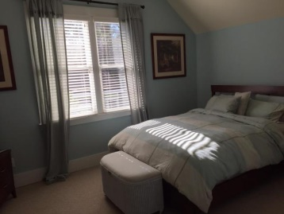
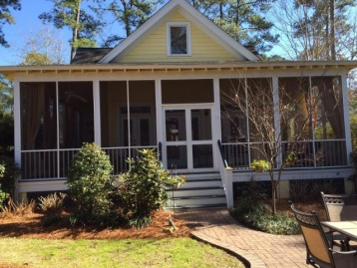
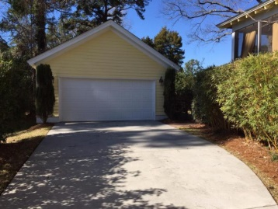


Charming and Spacious Custom-Built Home
Price Reduced!
5056 Coral Reef Drive
The Villages In St Johns Woods
Johns Island
MLS# 15004001 - $445,500
Charming and Spacious Custom built Home located in the desirable community of the Villages in St Johns Woods which is just 9 miles from Downtown and only minutes from fabulous restaurants and the Year Round Johns Island Farmers Market.
The wrap around porch with its screened in and an enclosed sitting room allow you to sit back and Enjoy the Peaceful living and the Beauty of the Large Backyard.
Exquisite detail in every room and it features many Upgrades, Special additions and a Gourmet Kitchen. The Master Bedroom and newly renovated Bath are on the First Level with all Australian Cypress wood floors. Two Large bedrooms and a Loft are on the Second Level.
Wonderful Community Amenities including Saltwater swimming pool and a Children's playground. A MUST SEE!!
Robyn Lane, Realtor
843-222-5599
robynlane01@icloud.com
ERA Wilder Realty, 125-F Wappoo Creek Dr, Charleston, SC 29412

