Slide 1
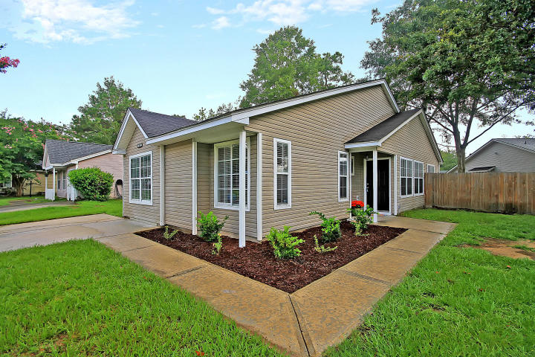
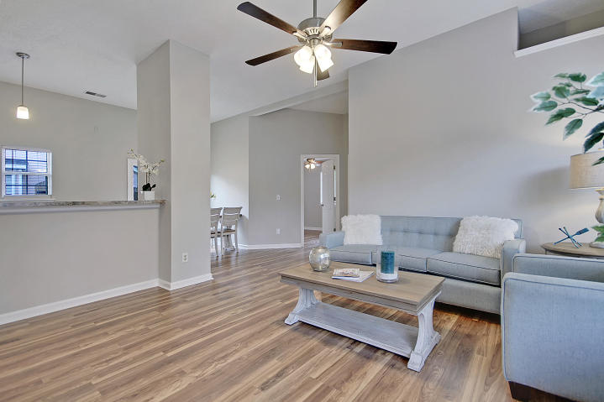
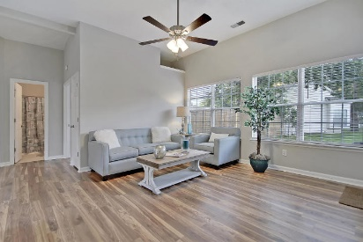
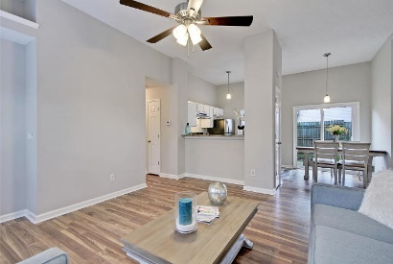
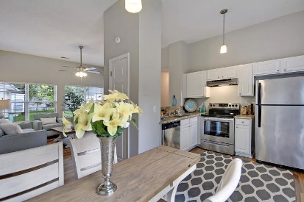
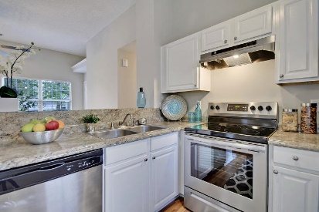
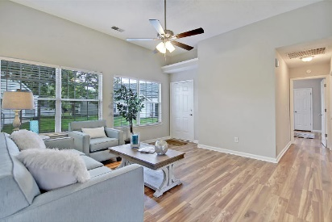
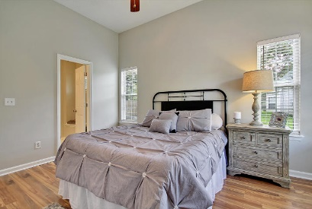
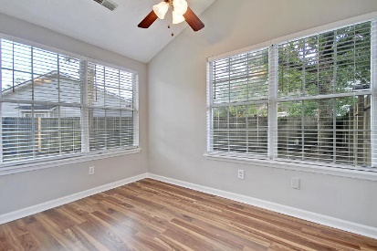
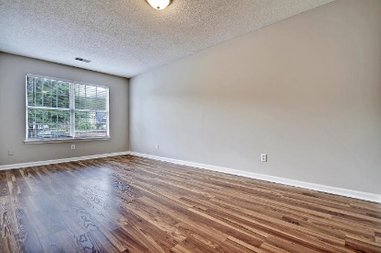


505 Hedge Way Sangaree Gardens | Summerville, SC 29486 MLS# 19020237 | $194,000
Turn-Key 3/2 with BONUS ROOM for UNDER $200K!
Welcome Home! A great find in the desirable Sangaree Subdivision. And NO HOA! This freshly updated, single-story home is waiting to welcome you. The oversized BONUS ROOM can be used as a 4TH BEDROOM or OFFICE! As you walk through the front door, you'll notice the beautiful new hardwood laminate floors and fresh Sherwin Williams Agreeable Gray paint throughout, as well the open floor plan and vaulted ceilings. The bright and open kitchen boasts freshly painted white cabinets and stainless steel appliances, including a brand new range. Walk out the sliding glass doors into your private backyard with a nice patio area for cookouts and entertaining. Just a short drive to all the shopping and restaurants that Main Street and Nexton have to offer. Come see this gem for yourself!
Michele Basler
(843) 813-0330
charleston917@gmail.com
Brand Name Real Estate | 4 Carriage Lane Suite 106 | Charleston, SC 29407

