Slide 1
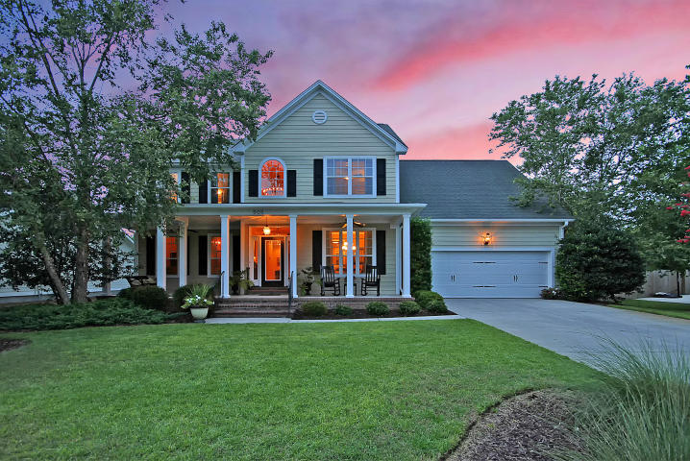
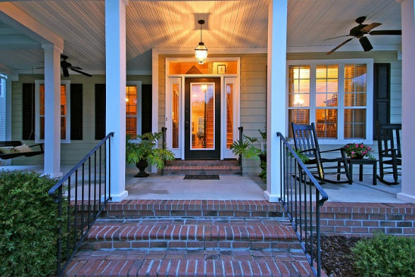

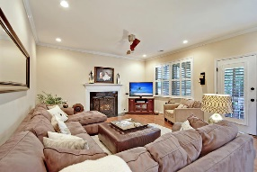
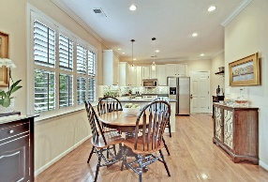
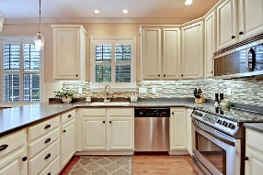
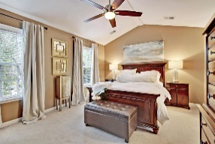
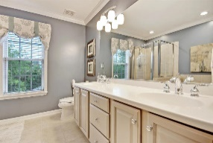
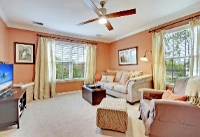
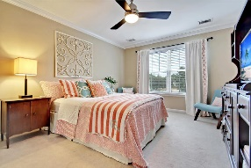
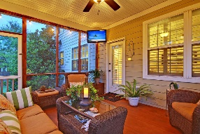
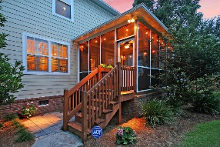
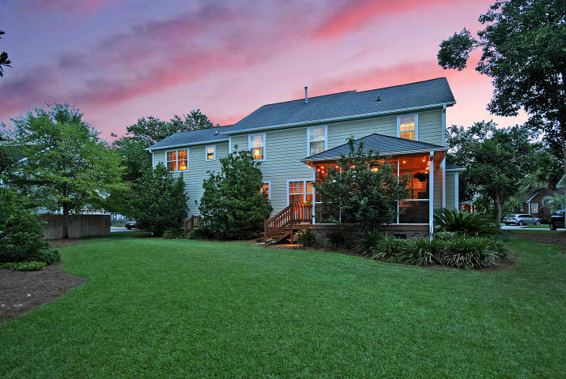

505 White Chapel Circle
Woodward Pointe ~ Charleston, SC 29412
MLS# 17018919 ~ $579,800
GREAT OPPORTUNITY to live in one of the premier neighborhoods on James Island! This immaculately maintained Woodward Pointe home boasts a great floorplan, hardwood floors, recently updated kitchen, stainless steel appliances, automated lighting, and a tranquil screened porch to enjoy your afternoons. This home has a gigantic two car garage, beautifully landscaped yard, and has a crawlspace. Located right in the hub of James Island, enjoy a fifteen minute ride to the beach or downtown. With shopping, restaurants, and parks down the street, come enjoy the best of the Lowcountry on James Island!
Jonathan Vroon
(843) 514-3114
jvroon@southernlivingre.com
www.southernlivingre.com
Southern Living Real Estate 2249 Salt Wind Way, Mt. Pleasant, SC 29466

