Slide 1
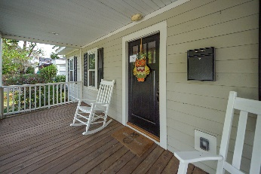
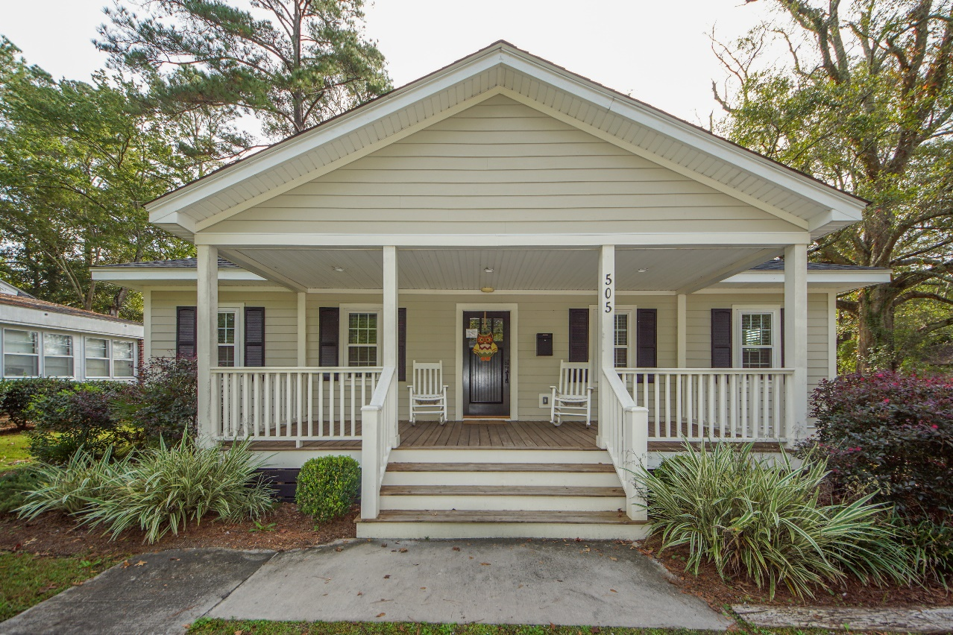
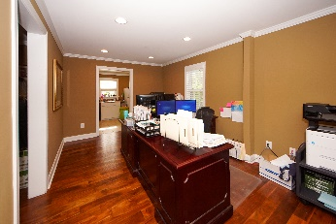
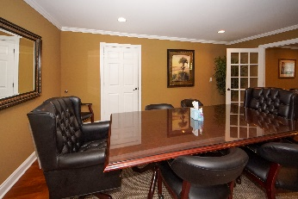
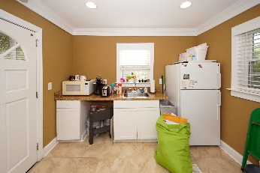
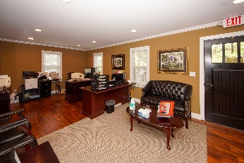
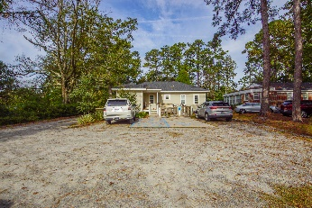
Commercial Property – Price Reduced!
505 N Laurel St Summerville, SC 29483 | CMLS# 30660107 | $384,900
Zoned residential commercial, this free standing office building sitting on .35 acres went through a extensive renovation completed in 2016. The list of renovation work includes: Exterior: new roof, siding and windows. Inside: New drywall, trim, flooring, paint, kitchen and bathroom. Current zoning allows for professional office, medical office, restaurant and child care services among other uses. Plenty of parking in both the front and rear of the building. Termite bond in place.
Russell Price, Realtor
russprice3@gmail.com | Mobile (843) 670-1170
Brand Name Real Estate | 4 Carriage Lane, Suite 106 | Charleston, SC 29407

