Slide 1
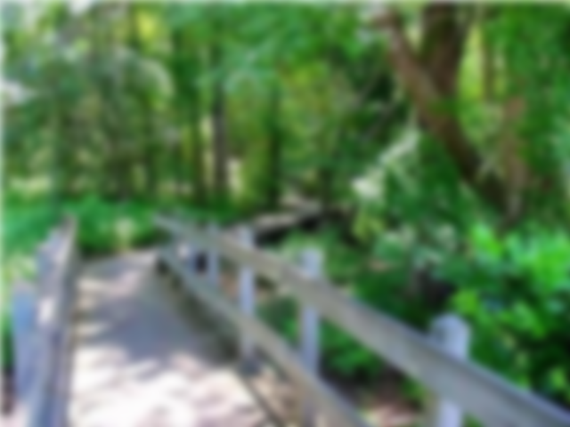
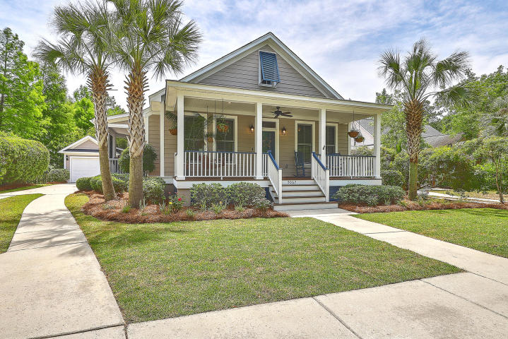
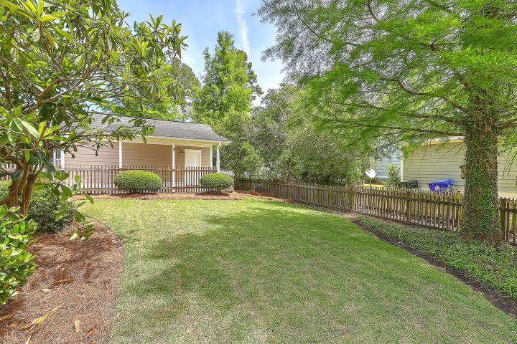
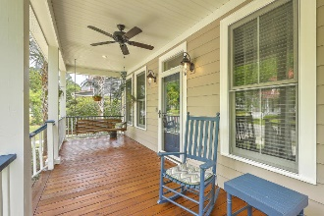
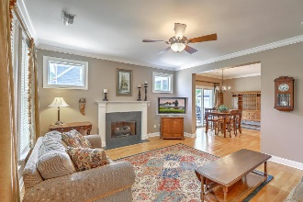
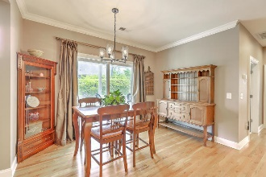
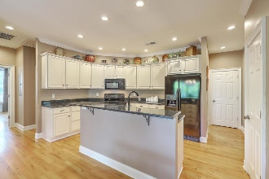
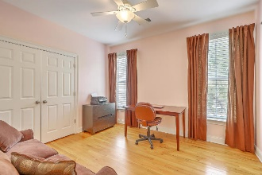
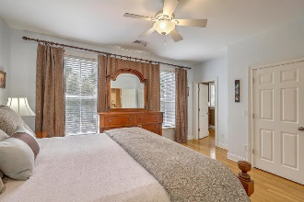
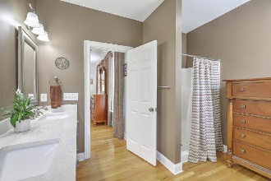
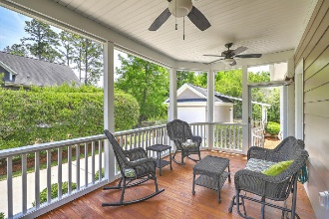
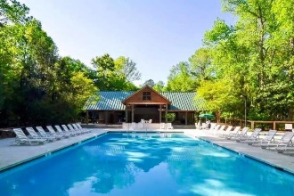
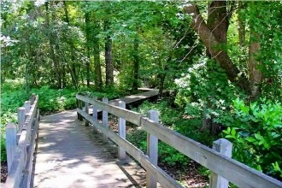

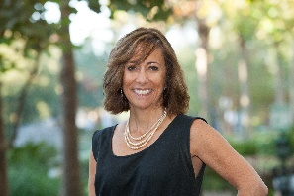
JUST LISTED!
The Villages in St Johns Woods | Lovely One-Story Cottage-Style Home
5067 Coral Reef Drive
The Villages In St Johns Woods | Johns Island | MLS# 20013046 | $374,975
Welcome home to your adorable cottage-style home located in the beautifully maintained, quiet section of The Villages of St. John's Woods. Can't you just envision sitting on your front porch swing, on a warm summer night sipping sweet tea?! Then head inside, through the Great Room which has a gas fireplace for those chilly winter evenings. Enter into the dining area and open concept kitchen which has 42'' classic white cabinets, beautiful granite counters with brand new sink and faucet, offering plenty of storage and prep space. While in the kitchen, you can't help but notice the gleaming hardwood floors throughout the whole home, 10' high ceilings and lovely moldings which really add character to your new home. From there, retreat to the Master ensuite which has wonderful natural light, 2 large closets, newly updated double sink vanities with new faucets, new hardware and nicely sized shower. The 2 additional spacious bedrooms and guest bath which also has a new vanity top, faucet and hardware, are evenly separated offering everyone lots of privacy. You will also find a nicely sized laundry room off the kitchen and a huge screened porch which could easily be enclosed! Out back, you will find a detached 1-car garage and carport and a picket fenced private backyard with irrigation and all new sod. Need extra storage? No problem! The entire attic in fully floored to store those holiday decorations. Enjoy wonderful amenities including pool, pavilion, play park and walking trails. Centrally located, you are just 15 mins. to MUSC, CofC and downtown Historical Charleston. Lots of great restaurants in town, golf just over the bridge at the James Island Municipal Course and the beautiful Kiawah Beachwalker Park is an easy drive. You don't want to miss this beauty of a home!
Virtual Tour: https://my.matterport.com/show/?m=AtKMcvGH16U
Desiree Maurer
Office - (843) 416-2000
Mobile - (843) 327-9010
desiree.maurer1@gmail.com
www.yourcharlestonhousesearch.com
Keller Williams Realty
496 Bramson Ct Ste 200
Mt. Pleasant, SC 29464

