Slide 1
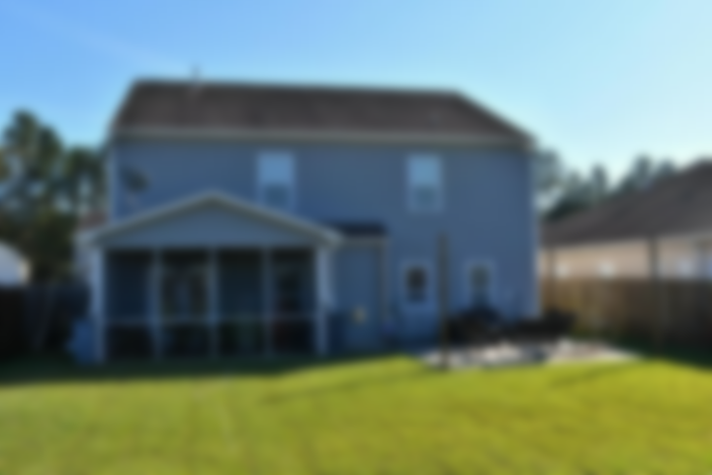
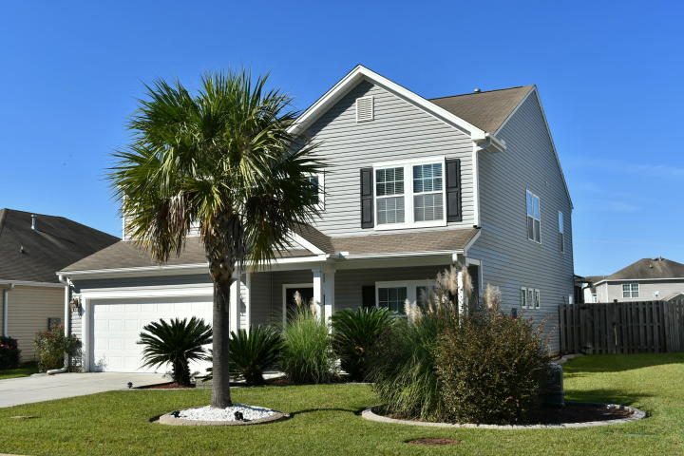
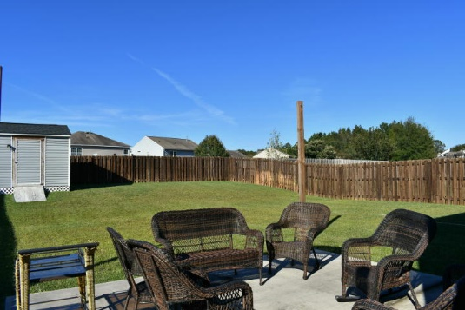
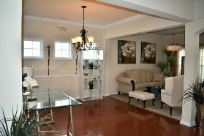
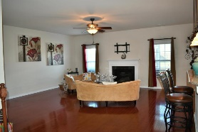
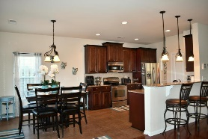
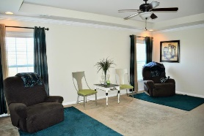
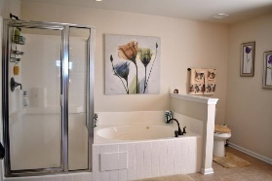
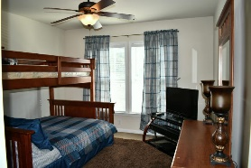
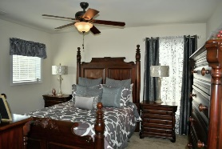
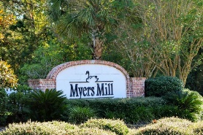
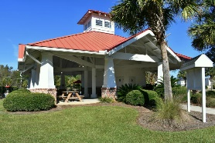
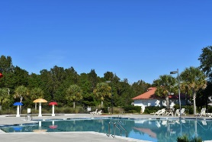


Just Listed in Myers Mill
5069 Blair Road
Myers Mill | Summerville, SC 29483 | MLS# 19030370 | $328,000
This Myers Mill home is move in ready for you. Gorgeous 4 bedroom 2.5 bathroom home features hardwood flooring throughout, spacious bedrooms, serene owners suite with separate garden tub and a gorgeous open kitchen with beautiful cabinets and granite!
Large closets in all bedrooms. Enjoy the coziness of the open living room w/ gas fireplace. Separate formal dining room as well as eat in kitchen with bar seating and ample storage.
Large two car garage. Lush fenced backyard and screened back porch with patio perfect for relaxing after a long day.
Myers Mill has a neighborhood pool as well as walking paths. Make this home yours today! A $1,640 Lender Credit is available and will be applied towards the buyer's closing costs and pre-paids if the buyer chooses to use the seller's preferred lender. This credit is in addition to any negotiated seller concessions.
Lauren Courcoux
Mobile - (843) 224-8613
lauren.courcoux@carolinaone.com
Carolina One Real Estate | 2713 Highway 17 North | Mt Pleasant, SC 29466

