Slide 1
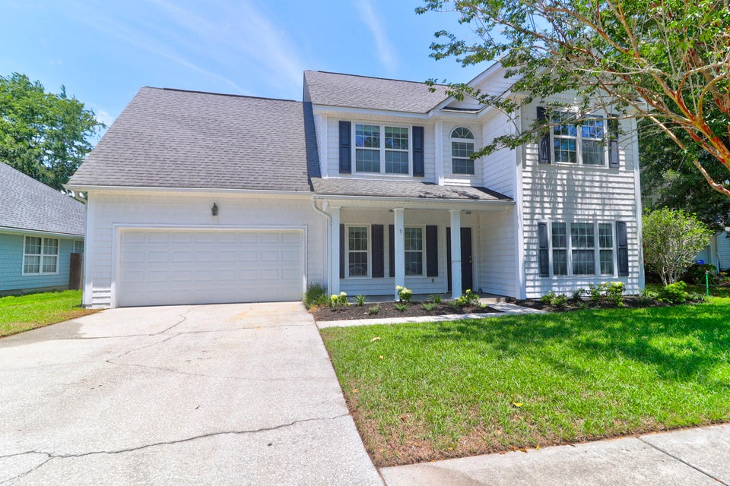
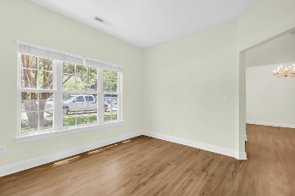
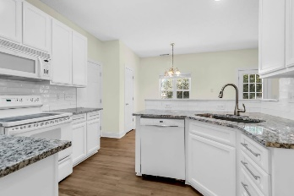
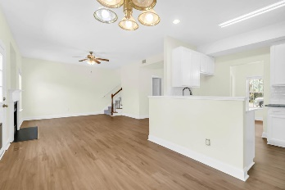
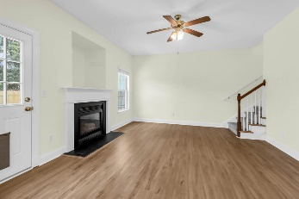
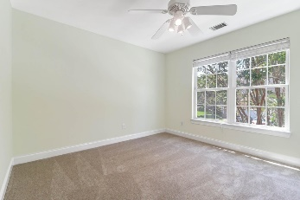
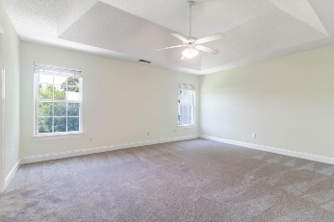
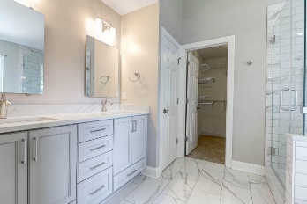
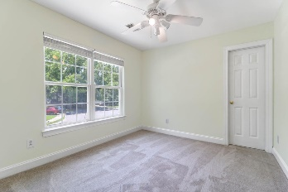
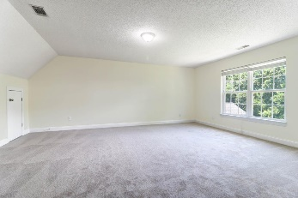
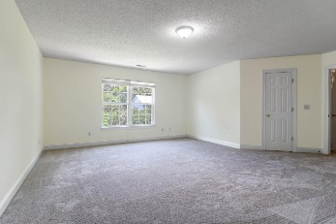



READY FOR YOUR BUYER'S FURNITURE!
506 Cecilia Cove Drive
Lawton Harbor
Charleston, SC 29412
MLS# 24017062
$700,000
Discover the perfect blend of comfort and style in this meticulously updated 4-bedroom, 2-full-bath residence located in the highly sought-after Lawton Harbor neighborhood. The recent renovations include fresh paint, new cabinet doors, new countertops, backsplash, luxury vinyl plank floors, new carpet, and a beautifully landscaped yard and make this home is ''move in ready!'' Step inside to find an inviting open floorplan bathed in natural light, seamlessly connecting the spacious living area with the gourmet kitchen. The kitchen features new countertops complemented by a stunning backsplash, providing the perfect kitchen for cooking and gatherings with friends and family. Retreat to the luxurious master suite boasting an updated bath with modern fixtures and a walk-in shower, offering a serene escape at the end of the day. Three additional bedrooms provide ample space for family, guests, or a home office, each enhanced with new carpeting for added comfort. Outside, the freshly landscaped yard offers a private sanctuary for outdoor relaxation and entertaining, with a fenced in backyard and on a cul de sac. This great location is in walking, biking and golf carting distance to grocery shopping and great restaurants. Just minutes from downtown Charleston makes this is a fantastic location! A $2,500 Lender Credit is available and will be applied towards the buyer's closing costs and pre-paids if the buyer chooses to use the seller's preferred lender. This credit is in addition to any negotiated seller concessions.
Leesa Northrup
Office: 843.884.1622
Mobile: 843.442.0987
Fax: 843.746.4994
lnorthrup@carolinaone.com
Carolina One Real Estate 628 Long Point Road Mount Pleasant SC 29464

