Slide 1
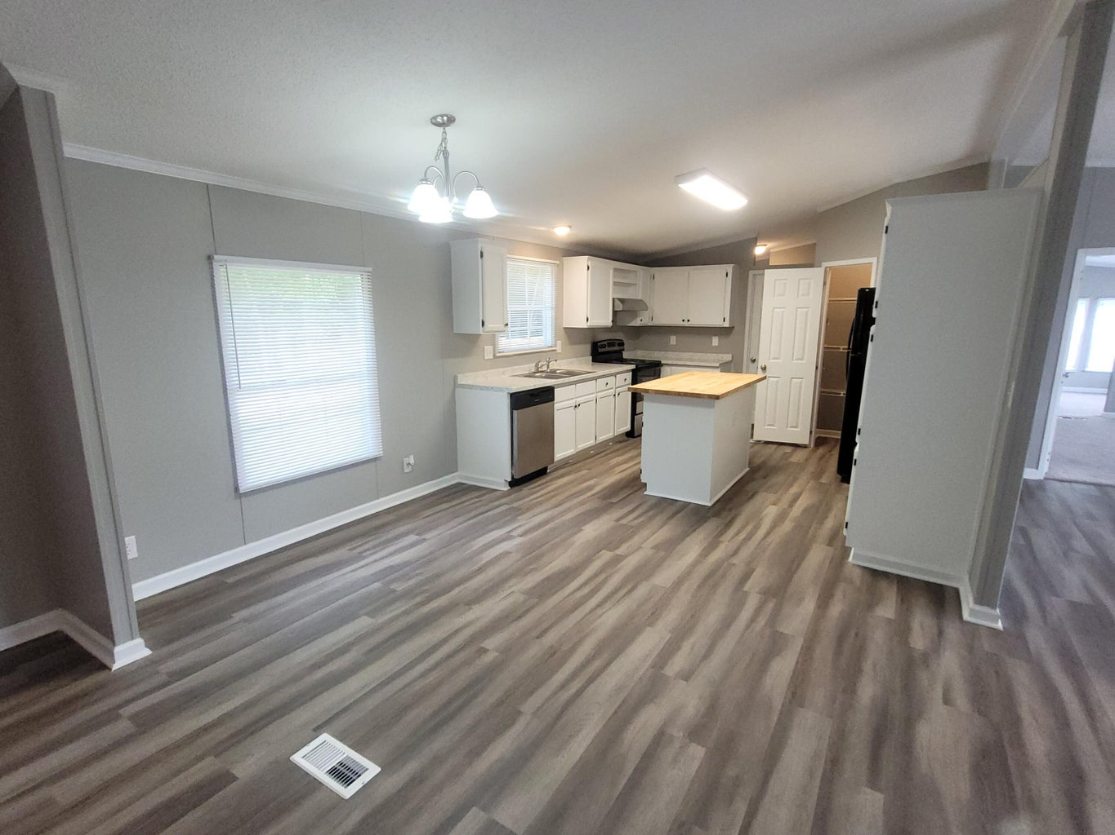
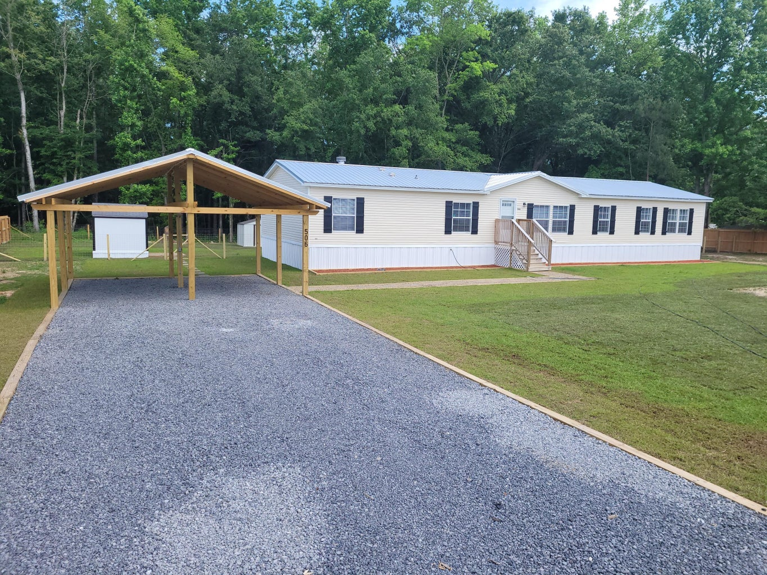
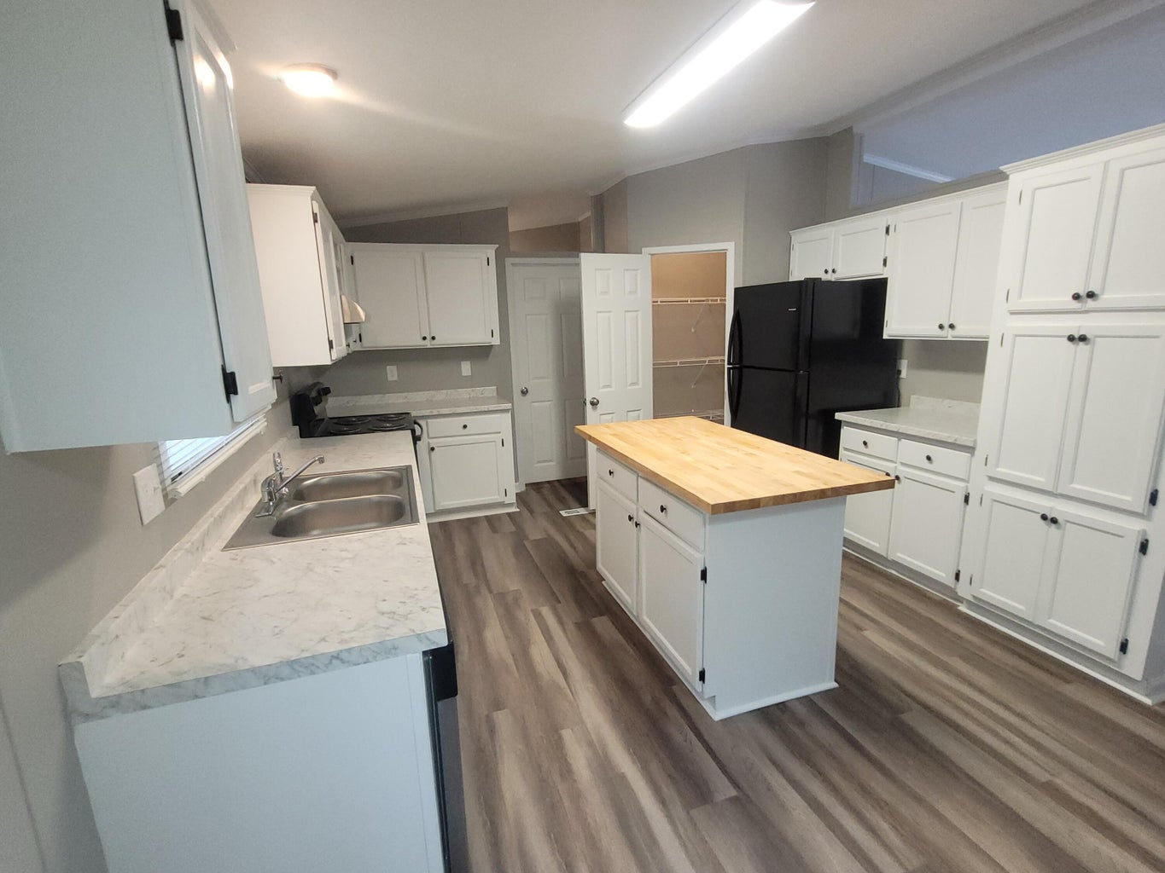
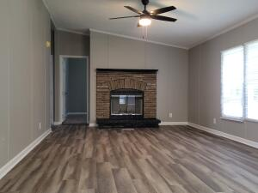
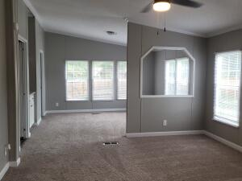
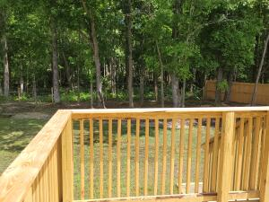
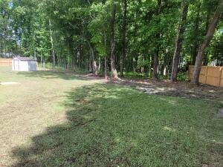
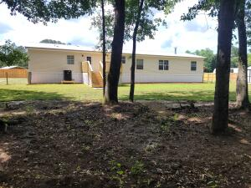
Like New 4 Bedroom Home On 1 Acre
506 Sagebrush Court
Moncks Corner, SC 29461 | MLS# 24011320 | $324,900
Beautifully renovated 2100 sq ft 4 bedroom 2.5 bath manufactured home on 1 acre. The property features new rock driveway and sidewalks, 2-car pergola carport with electric and light, storage shed and fenced in yard. The home has been completely renovated and updated with new metal roof, HVAC system, hot water heater, and new plumbing and lighting fixtures. There is new wide plank vinyl flooring in the living areas, new carpet in the bedrooms, fresh paint throughout plus new blinds and screens. The home features an open floor plan with a living room and separate family room with fireplace. The large kitchen boasts of newly painted white cabinets, new counter tops, center island with butcher block and new appliances. There is plenty of room in the huge primary suite with a sitting area, walk-in closet and bathroom with a soaker tub, separate shower and double sinks. The other 3 bedrooms are ample sized and share an updated bathroom. There is a convenient half bath located off the laundry area and near the backdoor. Enjoy grilling out on the new back deck or letting the kids and pets play in the fenced back yard overlooking a pond and trees for added privacy. There is a storage shed for your outdoor items and pump house for the well and filtration system. This home is move in ready and conveniently located in Moncks Corner with easy access to Hwy 17A and surrounding areas. Schedule a showing today!
Dora L McGillis
843-343-5012
doramcgillis@hotmail.com
www.hbrtwn.com
Harbourtowne Real Estate
672 Marina Drive, Ste 110
Daniel Island, SC 29492
Harbourtowne Real Estate | 672 Marina Drive, Ste 110 | Daniel Island, SC 29492

