Slide 1
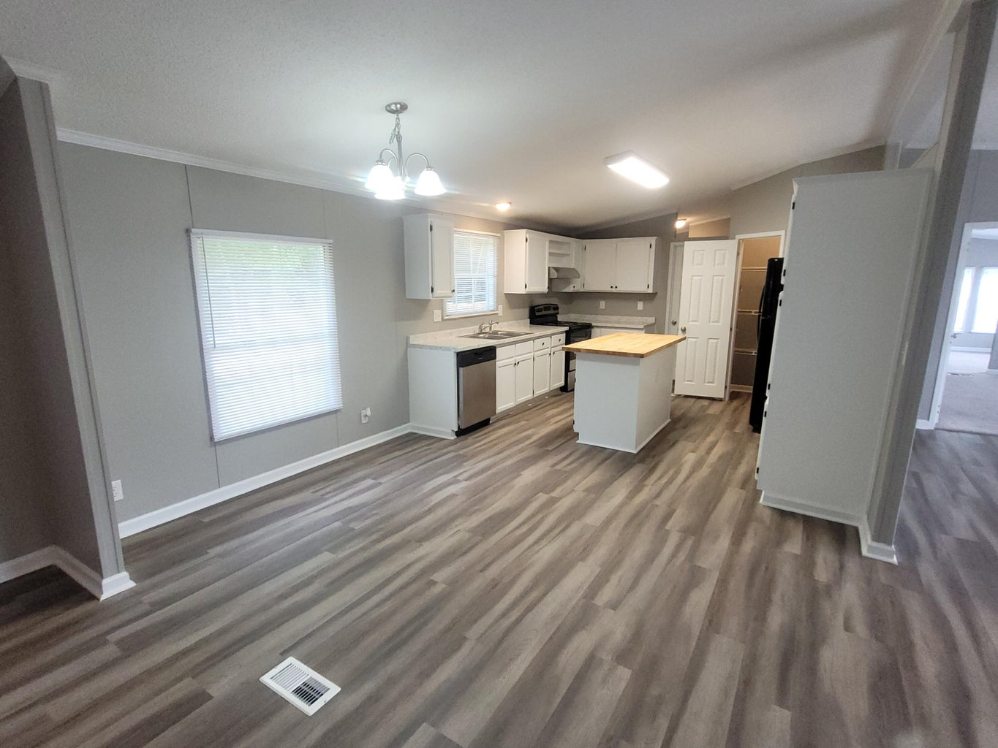
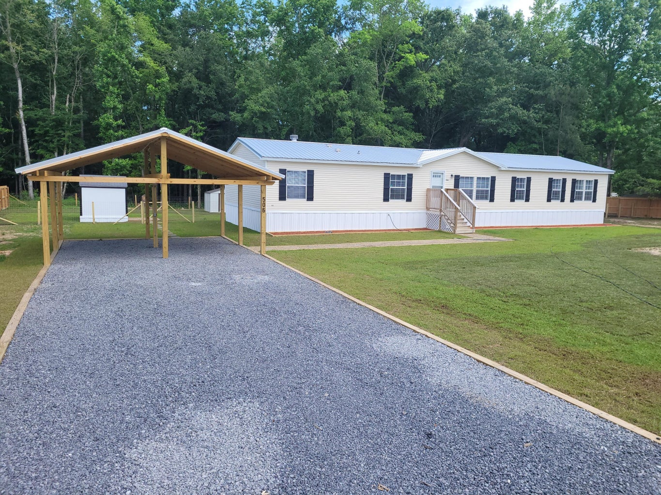
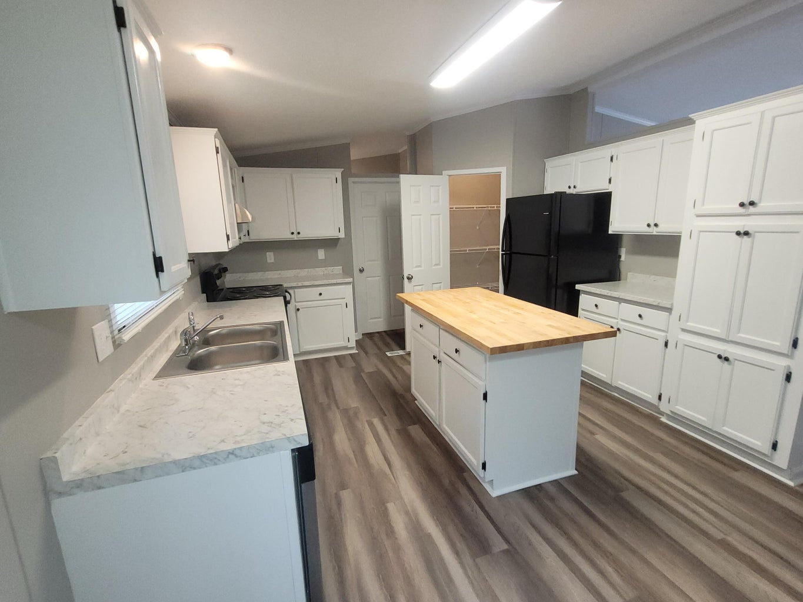
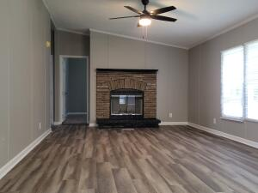
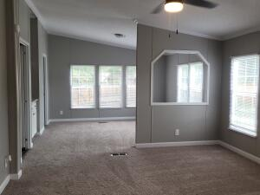
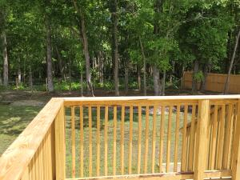
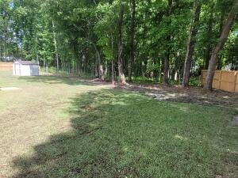
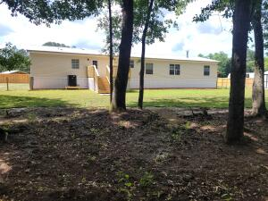
Seller Offering $12K Incentive For VA Buyer!
506 Sagebrush Court
Moncks Corner, SC 29461 | MLS# 24011320 | $314,900
Special offer for VA buyers
Pay closing costs
Buy down the rate
No money down with VA financing
Beautiful home with 4 bedrooms and 2.5 baths over 2100 sq ft
1 acre lot with trees for privacy
Completely renovated
New roof
New HVAC
New flooring
New appliances
2 car carport
Privacy fence and storage shed
Dora L McGillis
843-343-5012
doramcgillis@hotmail.com
www.hbrtwn.com
Harbourtowne Real Estate
672 Marina Drive, Ste 110
Daniel Island, SC 29492
Harbourtowne Real Estate | 672 Marina Drive, Ste 110 | Daniel Island, SC 29492

