Slide 1
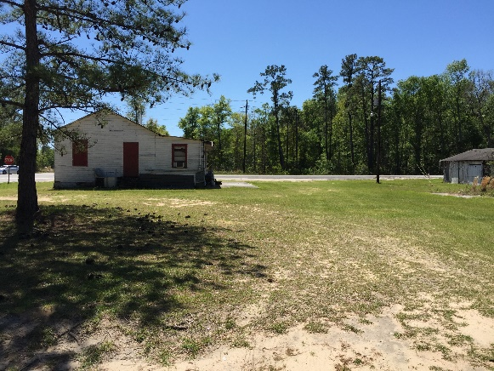
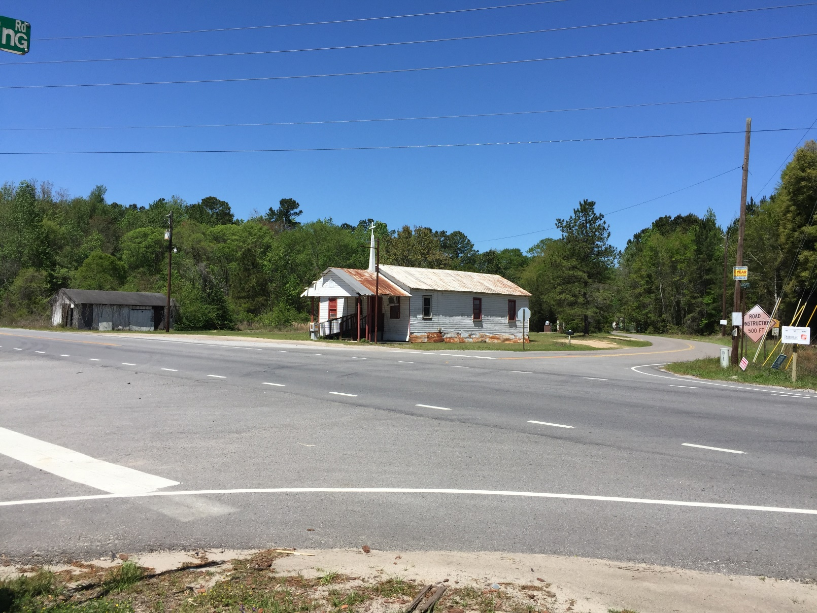
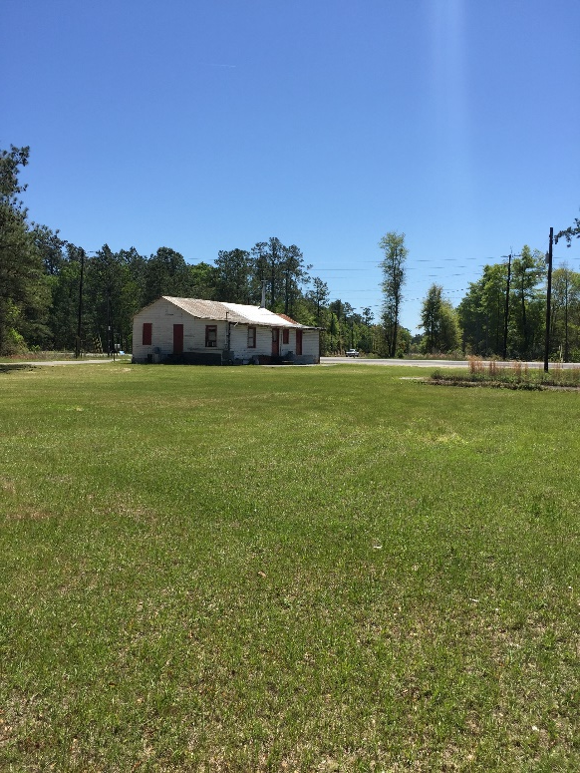


HUGE PRICE REDUCTION! Prime Commercial Property near Edisto River
Excellent location on Hwy 17A South that is less than a mile to the Edisto River and river access. This corner lot property has two commercial buildings that Dorchester County (AC Zoning) has listed as a "retail store" and "church". Their ages are unknown according to the owners. The value is in the land. They are two adjoining parcels of land equaling 2.74 acres(Tax ID#164-00-00-001;#164-00-00-020). This is a fabulous location for numerous uses like a new store, gas station, or multifamily.
5074 Hwy 17A S
Ridgeville, SC 29472
MLS# 16029864 CMLS# 29949595
$350,000
Sherri Seymour
843-303-3495
Seymour.Sherri@gmail.com
CCBG Real Estate Group PO Box 1440
Mount Pleasant, SC 29465

