Slide 1
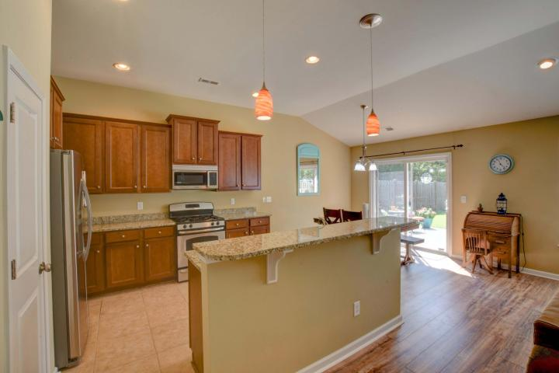
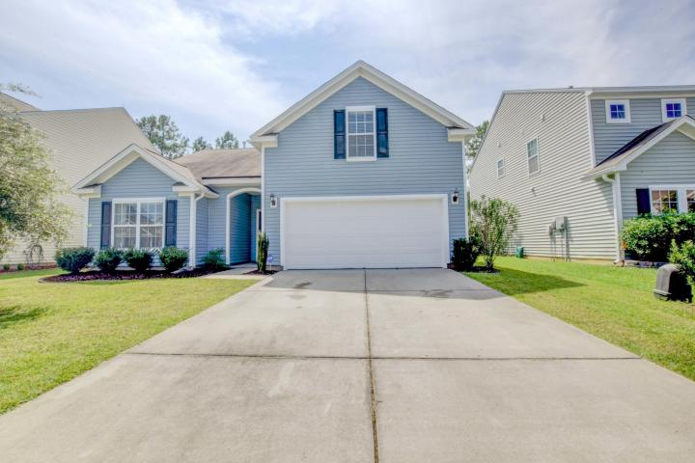
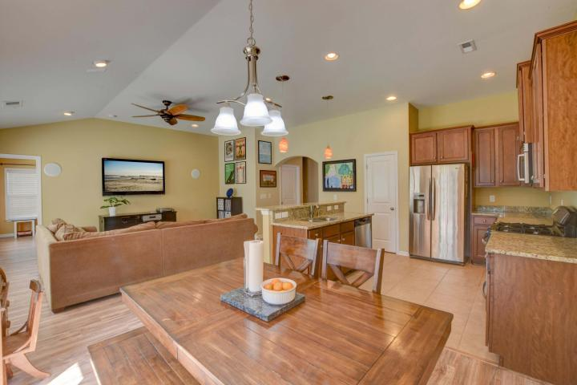
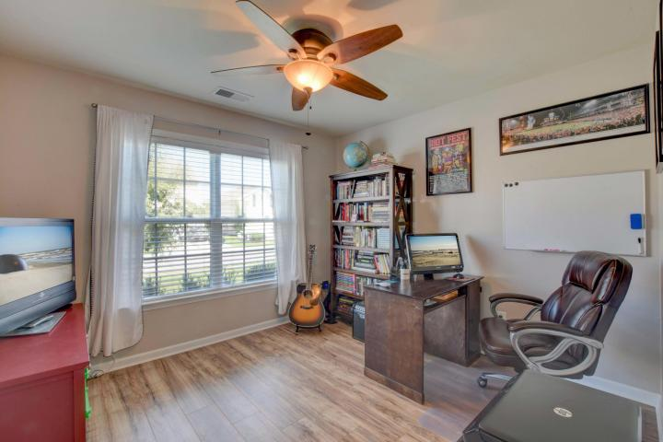
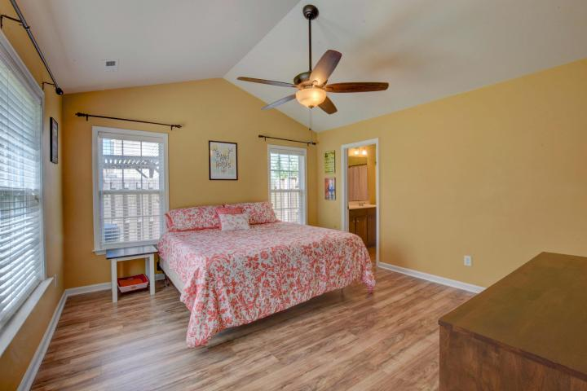
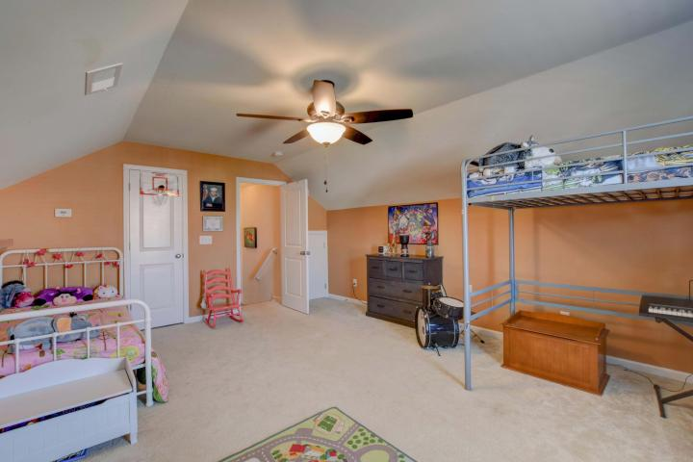
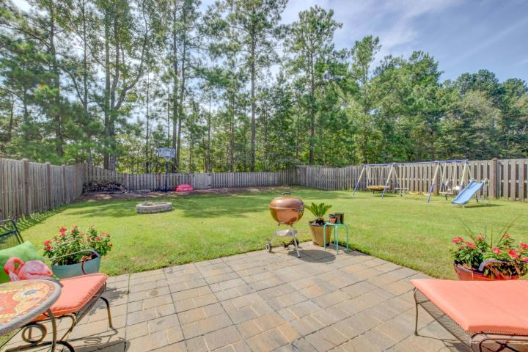
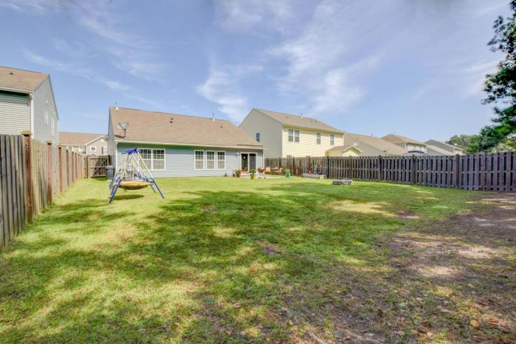

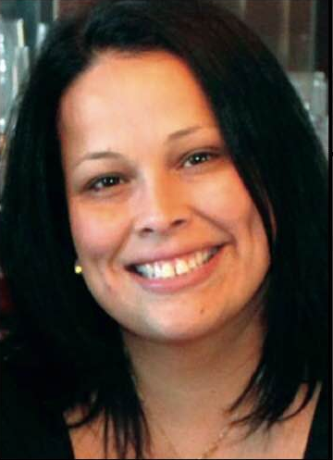
Looking To Get A Little Froggy?
5076 Blair Road
Myers Mill ~ Summerville, SC 29483
MLS# 17024657 ~ $232,500
Welcome Home to your new beautiful ranch home. 3BR 2BA with a frog(4th enormous bedroom) with a huge private yard. Brand new floors throughout, this home shows like a model home with all the upgrades!
Granite countertops, GAS Stove, ceiling fans in every room! This home is situated close to everyday conveniences, shopping, restaurants, all major highways.DD2 school district!
Do not miss owning in Myers Mill!
Lisa Horan
Full Service Realtor
843-501-8856
lisaghoran@gmail.com
AgentOwned Premiere Group • 100 Crowfield Blvd • Goose Creek, SC 29445

