Slide 1
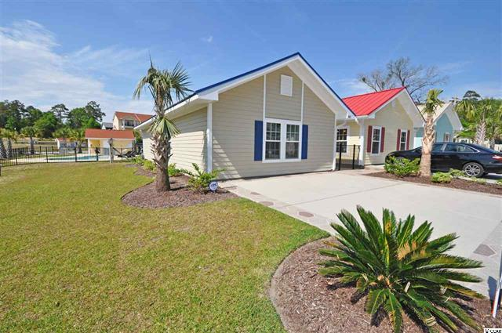
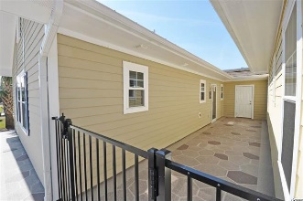
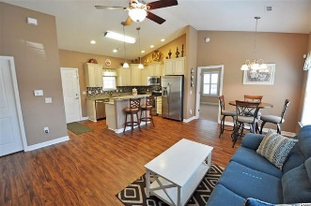
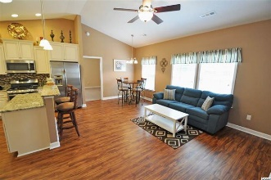
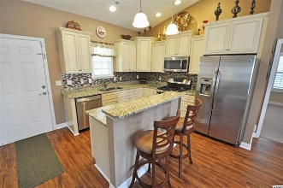
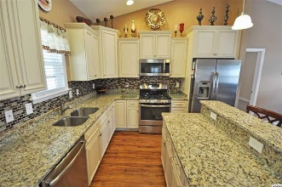
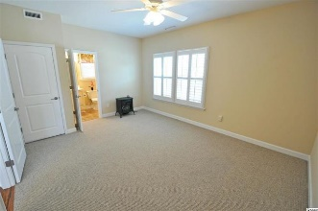
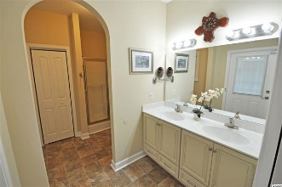
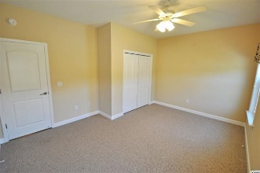
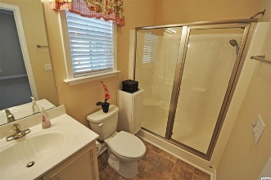
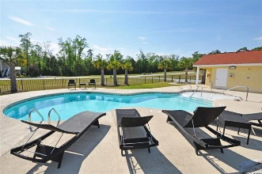


Like-new, year-old resale in natural gas-powered waterway community
507 Castellar Ln
Little River, SC 29566
MLS: 1608691
$165,900
Life's a gas at Grande Harbour with natural gas heat, gas stoves, gas hot water, gas grills - and of course, keep your boat at Grande Harbour Marina for gas-powered waterway living ready when you are! All of the new homes at Grand Harbour are built like individual homes but enjoy the carefree and amenity-rich lifestyle of a condo! True beach and boating lifestyle in this new resort community with community pool and picnic/cookout area, plus high speed fiber optic internet, cable TV, phone and security all included in the HOA dues! Come check out the good life -- the fun life -- the gas life -- at Grande Harbour Cottages and Marina. This MAKO Model is less than a year old and features a 2 bedroom, 2 bath ground-level cottage floorplan that affords a lot of easy living in a convenient, comfortable space, so popular today with first-time homebuyers, retirees and others. But the attention to detail and upgrades this lovely home features are extraordinary! From the moment you drive into the 2-car parking space adjoining the house in the front to the gated, grande-entry courtyard and onto the back patio off of one of the two complete master suites, their is a lovely, subtle architectural flag stone design coating that is consistent throughout. That threading of good taste and high-end finishes and upgrades truly defines this wonderful home, outside and in... The kitchen is granite with stainless appliances and every possible add-on meticulously included, such as staggered cabinets with display shelves, exterior-vented microwave, grill and turnkey cast iron pots and pans and more. Berber-style loop carpet and luxury, padded vinyl flooring; energy-efficient windows tinted to reflect UV rays and installed with safety tempered glass, along with an Anderson full-view heavy duty storm door with reflective film are just a few more examples of the care and pride that has gone into the finishing of this basically brand-new home. There is even a large outdoor lock-out storage closet off of the courtyard. Enjoy exploring to discover custom plantation and horizontal vinyl shutters, top of the line, for example, or walk-in showers with brushed nickel swing glass doors to lights in every closet. This cottage boasts a smaller space with BIG, BIG Value and a unique opportunity for the discriminating buyer who appreciates quality, the inviting beach lifestyle and luxury at an affordable price... Life's a gas at Grande Harbour!
Deborah Collins
843-424-9013
dctidewater@yahoo.com
Connie Ross-Karl
702-306-2643
conniesross@aol.com
NEW WAY PROPERTIES MYRTLE BEACH

