Slide 1
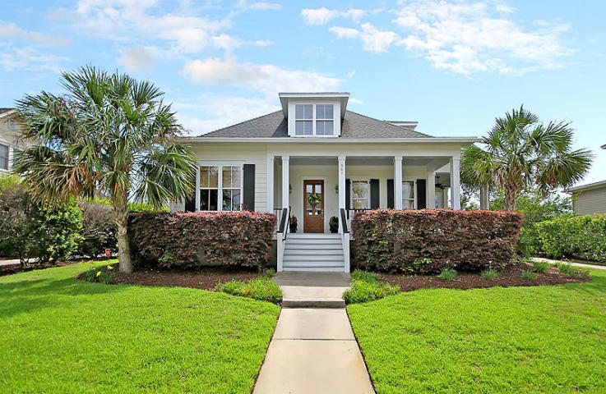
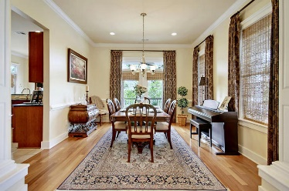
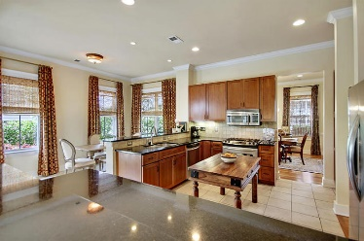
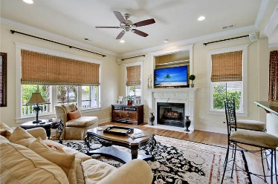
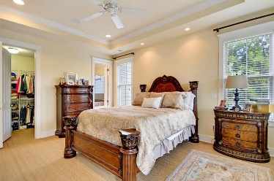
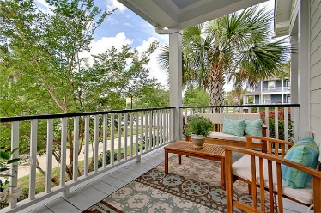
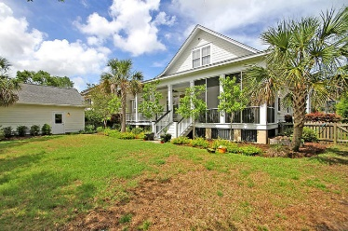
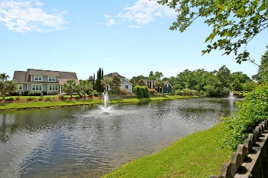
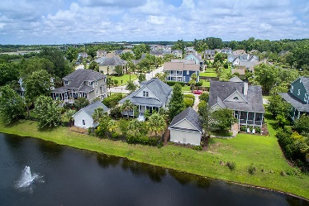

507 Two Mile Run Grimball Gates ~ Johns Island, SC 29455 MLS# 18015256 ~ $499,000 Snacks & Prizes for all!
Broker Open House Thursday 11-1
Gorgeous Listing
STUNNING 4 bedroom 3 full bath lowcountry cottage designed by Allison Ramsey, located on a BEAUTIFULLY landscaped pond lot with 3 HUGE PHENOMENAL covered porches to enjoy the views! This home is METICULOUSLY MAINTAINED and is one of the most elegantly done in Grimball Gates. Features: teak hardwood floors, custom moldings and trim, seagrass carpeting in bedrooms, 10 foot ceilings, gourmet kitchen open to living area with dual fuel gas cooktop, granite and stainless steel appliances, screened porch, fenced backyard, oversized laundry room, and fireplace has gas logs in the living room. The GATED COMMUNITY has a 95 acre island preserve has trails for running, walking, golf carting, boat storage, and a community deepwater dock with covered pierhead and dual floaters on the Intracoastal!
Stan Huff
843-670-2835 stan.huff@agentowned.com
Jill Marcacci
843-297-5590 jill@agentowned.com
www.agentownedrealty.com
AgentOwned Realty Co. Preferred Group, Inc. | 824 Johnnie Dodds Blvd | Mt Pleasant, SC 29464

