Slide 1
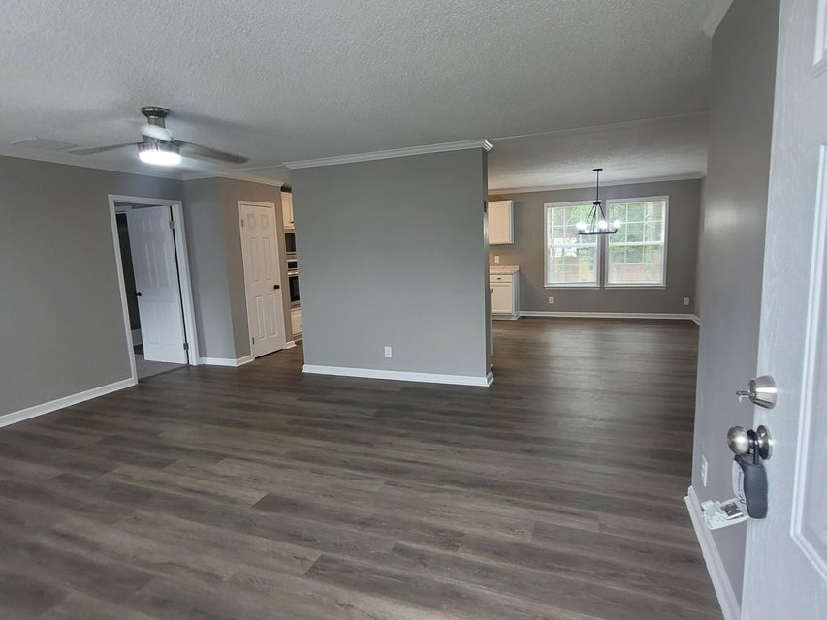
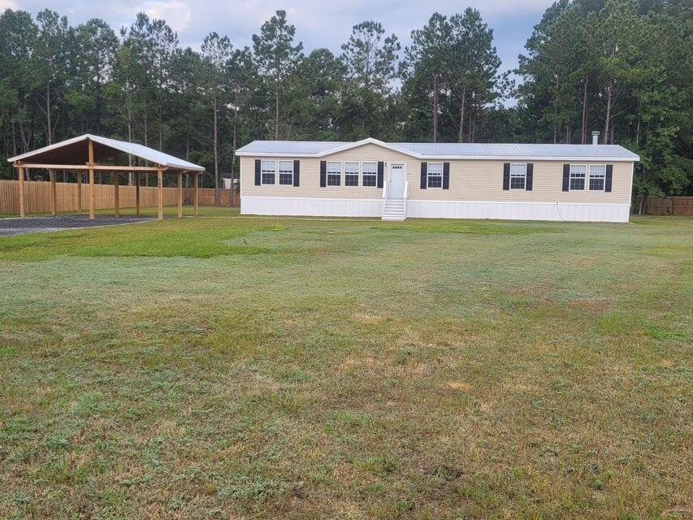
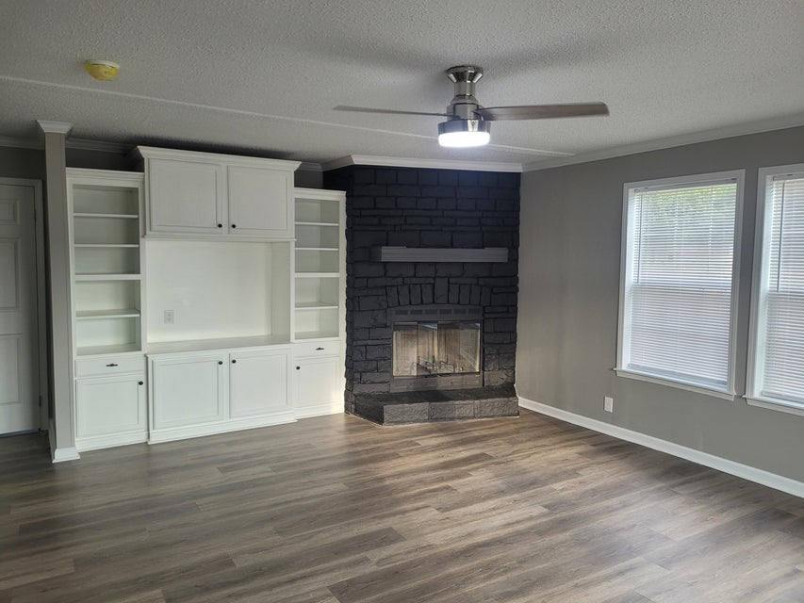
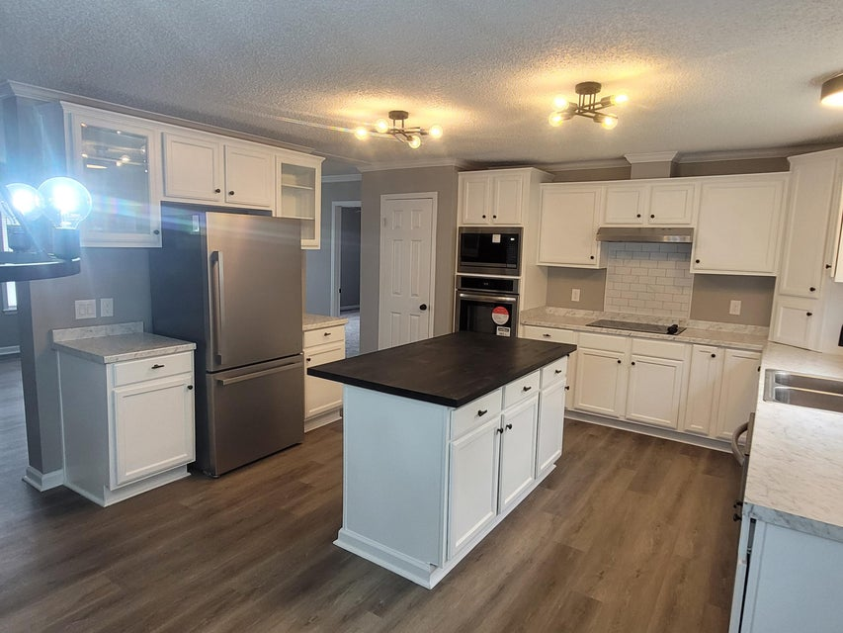
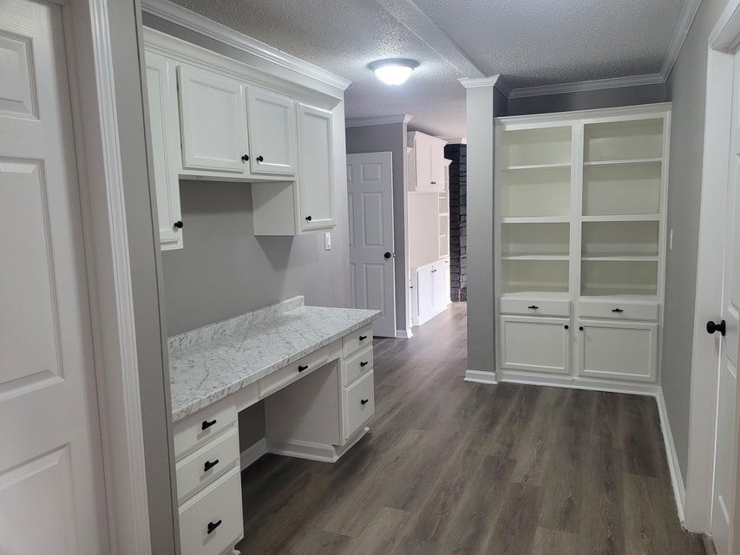
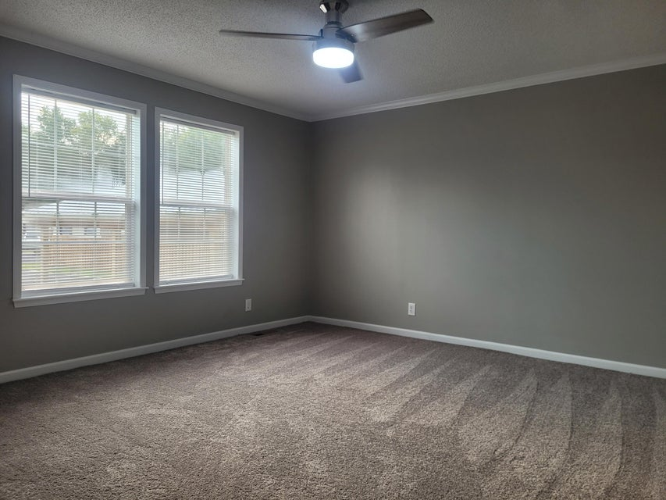
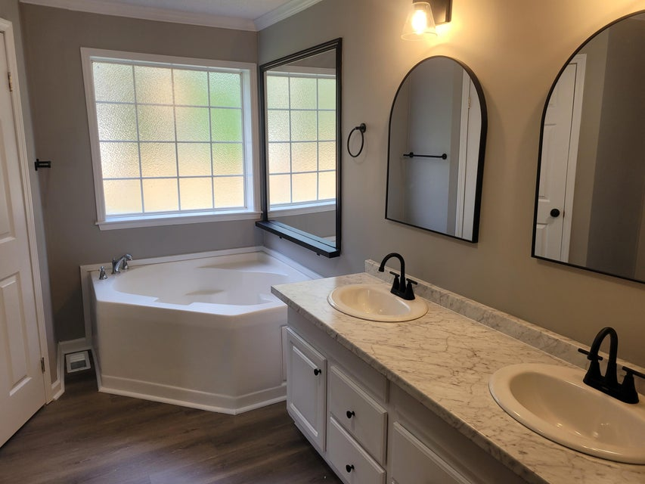
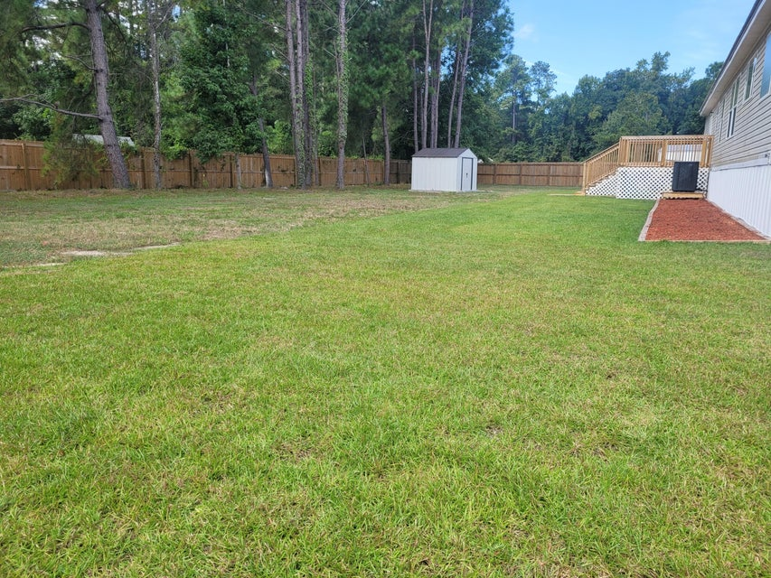
LET’S MAKE A DEAL! IMPROVED PRICE!
2.5% BUYER’S COMMISSION OFFERED
507 Sagebrush Court
Moncks Corner, SC 29461 | MLS# 24024721 | $324,900
Seller offering $10K in flex money to help with closing costs or buy down the interest rate.
Does your buyer have a house to sell? Maybe we can do a trade
Your buyers will love the unique upgraded features of this home
Large lot with pergola carport
Finished sheetrock walls
Thermopane windows
Built-ins throughout
Completely renovated
Schedule a showing today and let’s make a deal!
Dora L McGillis
843-343-5012
doramcgillis@hotmail.com
www.hbrtwn.com
Harbourtowne Real Estate
672 Marina Drive, Ste 110
Daniel Island, SC 29492
Harbourtowne Real Estate | 672 Marina Drive, Ste 110 | Daniel Island, SC 29492

