Slide 1
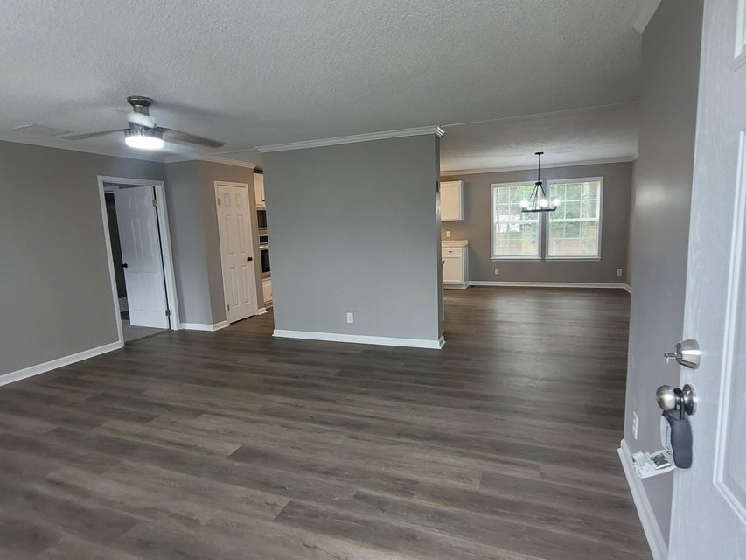
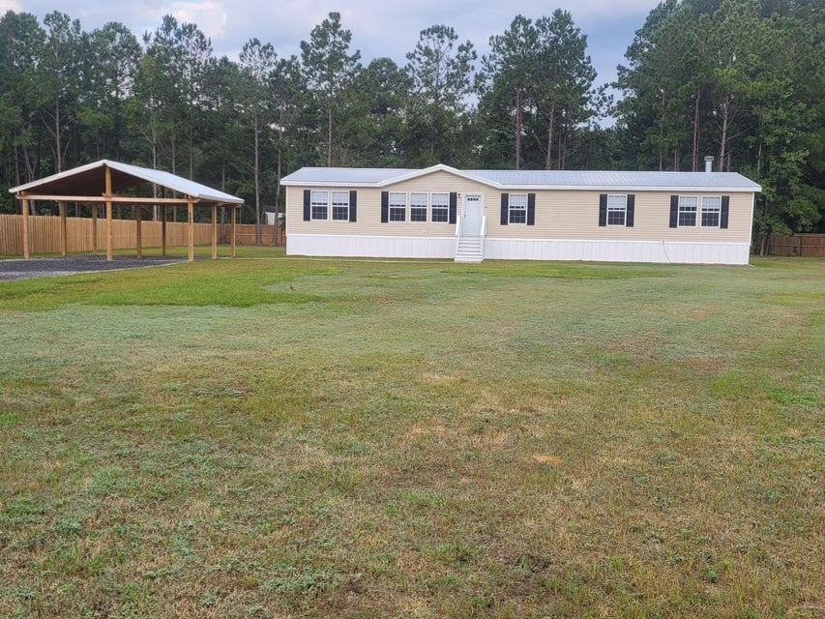
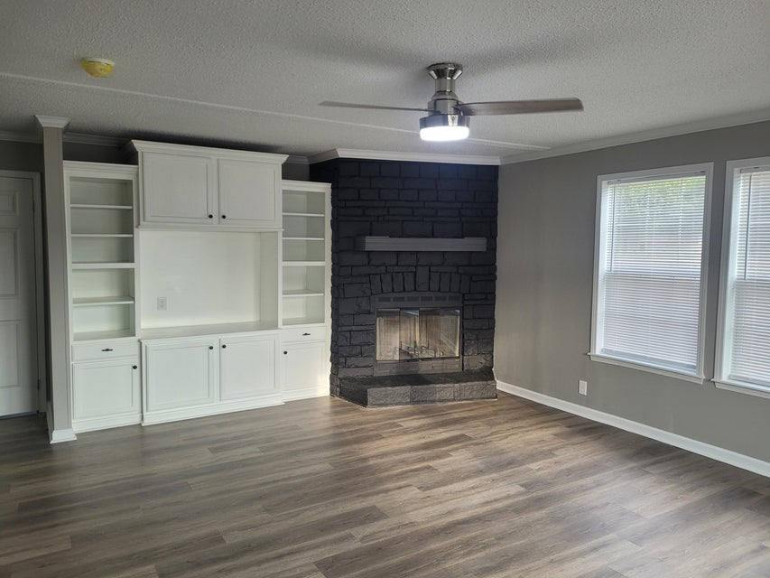
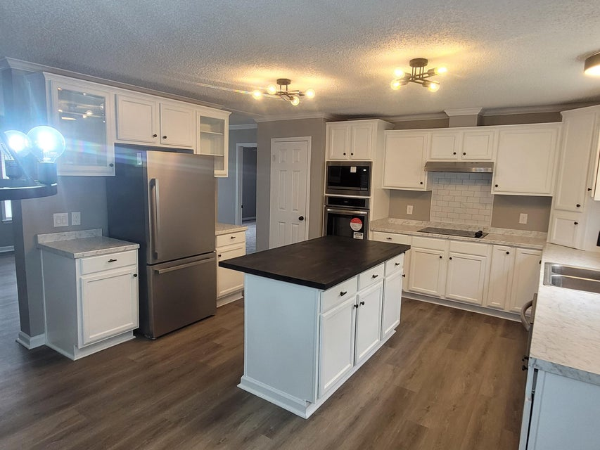
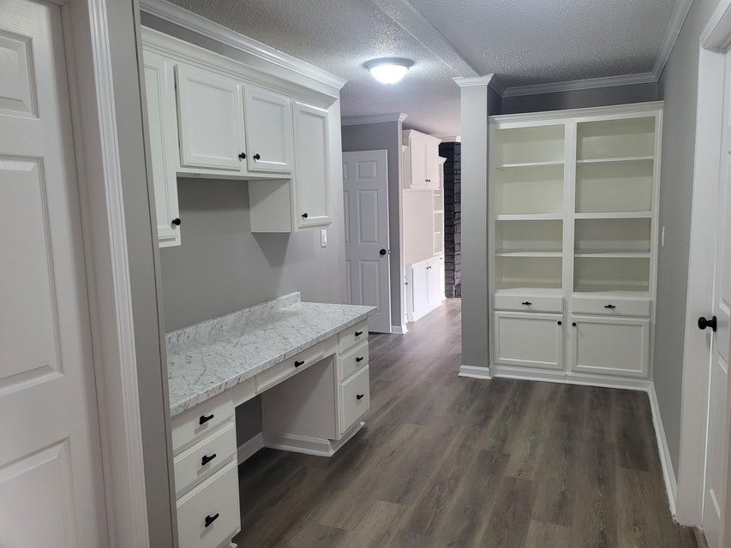
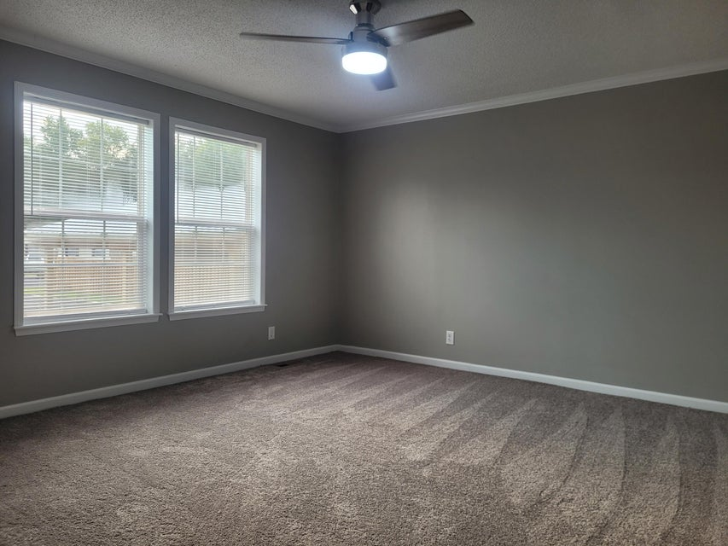
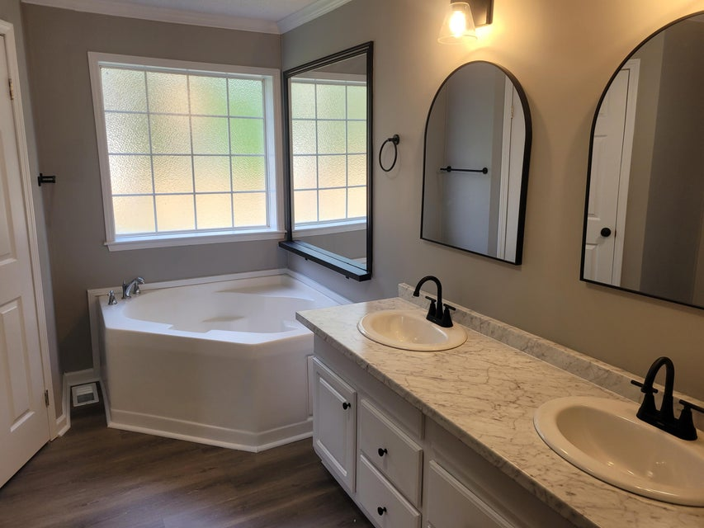
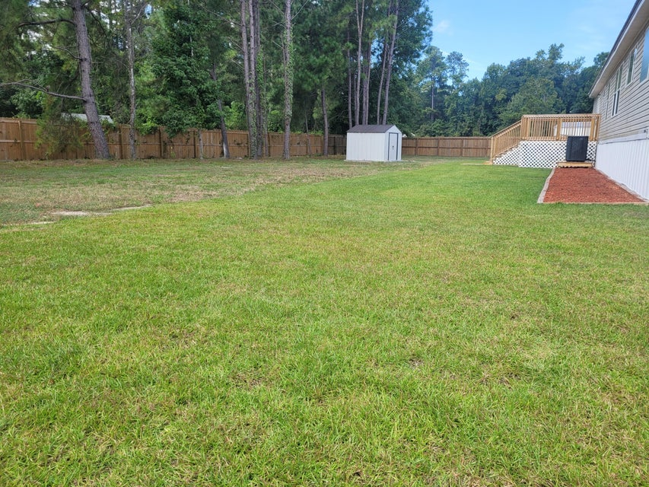
SELLER OFFERING
2.5% BUYER’S AGENT COMMISSION
507 Sagebrush Court
Moncks Corner, SC 29461 | MLS# 24024721 | $339,999
Beautiful 2400 sq ft home with 4 bedrooms and 2 baths
Completely renovated with upgrades
Finished sheetrock
Thermopane windows
Built-ins throughout the home
New roof
New HVAC
New flooring
New appliances
2 car carport
Privacy fence and storage shed
Dora L McGillis
843-343-5012
doramcgillis@hotmail.com
www.hbrtwn.com
Harbourtowne Real Estate
672 Marina Drive, Ste 110
Daniel Island, SC 29492
Harbourtowne Real Estate | 672 Marina Drive, Ste 110 | Daniel Island, SC 29492

