Slide 1
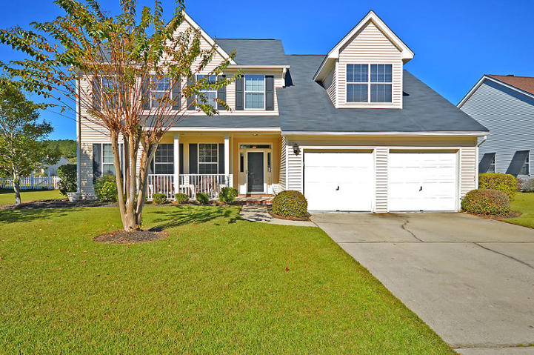
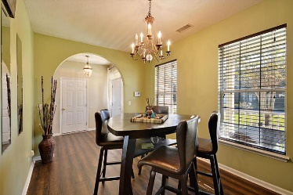
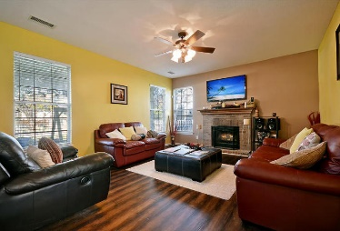
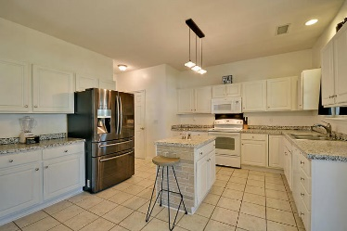
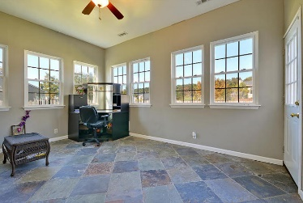

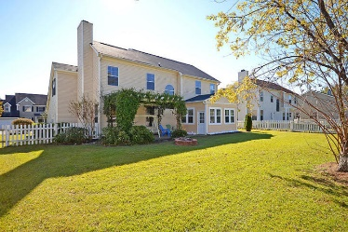
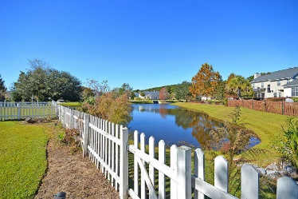

5082 Weatherstone Road Village Green · Charleston · MLS# 17031371 · $289,000
Loaded with Updates
Motivated Seller
BEAUTIFUL 4 bedroom 2.5 bath home with GORGEOUS views of pond in back! The layout of this home is exceptionally open, very airy, and full of natural sunlight. Upon entering, you walk through the elegant foyer with hand scraped wood floors. To the left is a flexroom/dining room with convenient back entrance to the kitchen and guest bath. Going straight the foyer flows into the very spacious family room with handsome fireplace, wood tread stairs, numerous windows and is open to the oversized eat-in kitchen with island, white cabinets, and a ton of countertop space and leads to a large laundry room. The main level also has a multi-functional sunroom with tile floor that has outstanding views of the pond, wildlife, and backyard. Outside, watch the sunset as you swing under the braided vine covered veranda with a brick floor. As if that weren't perfect enough, beyond the veranda, there is a huge backyard that is fenced and cute storage shed. On the second level is the master bedroom with large walk-in closet and vaulted ceilings, and more relaxing views. The spa-like master bath has a soaking tub, separate shower and double vanities. Two additional bedrooms upstairs also have walk-in closets, ceilings fans, and vaulted ceilings. The last room is a HUGE FROG! This room is large enough to be another bedroom, a game room, home gym, or even an office. Village Green is a wonderfully landscaped community with a play park, and community pool! The neighborhood is close to local shopping and grocery stores and is a short drive to downtown Charleston with 5-star restaurants, world class shopping and iconic history as well as a short drive to plantations, the beaches, the airport, Boeing and Daniel Island. Come take a look because you will not find another home that offers as much as this one!
Stan Huff
843-670-2835 stan.huff@agentowned.com
Jill Marcacci
843-297-5590 jill@agentowned.com
www.agentownedrealty.com
AgentOwned Realty Co. Preferred Group, Inc. | 824 Johnnie Dodds Blvd | Mt Pleasant, SC 29464

