Slide 1
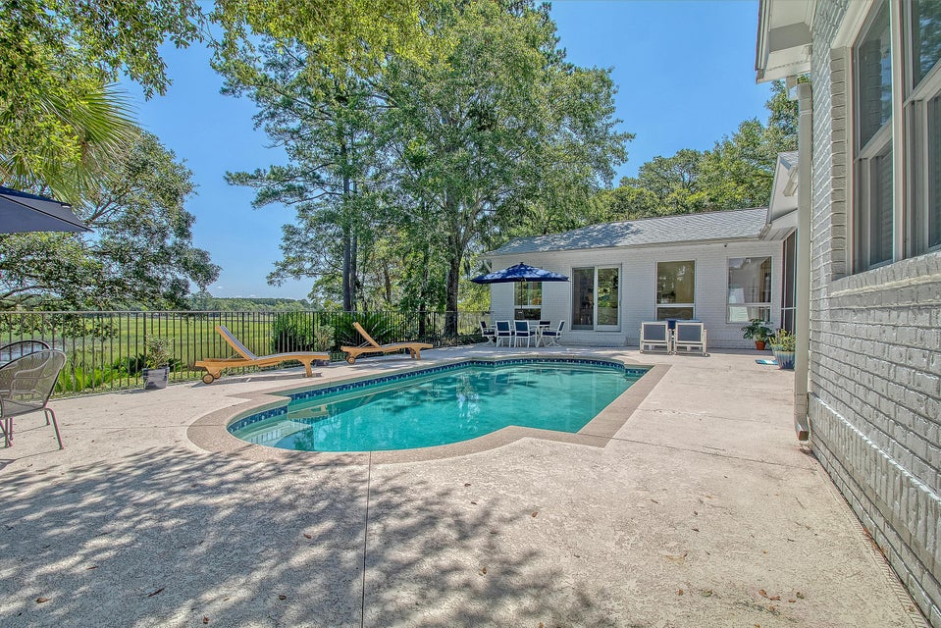
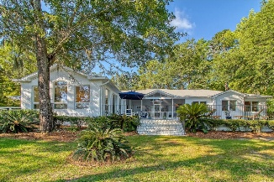
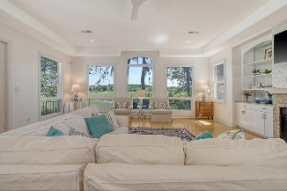
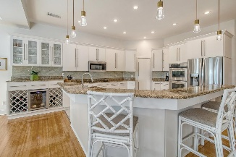
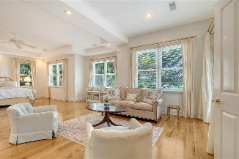
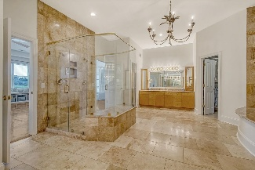


Open House Tuesday 8/26 11-1pm Light Lunch Will Be Served
Hosted by Kathy Ware | 843-830-3804 | kathy.ware@carolinaone.com
5084 Timber Race Course
Stono Ferry | Hollywood, SC 29449 | MLS# 25017794 | $1,475,000
Elegant single story home on a beautiful Lowcountry tidal creek setting, renovated since 2023 with new roof, HVAC, tankless hot water heaters, pool equipment, security system, lighting and many other updates. 5084 Timber Race is a true home - a luxurious retreat in an amenity filled neighborhood with convenient proximity to downtown Charleston, the beaches, dining and shopping. Marsh and water views from the living spaces and primary bedroom and guest bedroom seamlessly blend the spectacular outside views with the indoor spaces. This single level floorplan provides an easy living lifestyle and stunning displays from sunrise to sunset. The house has wonderful gathering spaces as well as a layout which provides unique privacy for owners and their guests/family.
The house is ideal for entertaining and relaxing indoors and outdoors in multiple spaces. Expansive, light-filled open floor plan is accentuated by high ceilings, large windows, and architectural details throughout the home. The beautiful foyer leads to a formal dining room and living room. These rooms are thoughtfully designed spaces in a bright, open and spacious floor plan, allowing for a number of uses as desired by buyer. The foyer, dining, and living rooms lead to a large open kitchen with an oversized island, and adjacent breakfast and family room overlooking the pool, marsh and back yard. The heart of this home is the generously sized family room, with a gas fireplace with built ins, an abundance of natural light, and tidal creek views.
VIDEO TOUR
Carolina One Real Estate
195 W Coleman Blvd
Mt Pleasant, SC 29464-3495
Jennie Hood Emerson (843) 327-0384
jennie@carolinaone.com
www.yourcharlestonhomes.com

