Slide 1
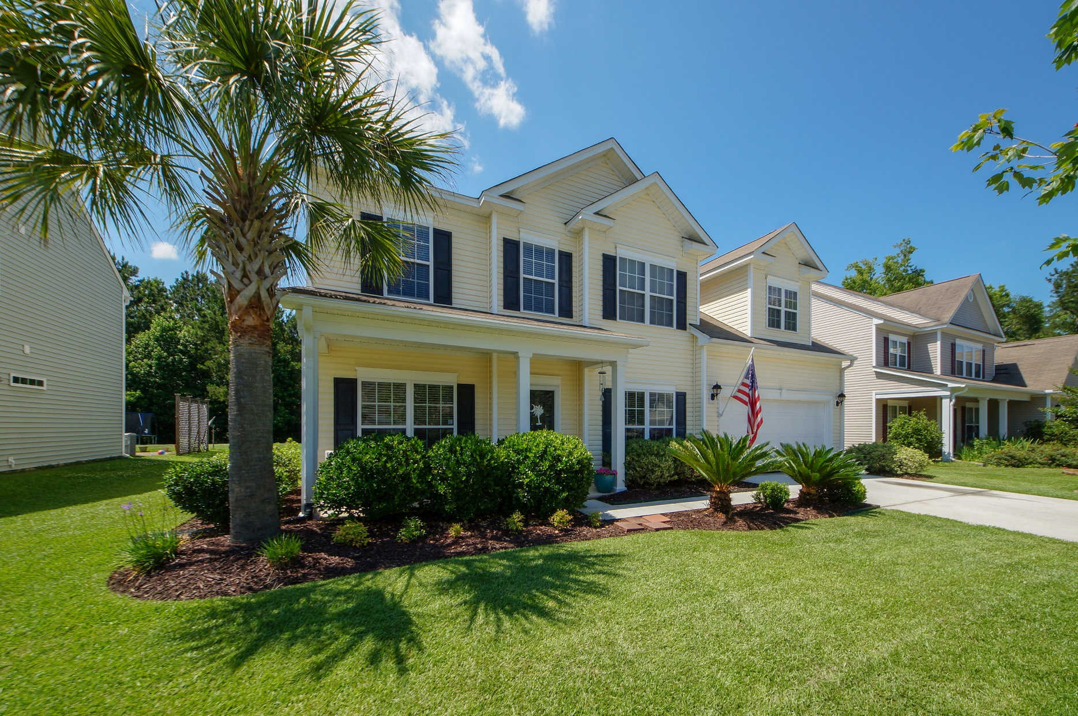
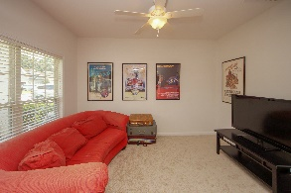
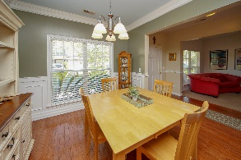
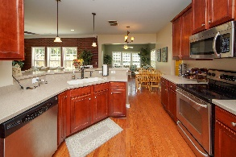
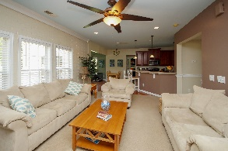

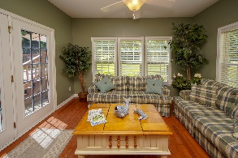

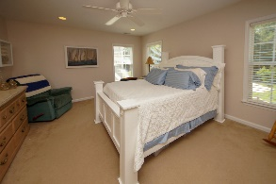
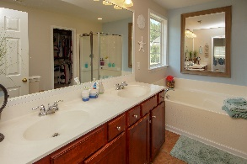
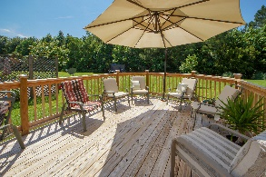
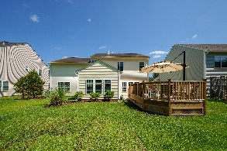


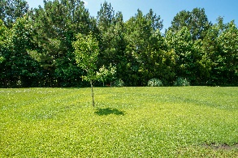
4 bed / 2.5 bath
5089 Blair Road
Myers Mill in Summerville
MLS #18015933
PRICE REDUCED
$275,000
Greg Flanagan
Broker/REALTOR/CLHMS
843-952-4444
greg@flanaganhometeam.com
www.FlanaganHomeTeam.com
Meticulously maintained, overabundantly spacious home on one of the largest lots in Myers Mill. Just minutes from public and private schools in a well established neighborhoods. From the moment the door open you can realize there are no other comparable homes on the market. This home can fit even the largest of gatherings with four separate rooms/areas to entertain or use for private get away time. There's too much detail to describe, look at the pictures, and schedule your tour today. It may just be the last house you'll need to see.
Greg Flanagan
Broker/REALTOR/CLHMS
Luxury Marketing Specialist
Office: 843-952-4444 | Cell: 843-818-8867
www.FlanaganHomeTeam.com
Keller Williams Realty Charleston | 496 Bramson Ct Ste 200 | Mt. Pleasant, SC 29464

