Slide 1
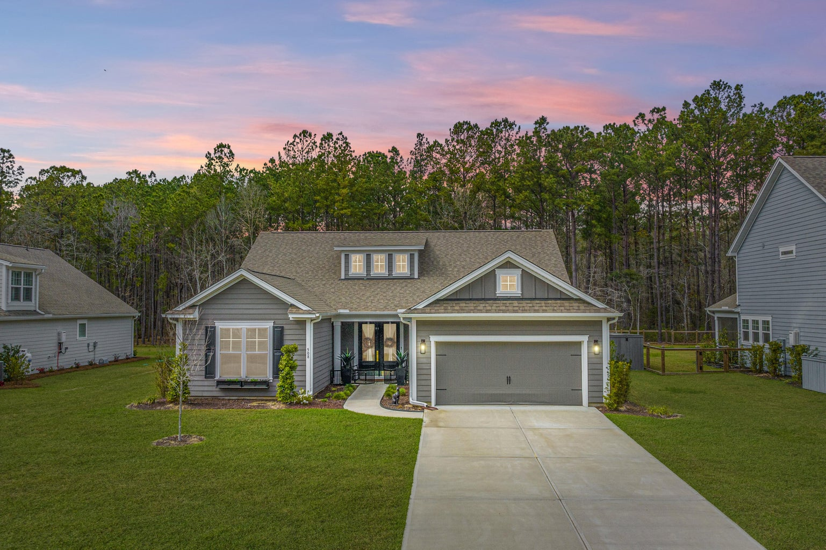
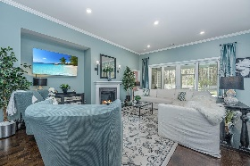
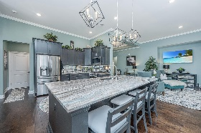
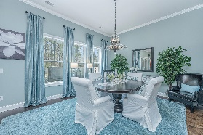
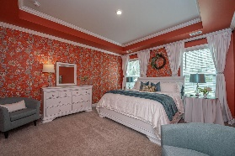
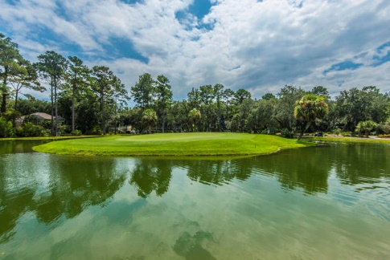
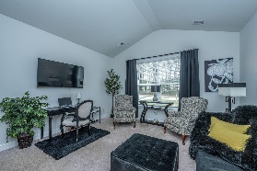
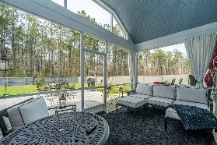
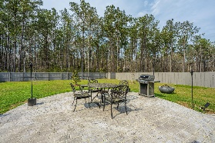
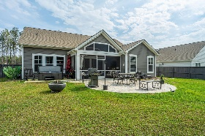
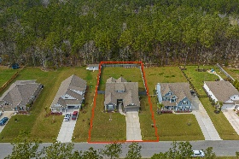

508 Pontoon Road
Bridges at Seven Lakes | Huger, SC 29450
MLS# 23004915 | $650,000
Better Than New!
Better than new! Pride of ownership shows as you walk in the double front doors. A tray ceiling in the foyer welcomes you to a open floor plan and 11 foot ceilings in the living area. The Emerald class Cumberland model gives the owner many options for living style layout. Oversized granite breakfast bar kitchen island for extra seating and counter. Many upgrades to the kitchen were made by the owner after closing. A coffee bar was created to allow a neater and open counter space. The mirrored back splash adds style in a chef kitchen. The living area flow puts everyone at ease for get togethers or relax in front of a cozy fireplace. The guest bedrooms / office are placed for a private setting from the living area and primary bedroom. A full bath and hall separate the rooms. The primary bedroom is a retreat in itself, size of the en suite, walk in closet and bedroom are designed for owner comfort and function. The tray ceiling and multi crown moldings give class and volume to the room. If the living space is not enough, the large screen porch are another relaxing spot to enjoy the morning coffee and evening drink. Watch and listen for the wild life in the woods boarding your backyard. A custom designed patio is a great spot for you outdoor furniture and fire pit. There is also an extra patio for the hot tub. A newly built fence surrounds the backyard for a private feel. The 2 car garage was built with an extra 3 foot in length giving more space for workbench and storage. The list of amenities for this niche neighborhood are many. Bocce ball, horseshoes, playground, soccer field, two dog parks, fishing dock, kayak-canoe-paddle board launch beach , resort style pool, fire pit, restrooms and a huge covered pavilion. A $2,500 Lender Credit is available and will be applied towards the buyer's closing costs and pre-paids if the buyer chooses to use the seller's preferred lender. This credit is in addition to any negotiated seller concessions.
George Arlet
(843) 452-7200
georgearlet@comcast.net
Joe Arlet
(843) 226-4141
joe.arlet@carolinaone.com
Carolina One Real Estate
2713 Highway 17 North
Mt. Pleasant, SC 29466

