Slide 1
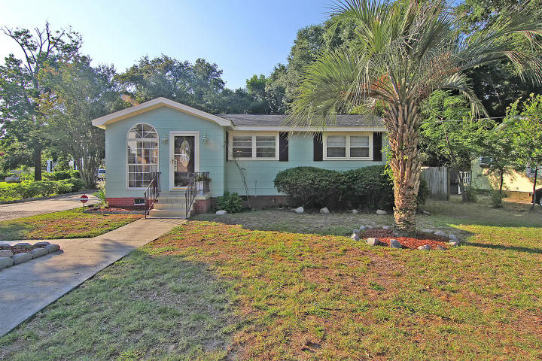
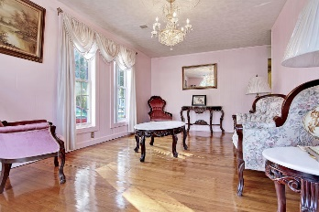
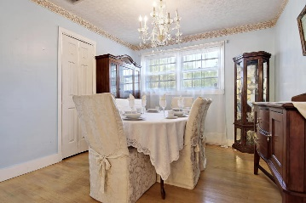
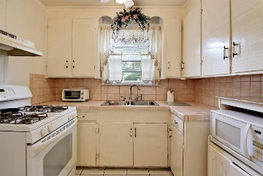
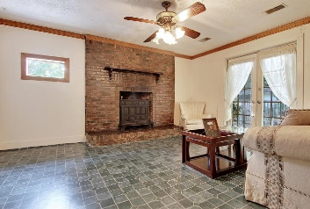
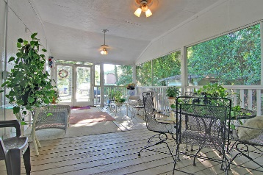


CHRISTMAS SPECIAL!
509 Ferry Street
Old Mt Pleasant
Mount Pleasant
MLS# 16017220
$375,000
This Charming Cottage style home is located in the Old Village area of Mount Pleasant is situated on a quiet tree lined street and is surrounded by a private landscaped yard. This Authentic Cottage with beautiful wood, ceramic and carpeted flooring offers 4 bedrooms, a formal living room, a Classic dining room, a large kitchen with built-in appliances and a valuable breakfast room perfect for informal dining. There is a popular family room with a wood burning fireplace and a French door walk-out to a useful screened-in porch perfect for relaxing or just reading a book! The home is located close to community parks and a short walk to the harbor. This home is being offered in it’s current “AS IS” condition and is PRICED TO SELL QUICKLY! The home is perfect for the do-it-yourself contractor or for the smart investor who is looking for a quick return on his investment. The Line Forms Here! BRING YOUR CHECKBOOK! Age, sqft, taxes, acreage, schools are approximate buyer to verify any and all information deemed necessary.
Bill Everett, Jr
Broker
843-693-8539
Bill@TheEverettGroup.net
RE/MAX Pro Realty, 9209 University Blvd, Charleston, SC 29406

