Slide 1
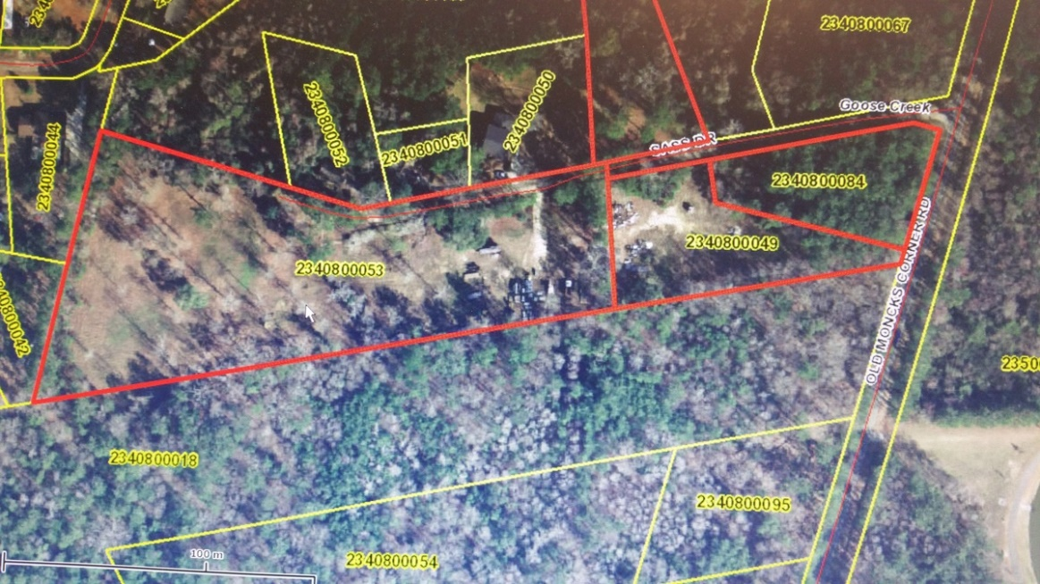


509 Old Moncks Corner Rd Goose Creek, SC 29445 ~ CMLS# 29989145 ~ $425,000
Developable 9.2 Acres ~ Reduced $100,000
Vacant commercial land contiguous with
TMS 2340800053 & 049 Zoned R-1.
Possible contiguous 21 acres available for sale.
Property Subtypes: | Office, Residential (Single Family), Self Storage | Submarket/Township: | 73 - G.Creek/M.Corner Hwy.17a to Hwy.52
Gross Land Area: | 9.87 Acres | County: | Berkeley
Unit Price: | $43,059 Per Acre | Taxing Authority: | Berkeley & Goose Creek
Sale Terms: | Cash to Seller | Tax ID/APN: | 234-08-00-084
Cap Rate: | Undisclosed | Zoning: | GC - General Commercial District
Bob Glover, CCIM
(843) 572-0000
bobgloverccim@gmail.com
Bob Glover Real Estate LLC | 105 A Old Hwy 52 | Moncks Corner, SC 29461

