Slide 1
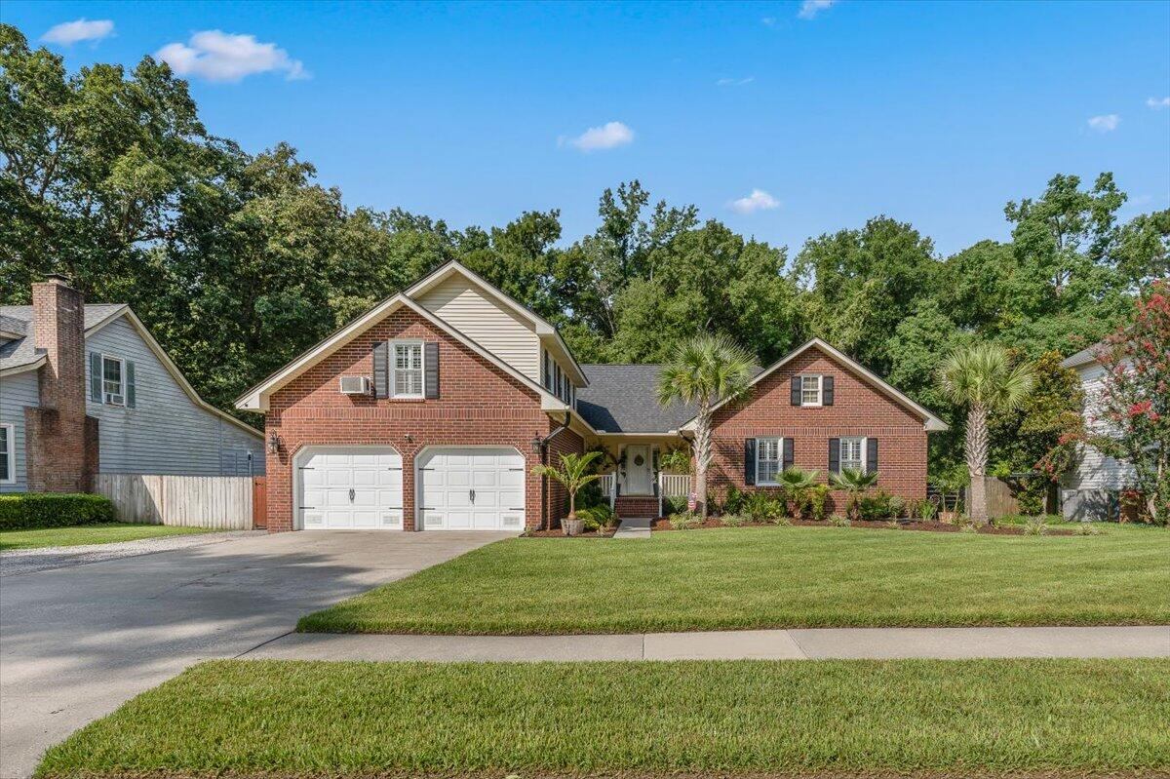
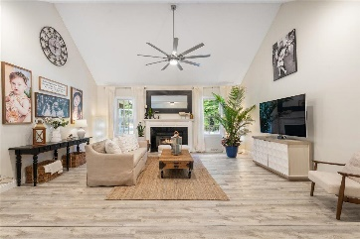
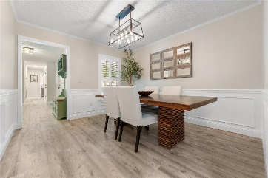
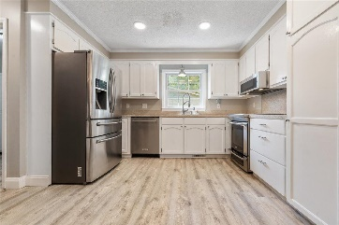
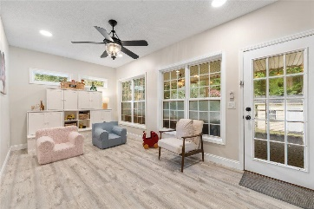
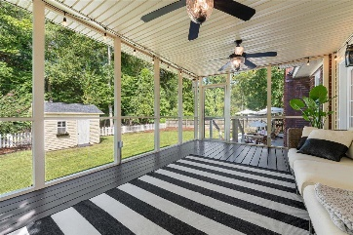
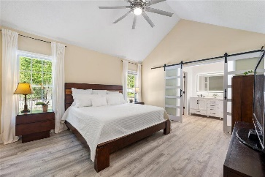
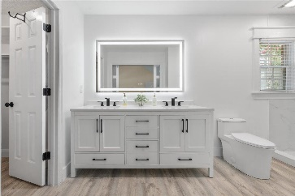
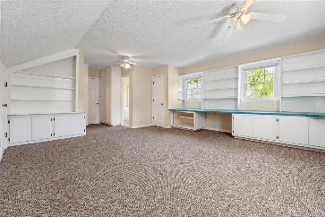
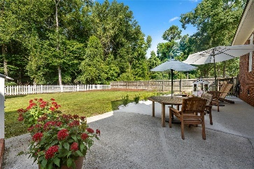
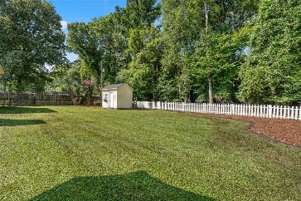



Stunning Brick Home in Newington Plantation
509 King Charles Circle
Newington Plantation
Summerville, SC 29485
MLS# 24019601
$549,500
4 Bed | 3 Bath | 2,453 sf
Discover this stunning 4-bedroom, 3-bathroom gem nestled in the highly sought-after Newington Plantation subdivision of charming Summerville, SC. This elegant residence offers over 2,450 square feet of METICULOUSLY designed, maintained, and renovated living space, blending comfort and luxury in every detail. As you step inside, you are greeted by an abundance of natural sunlight streaming through large windows, highlighting the beautiful LVP flooring that flows throughout the main level. The spacious living areas are adorned with plantation shutters on all forward-facing windows, adding a touch of Southern charm to the home's sophisticated ambiance. Enjoy your personal time reading a book or lounging in your favorite chair next to the wood-burning fireplace in the living room. The main floor boasts three generously sized bedrooms, each filled with ample sunlight and warmth. Above the garage, discover a versatile bedroom with an en suite bathroom, perfect for use as a bonus room, guest suite, or private in-law suite. The downstairs primary bedrooms features and beautifully renovated en-suite which was completely redone. Outside, the property is a visual delight. A brand-new 50-year roof with designer shingles offers unparalleled protection against fire, wind, UV rays, and algae, all backed by a lifetime transferable warranty. The exquisitely landscaped yard, enhanced by enchanting LED lighting, features lush Tamstar St. Augustine turf grass that adds a vibrant, natural touch. The extended driveway provides ample parking space and convenient access to the side yard through a double gate, ideal for boat or RV storage. Energy efficiency is at the heart of this home, featuring LED recessed lighting and a smart home-controlled Bosch 5-ton inverter-style HVAC system with whole-home dehumidification. Beneath the home, the crawl space is equipped with a state-of-the-art dehumidification system and a sump pump over a vapor barrier, ensuring a healthy and dry foundation. Step outside to the spacious screened-in porch, a perfect spot for morning coffee or evening relaxation, basking in the serene views of the nature preserve that borders the property. The large cement slab offers an ideal space for hosting BBQs or gatherings, surrounded by the beauty of the meticulously maintained yard. A charming shed provides additional storage for all your outdoor needs. Residents of Newington Plantation enjoy a wealth of neighborhood amenities for only $100 PER YEAR, including a pool, park, and easy access to the scenic Sawmill Branch Trail. With two elementary schools within the neighborhood and close proximity to hospitals, places of worship, the airport, large corporations, and major roads, this property offers the perfect balance of tranquility and convenience. You will find no other home like this one. Renovations include roof (2022), landscaping with LED lighting (2022), extended driveway (2023), HVAC (2020), primary bathroom renovation (2023), water heater (2023), flooring (2018), crawlspace dehumidifier (2020), fresh paint (2024). Additional flooring for FROG that matches rest of house to convey at no additional cost.
Nick Mazzilli (843) 640-5575
nick@themazzilliteam.com
nickmavencharleston.com
Maven Realty
2180 McMillan Ave
#71672
Charleston, SC 29405

