Slide 1
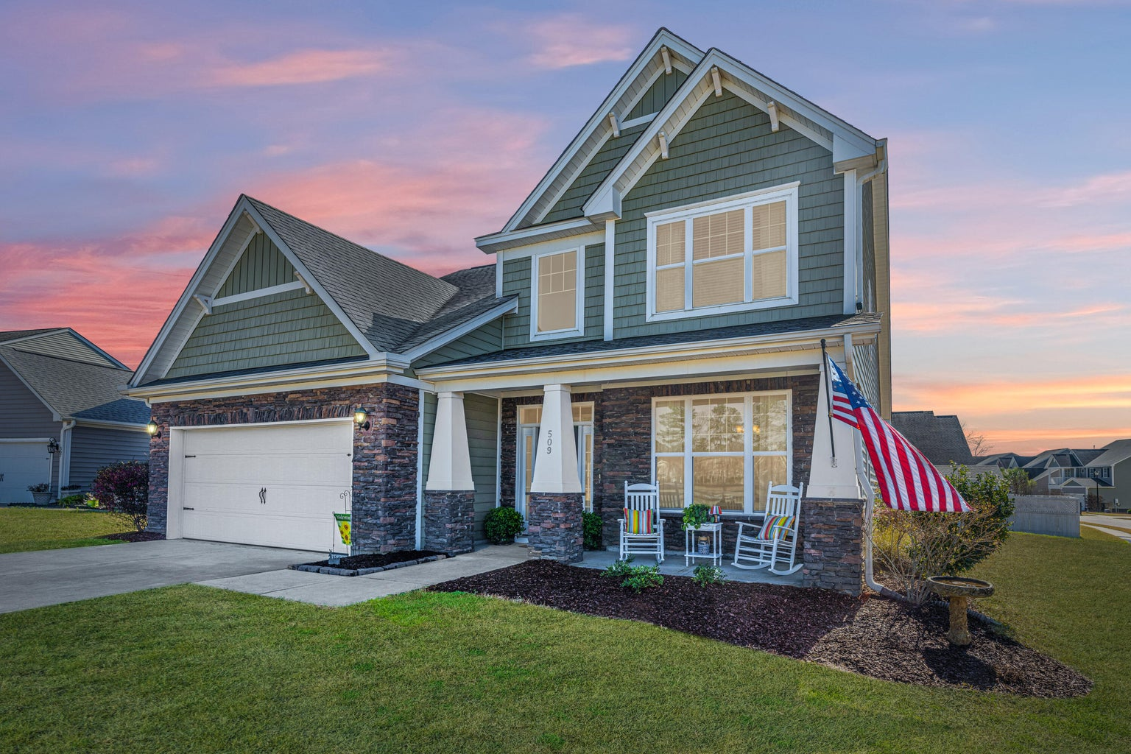
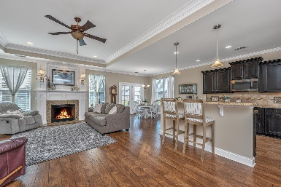
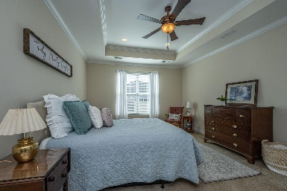
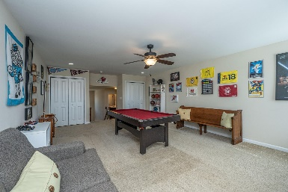
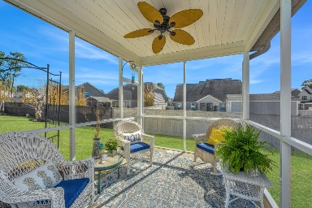


509 Pendleton Drive
Foxbank Plantation · Moncks Corner, SC 29461
MLS# 23003291 · $429,000
This One Ticks All the Right Boxes!
Bright, spacious & turnkey! This beautiful home in Foxbank Plantation features the Primary Bedroom on the main level & an upstairs Loft big enough to comfortably hold a pool table & then some. This home sits on a corner lot & directly across from a lagoon. The Kitchen offers a large pantry, dual wall ovens, gas cooktop & tons of cabinets. The Living Area has a gas log Fireplace & no shortage of natural light. Upstairs are 3 large bedrooms. Foxbank has its own elementary school, restaurants, churches & 140 acres of protected wetlands. Get to know your neighbors at the 2 pools or dog park! A $1,700 Lender Credit is available & will be applied towards buyer's closing costs & pre-paids if Buyer chooses to use Seller's preferred lender. This is in addition to any other negotiated concessions.
Bill Trull
(843) 343-2175
bill.trull@carolinaone.com
Carolina One Real Estate | 195 W Coleman Blvd | Mt Pleasant, SC 29464-3495

