Slide 1
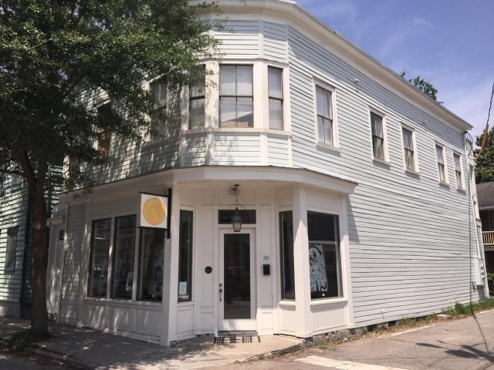


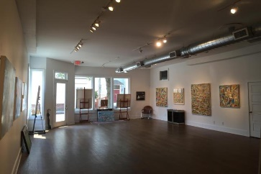
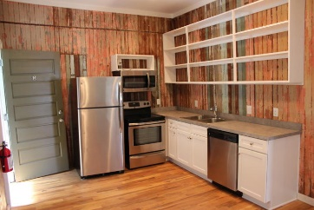
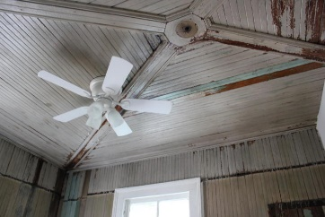
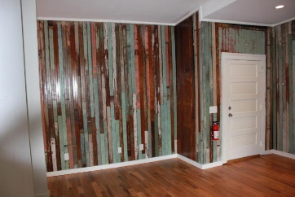
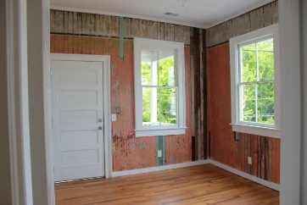


Renovated Victorian
Multi-unit Mixed-use
Investment Property
See more about this property at www.50bogardstreet.com
50 Bogard Street
Elliotborough | Charleston, SC 29403
MLS# 17028629 | $1,295,000
Completely renovated Victorian period multi unit mixed-use investment property located in the Cannonborough-Elliotborough neighborhood that is experiencing widespread revitalization of commercial and residential properties.
Strong Rental History.
Property is in an X flood zone. No Flood Insurance required.
Edmund Major
843-343-6666 C
edmund@flywaysc.com
www.flywaysc.com
Flyway Real Estate, LLC
1630 Meeting St.
Bldg 1
Ste 302
Charleston, SC 29405

