Slide 1
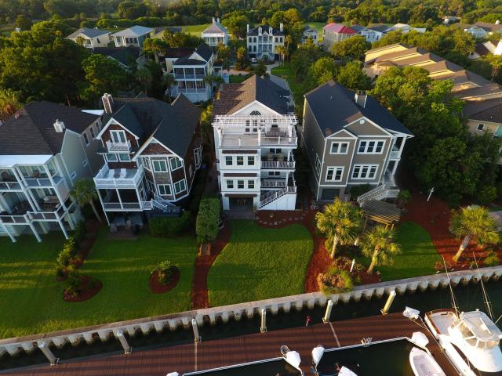
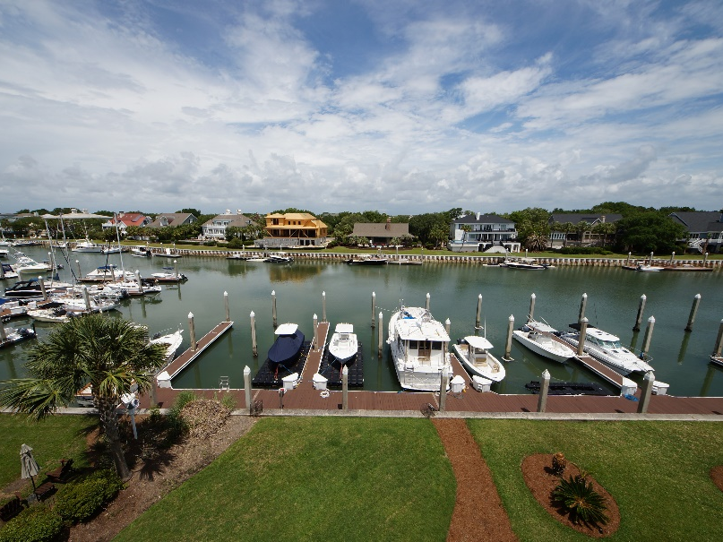
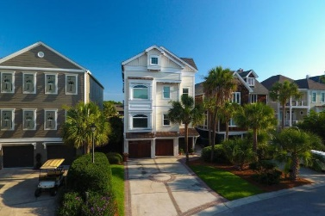
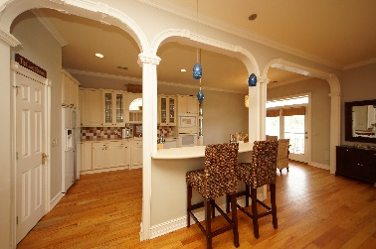
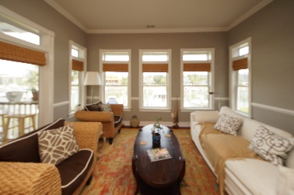
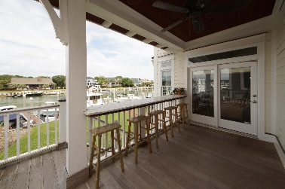
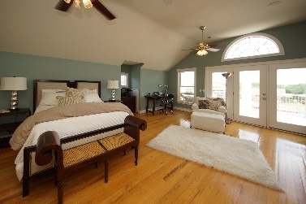
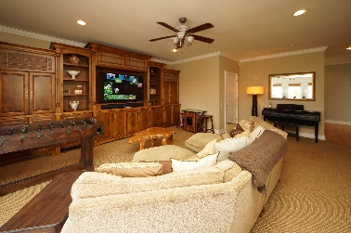
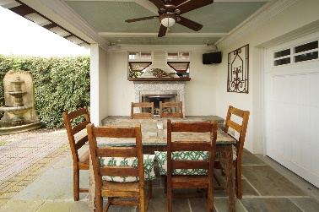
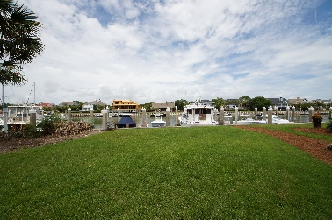
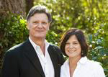

Potential Short Sale!
4% BUYERS AGENT COMMISSION
50 Morgan Place Drive
Wild Dunes ~ Isle of Palms, SC 29451 ~ MLS# 18014985 ~ $1,875,000
Three story elevated home backs up to deep water. Located in the gated neighborhood of Morgan Place within Wild Dunes resort, this remodeled home by well-known local coastal architect Steven Herlong, sits at the end of a quite cul de sac just steps away from the docks and private community pool. The exterior is designed with antique white rafter tips and Western Red Cedar wainscot overhangs and Sapele mahogany doors. Each of the three elevated floors is accessible by elevator from the 4 car garage with each having its own veranda facing the water. The outdoor kitchen with fireplace overlooking water is spectacular. Come and see this one of a kind property, ceiling audio speakers inside and out. The entire third floor is a huge Master suite, with spacious double vanity bath & jacuzzi tub and a 4 person dry cedar sauna, superstar dressing room and nearly 400 sq ft of pergola covered veranda style terrace and spectacular marina and sunset views.
Chuck & Edy Mimms
Cell 843-224-9507
Office 843-530-8100 www.sanddollarsc.com
www.facebook.com/Sanddollarsc
Sand Dollar Real Estate Group | 2205 Middle Street | Suite 203, Mailbox 2 | Sullivans Island, SC 29482

