Slide 1
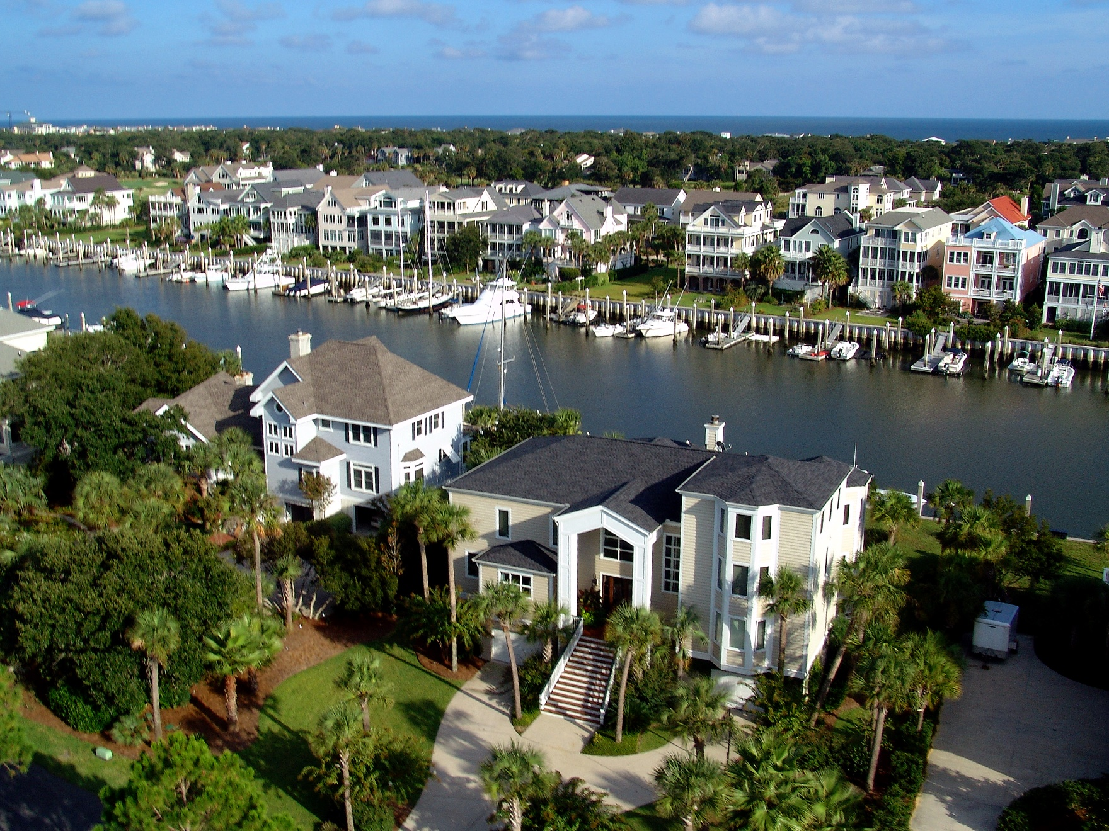
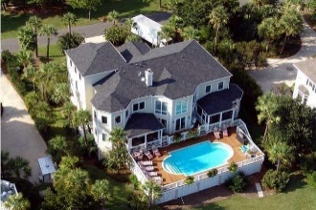
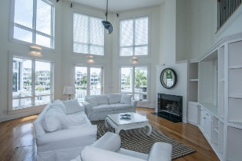
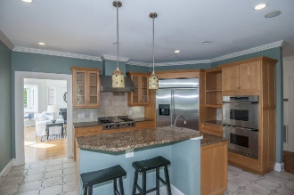
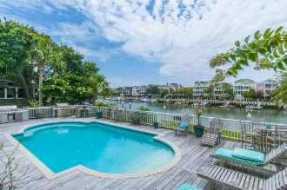
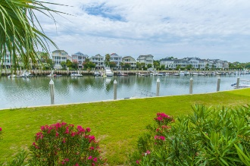


50 Waterway Island Drive Isle of Palms :: MLS# 16018883 :: $2,295,000
Wild Dunes Waterfront with 80' Dock
Wild Dunes Waterway Island home located on Morgan Creek with 80ft of deep water dock space in your backyard, bring your boat and other watercraft to enjoy.
This home is contemporary in nature with open living area with two story ceiling with wall of windows overlooking Morgan Creek and marina. The kitchen is a chef's dream with all stainless professional grade appliances, granite counters and maple cabinets. There is an eat in area with built in window seat that completes the kitchen.
Master suite on main level with outdoor access to private deck overlooking pool and marina, large bath and walk in closet. Formal dining and laundry room finish the main floor. Upstairs are three/four more bedrooms and three baths. Third floor media/ game room . Home has ample parking and storage in garage.
Clay Cunningham
O (843) 886-8110
M (843) 345-4647
clay@carolinaone.com
www.claysre.com
Carolina One Real Estate
1503 Palm Blvd Ste
Isle of Palms, SC 29451

