Slide 1
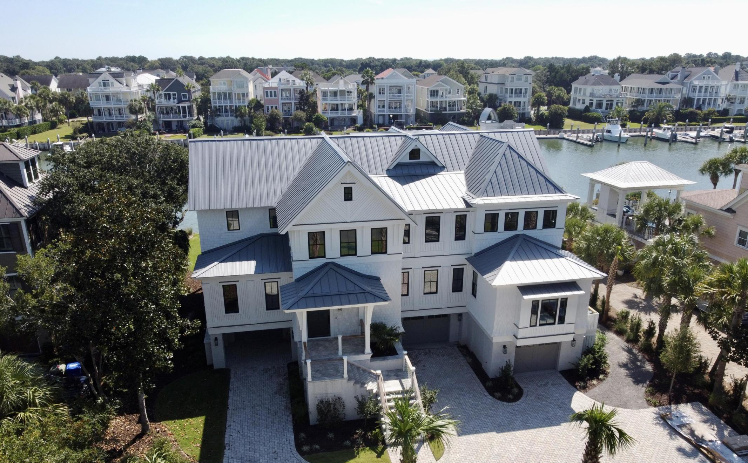
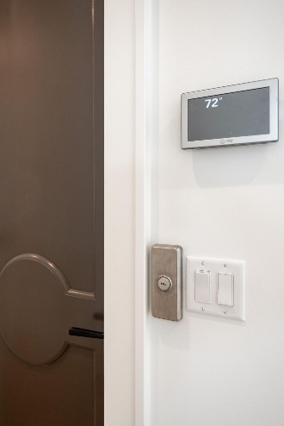
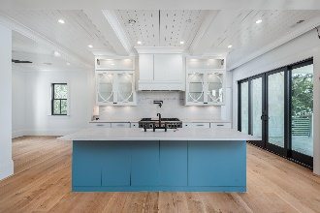
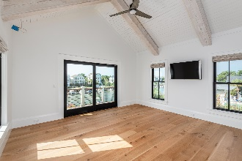
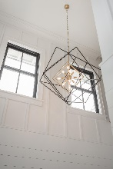
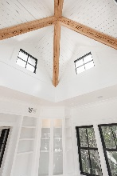
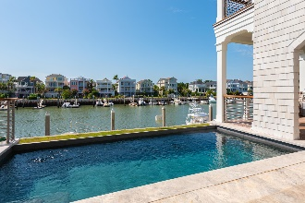
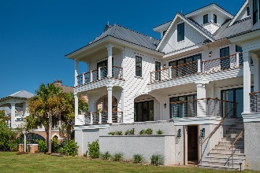
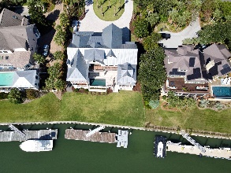



50 Waterway Island Drive
Wild Dunes | Isle of Palms | MLS# 20021661 | $5,295,000
Don’t Miss the New 3D Tour!
OWNER MOTIVATED
"Simply The Best" Architectural integrity and unique details are found throughout this grand home focusing on issues of design and island lifestyle. Once inside, you're greeted by unsurpassed views of Morgan Creek. Noting the detail of the huge cypress radius ceiling, it sets the theme for the strength of this home and its offerings! In addition to the flow of natural light, the great room features automatic shades over the sets of sliding glass door panels, fireplace, security cameras (w/live feed to IT system) and surround sound. Plentiful custom cabinets, pull-outs, superb Quartzite surfacing and professional appliances highlight this "chef's" kitchen and scullery (w/ dual pantries, bistro-style coffee bar) w/wine bar all with a hint of nautical elegance! Relax in the "keeping room" in front of the fire after a grand meal! Practicality comes in to play in the laundry room which contains five separate pull-out hampers and a Corian waterfall-edge folding area over the GE washer/dryer, sink and lots of elbow room. The master suite awaits you with more than just views. Generous closets (his and hers) with custom built-ins and lighting, all-glass enclosure shower with zero-entry, dual vanities with quartz countertops, plus this gorgeous tiled floor is heated! Selective use of board and batten, shiplap, and substantial trim throughout this home allows your eye to follow the wide staircase to the 2nd floor entertainment area offering wetbar w/ stainless countertop, beverage center, icemaker, TV, automatic shades over glass sliders, and nickel gap ceiling. A set of barn doors with frosted glass can close off the front spacious office and/or meeting room and still maintain plenty of natural light overlooking the front lawn. Second master bedroom greets you with gorgeous cypress-beamed vaulted ceilings offering small recessed lighting for more beam accents! The front bedroom is highlighted by six casement windows and can accommodate two queen-size beds. The hallway leads to the other two bedrooms - one offering a set of built-in drawers allowing more storage and space; the other features a fun corner light fixture for the idea of placement for a corner desk and two small beds. Next...the primary office is one image you won't want to forget...set up for the best "Meeting On The Creek" to suit any executive! The ultimate business quarters plays host to 17 windows, Pecky cypress beams, and VIEWS!!! Feel like the captain of your ship while you can simply check on your dock, boat, pool, and summer kitchen with one glance! LOCATION...situated at the arch of the Creek and the Intracoastal Waterway that lead to all the scenic barrier islands, the Charleston Harbor and beyond. The ideal setting for an opportunity to own a home that has it all - live, work, and play at a beach resort unlike any other vacation destination with golf, tennis, and swimming amenities in the Lowcountry!
Video Tour: https://player.vimeo.com/video/444671213
3D Virtual Tour: https://my.matterport.com/show/?m=Sv79qEdPhG2
Suzi Baldrick
Mobile 843-442-3149
suzi.baldrick@carolinaone.com
www.carolinacoastalproperties.net
Carolina Coastal Group
Carolina One Real Estate
1503 Palm Blvd
Isle of Palms, SC 29451-2280

