Slide 1
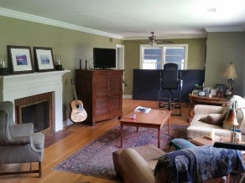
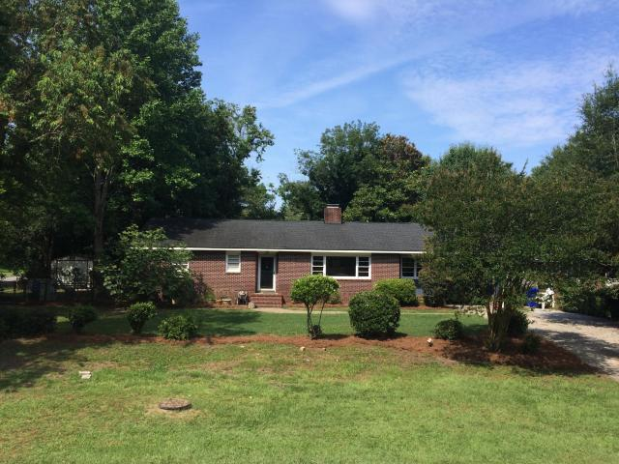
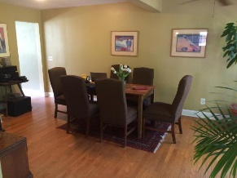
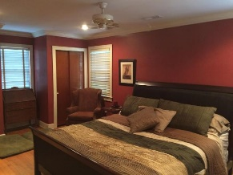
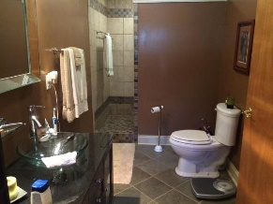


OPEN HOUSE
Sunday, Oct 2
1:00-4:00
$450,000
$450,000
5101 Parkside Drive
Park Circle · North Charleston · MLS# 16016230 · $339,900
Jimmy Banyas
(843) 822-2622
jimmybanyas@gmail.com
Nicely updated home on a .33 acre corner lot in the Cameron Terrace quadrant of Park Circle. Fenced in and very private. 1 car carport with 20x10 foot outbuilding with electrical. Separate well with irrigation. Professionally cleaned brick facade with brand new paint on three sides with Cedar siding. Brand new 4 Ton 16 seer HVAC last month. New roof in 2010. A 300 square foot addition in 2002 added to back of house to expand kitchen and master bath. 200 amp electrical upgrade and plumbing done during addition. Hardwood floors throughout home along with ceiling fans in all rooms. Wood burning fireplace in living room. Smooth ceilings. Large master suite with plenty of closet space. Master bath has walk in Florida shower. 2 other bedrooms and full bath with original tile work with updated plumbing. Fully updated kitchen, all stainless appliances including Sub Zero refrigerator, that is very bright and roomy with eat in dining and counter top bar on island. French doors off kitchen lead to a trellis covered Charleston brick paver grilling area. Very private back yard with mature trees. A very nice size home in a great area.
AgentOwned Charleston Group
902 Savannah Hwy
Charleston, SC 29407
Real Estate ● Mortgage Insurance ● Business Brokerage

