Slide 1
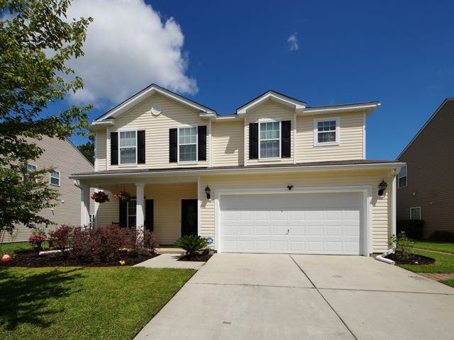
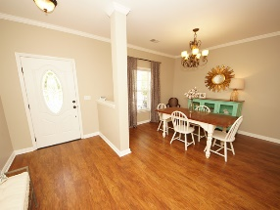
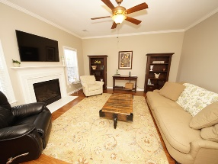
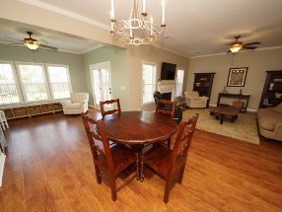
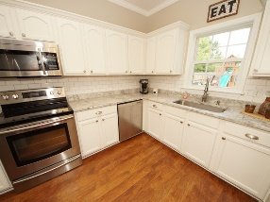
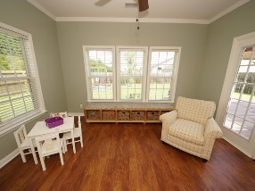
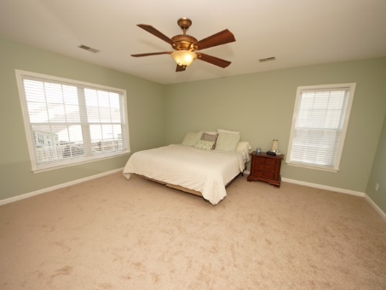
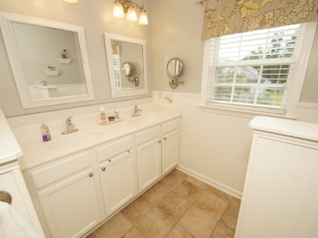
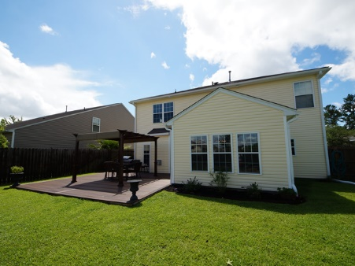

5103 Village Crier Ln
Wescott Plantation
Summerville
MLS# 17017170 | $275,000
2,416 Sq Ft - 4 Bedroom – 2½ Bath
NEW LISTING
Must see this beautiful home in Wescott Plantation with its brand new wood floors in the complete downstairs. Great open floor plan. In the kitchen you will find granite countertops, subway tile blacksplash and stainless appliances. Just steps away is a nice sunroom that leads out the French doors to a 20x20 patio with wood composite flooring and a gazebo that conveys with the property. Upstairs you will enjoy the new carpet throughout all 4 bedrooms and stairway. The master suit has ample shelving in the walk in closet and a spacious master bath with a garden tub to relax in. This house is move in ready and waiting for it's new owners.
Barbara Limehouse
843-870-8291
bllimehouse@gmail.com
Weichert Palmetto Coast
1035 Johnnie Dodds, Ste B2
Mt. Pleasant, SC 29464

