Slide 1
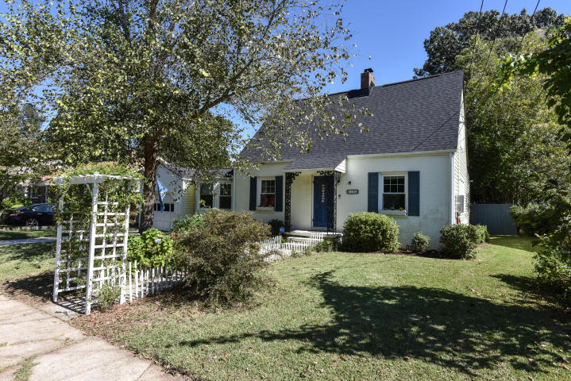
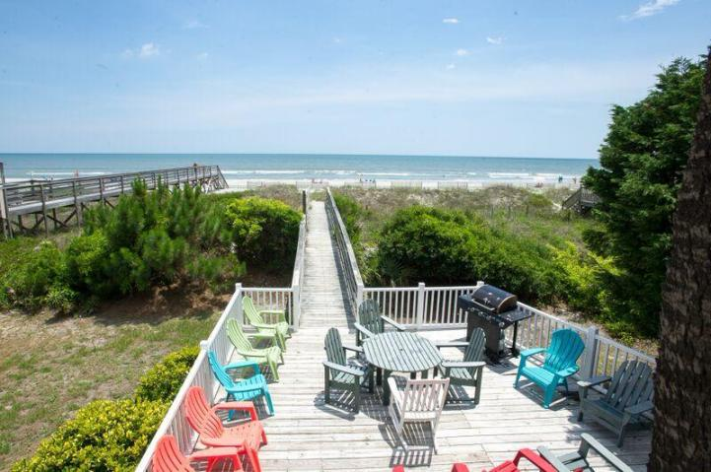
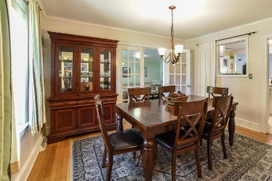
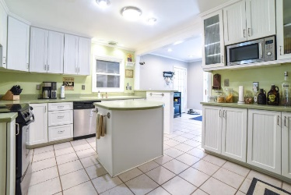
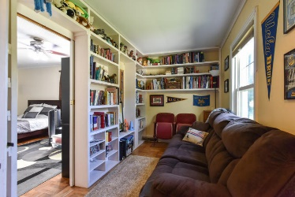
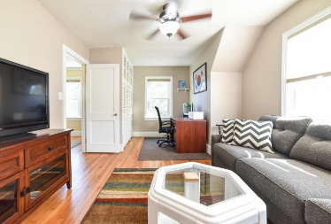
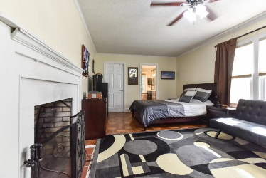
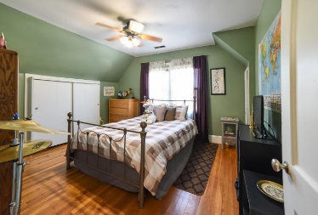
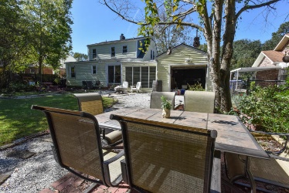
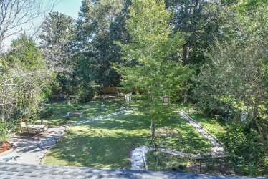
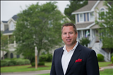

Open House Sunday, 1/14 2-4pm
5106 Parkside Drive
Park Circle · North Charleston, SC 29405
MLS# 17026824 · $375,000
Stunning one of a kind home in highly desired Park Circle on Parkside Drive with roughly 2100 square feet, and en suite custom master bath/spa and fireplace in master. Other updates include: New Roof - 2016,New pex plumbing 2017 New backflow/sewer cleanout, New water shutoff valve Updated electrical New high-capacity tankless water heater 2017 Bathroom addition 2016 Backyard/frontyard landscaping New hardiboard siding on 2nd story New gutters on 2nd story New back fence Renovated pantry (new electrical, flooring, built-in helves) New window treatments Current termite bond/pest control. Garage workshop/storage Fruit trees Mature magnolia, palmetto in backyard New exterior outlets and flood lighting Renovated eat-in kitchen, Added bathroom ventilation/fans new master laundry room/x flood zone.
Bryan Thompson
Office - (843) 769-5100
Mobile - (843) 452-1686
bryan.thompson@agentownedrealty.com
www.bryanthompsonrealestate.com
AgentOwned Charleston Group | 902 Savannah Hwy | Charleston, SC 29407-7802

