Slide 1
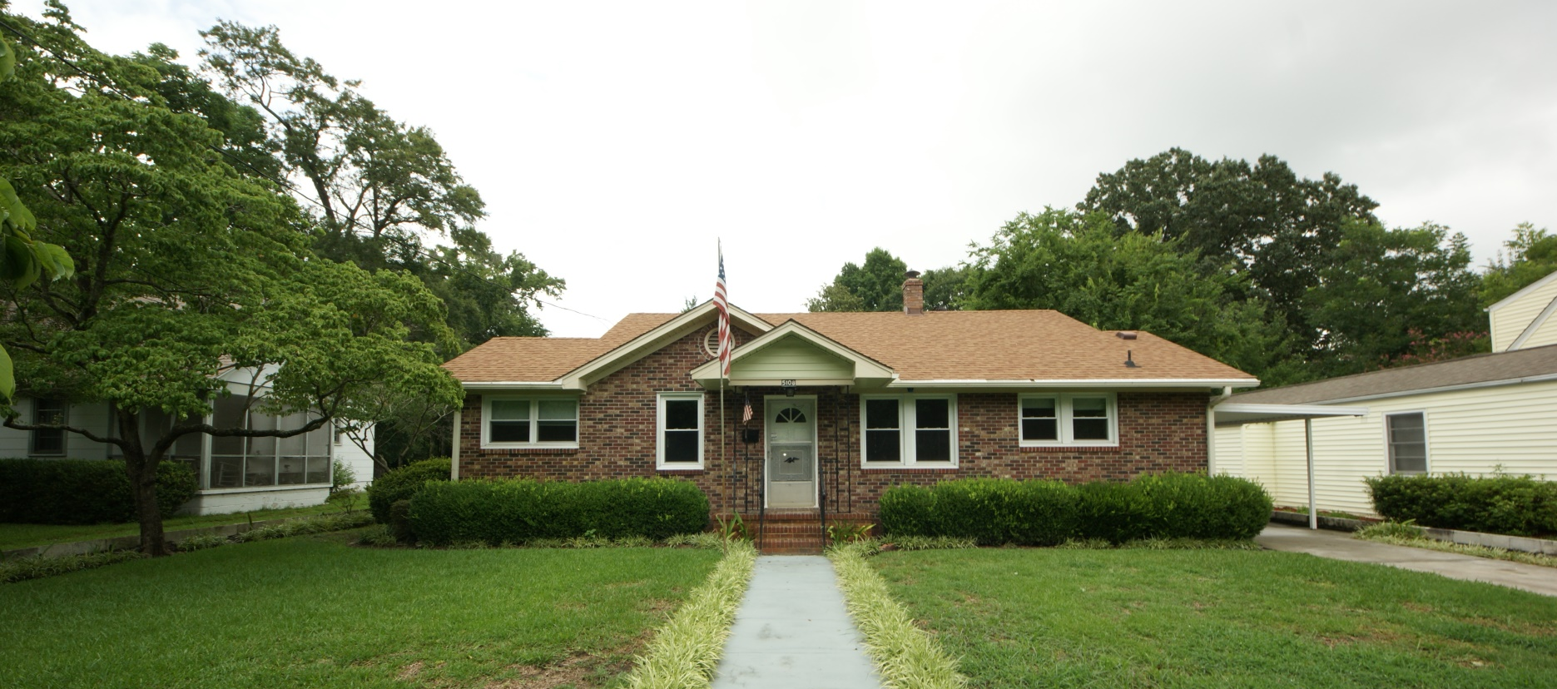
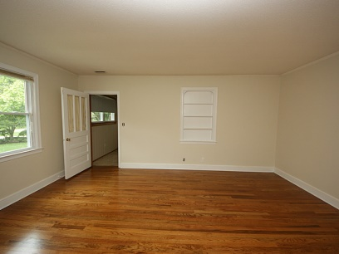
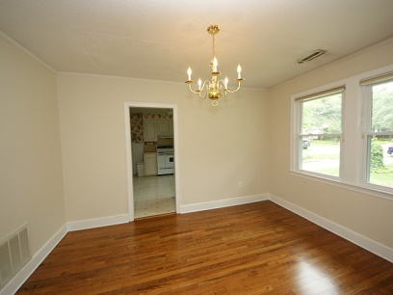
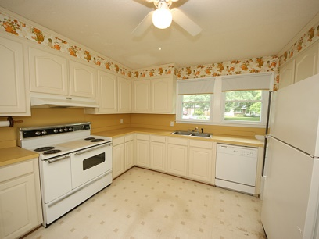
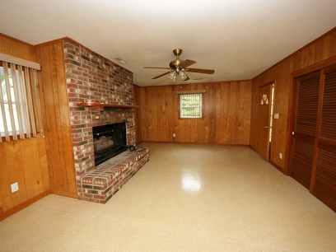
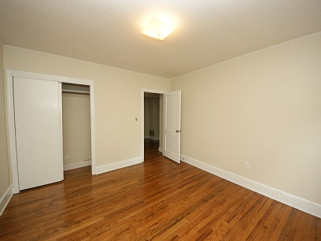
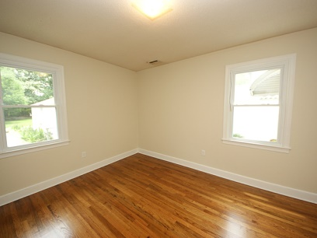
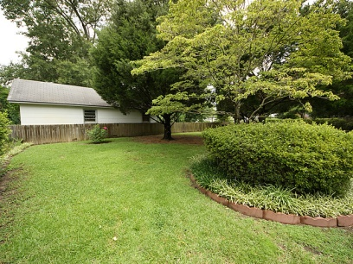
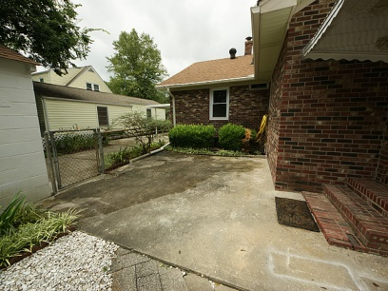
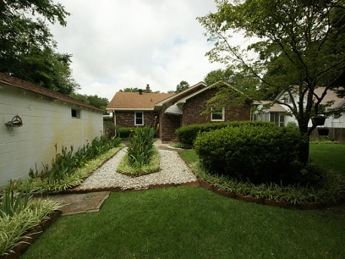
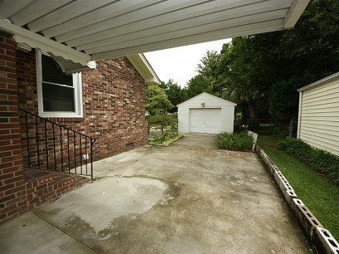


5108 Parkside Dr
Park Circle – N Charleston
MLS# 1412542 – $220,000
Recently Renovated & Reduced
Looking to get in on one of Park Circles most well-maintained Homes, you found it. Curb appeal is here, as the yard is Landscaped with an abundance of Flowering plants and Shrubs. The Owners have Green Thumbs. The Home being well-maintained, includes..All Brick Veneer Home, Newer Roof and Insulated Windows, H/A, Kitchen Cab and fixtures. The Huge Attic is floored with lots of storage. Insulation in the rafters above made from Astronauts Suits. The Main Bath has been updated with fixtures that include walk-in shower. Updated Wiring and Plumbing as needed. The Home has a Carport and a one car Garage Detached and the entire back yard is fenced. The Home has 3 Bedrooms, 11/2 Baths, Formal Lr and DR, large Eat-in Kitchen w/Laundry in this area closed off by doors. A Huge Den was added off the Back of the house w/1/2 bath and large storage, where this area a shower could be added. The Den has its own entrance at the Back of the house. The way the Den was added connecting a large Bedroom, private entrance, FP, 1/2 Bath and storage, this area could be used for your parents to stay in with privacy, yes a Mother in Law suite. This Home is a must to see and built on one of the largest lots in Park Circle, has a deep Well for watering all the wonderful plants the owners have planted. A Storage shed at the back for your Garden Tools..Its a very clean home...Ready to move in...Mother in Law suite possibility if needed.
John H. Beckroge
ABR, EPRO
jbeckroge@gmail.com
Mobile 843-367-3196

