Slide 1
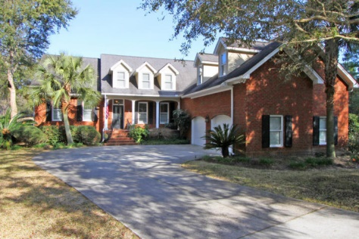
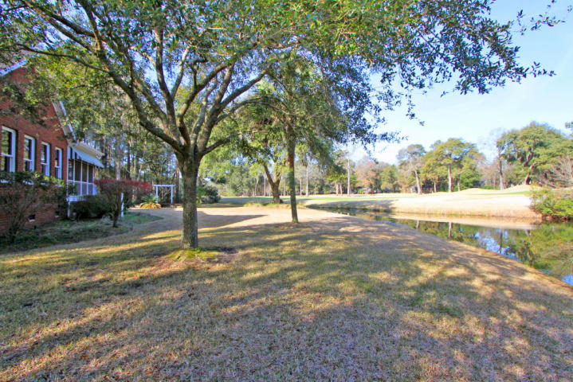
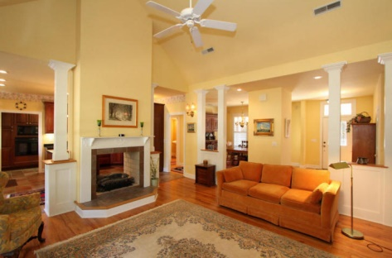
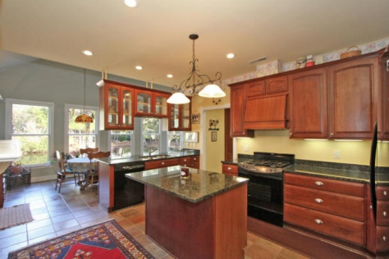
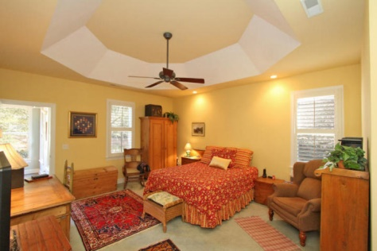
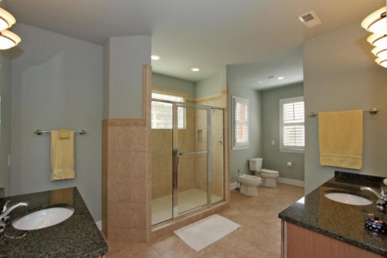
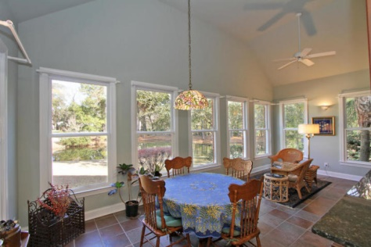
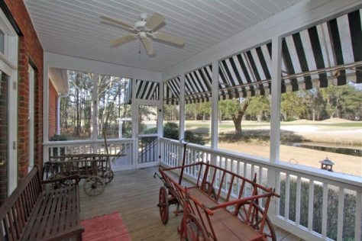


Golf Course Views
5108 Saint Ann Lane
Stono Ferry - Rural West Ashley
MLS# 15003930 ~ $575,000
Privacy, views, spacious living areas, countless features, and views of pond and 15th and 16th fairways. -Lovely brick home with Master bedroom and living areas downstairs -Open kitchen with granite counter tops and separate butler's pantry and 2 ovens -Spacious master suite has private door to the sun room -Master bath with split vanities, huge shower, walk in closet and bidet -Sun room enclosed with lots of windows for excellent views -Additional screened porch over looking golf course -Very large room over the garage This home is beautifully cared for and maintained. The Stono Ferry community is a peninsula reaching into the Stono Intercoastal Waterway and Log Bridge Creek. Besides the semi-private Links at Stono Ferry, the community offers a junior Olympic pool, lighted tennis courts, two polo fields, equestrian facility, and community social events. Stono Ferry Homeowners Association charges a 1/4 of one percent transfer fee to be paid by buyers. For square footage please measure.
Dan Amigone
Broker Associate
Complete Action Real Estate Services, Inc.
843-364-2888 - Mobile
daniel@caresrealestate.com

