Slide 1
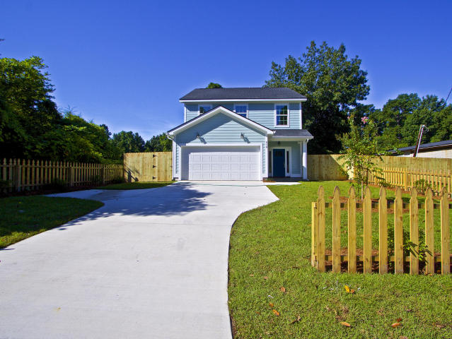
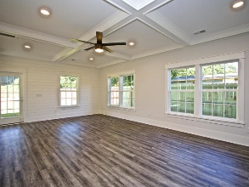
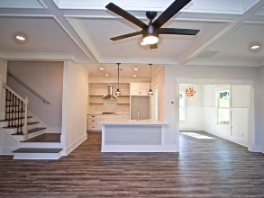
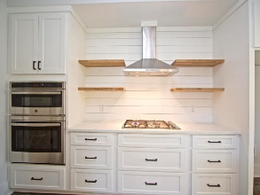
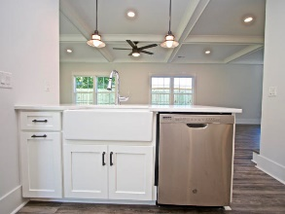
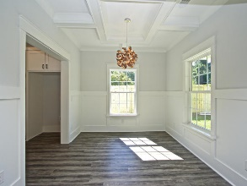
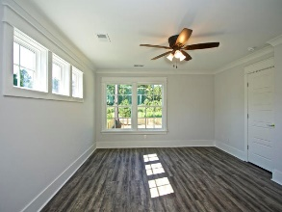
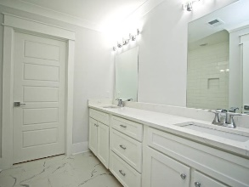
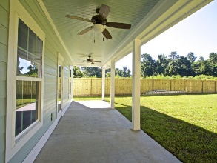
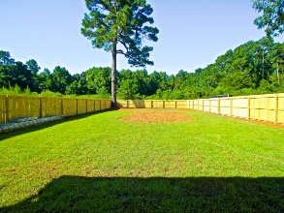
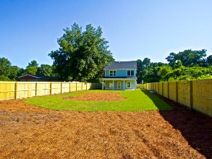


New Construction With Lots Of Details & NO HOA!!
Starbucks card to first 10 agents
510 E Richardson Avenue
Summerville, SC 29485
MLS# 18022807 ~ $375,000
Looking to live within walking distance to Downtown Summerville? Check out this brand new home built with lots of details and upgrades. No HOA, lot backs up to Gahagan Park, this 5 bedroom home offers waterproof hardwood floors throughout entire home, ceramic tile in bathrooms, custom trim (coffered ceilings, wrought iron pickets, chair railing) gas stove, gas water heater, custom built kitchen, wall oven, farm sink, separate dining area. Open floor concept is great for entertaining, lots of natural light, fully fenced backyard with lots of room for kids & dogs.
Don't miss this one!
Marcela Ruiz
(843) 513-3741
charlestonmrealtor@gmail.com | www.buywithruiz.realtor
The Boulevard Company, LLC | 35 Broad Street | Charleston, SC 29401

