Slide 1
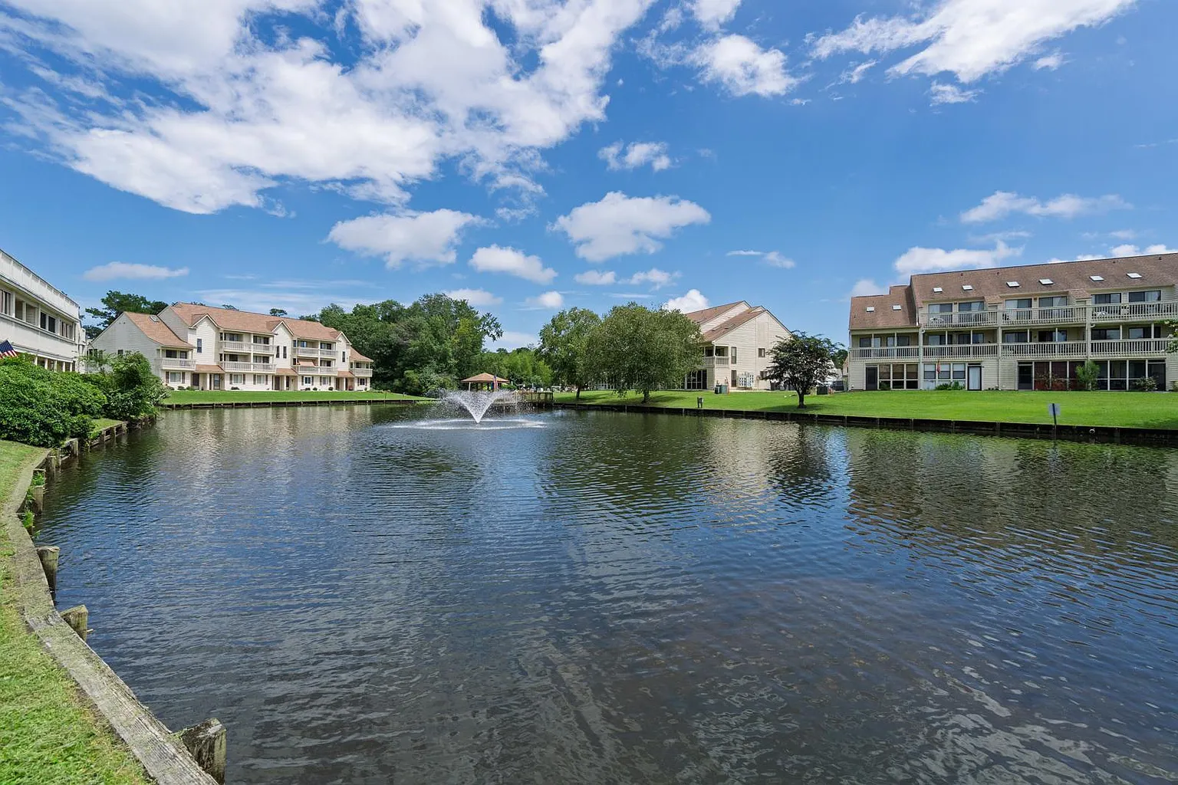

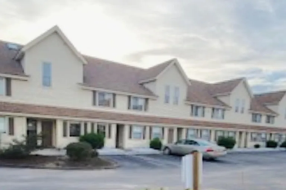
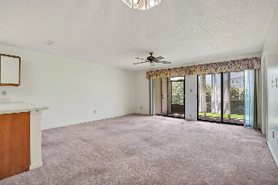
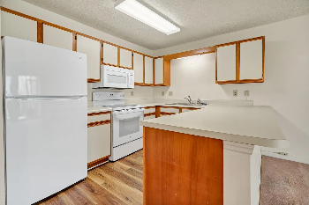
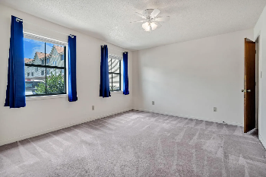
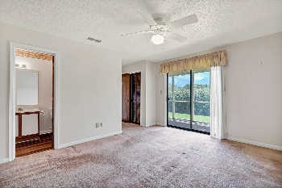

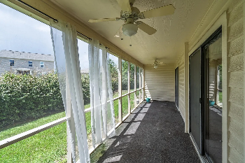
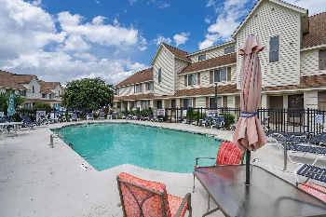
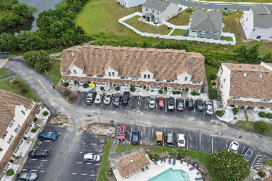
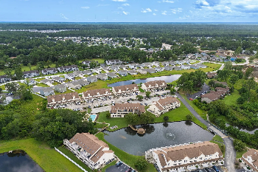
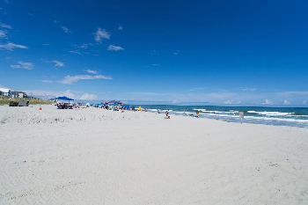
Joe Stalvey
843-460-2850
josephstalvey@gmail.com
Open House Saturday from 11-2
510 Fairwood Lakes Dr #19-C
Myrtle Beach, SC 29588 | MLS# 2520009 | $169,000
As you step into this ground level, single story ,two bedroom, two bath, large open plan one thousand sqft condo. With LVL and carpet for easy care. You don't feel cramped into a tight space. The kitchen (all appliances covey), dining area and living room are open for your comfort. The Master bedroom and ensuite are private. (not adjoining another bedroom) The secondary bedroom is situated to offer privacy as well. Enjoy the privacy of a very large rear porch that is as wide as the home. With all this privacy, you may want to get out from time to time. So here's the best of both worlds. Location, Location, Location !! Is on your side. The pool is located just steps away. Just off 707 is Glens Bay Rd. Drive straight and in less than 10 minutes, you are parking at the World Renowned Surfside Beach Pier and Surfside Beach. In less than 30 minutes you can be at the Myrtle Beach International Airport, to greet your friends and family. You are convenient to Hwy 31 that will take to North Myrtle Beach. Day trips to Charleston and its rich history and restaurants are within reach. In 20 minutes you are in Market Commons for all your shopping, entertainment and restaurants that can be found. You can be part of the hustle and bustle of all the Grand Strand has to offer and then return to the peace and tranquility of your quiet condo. Hurry and make this your home or vacation home.
The Charleston Real Estate Café | 672 Marina Dr Suite 110 | Charleston, SC 29492

