Slide 1

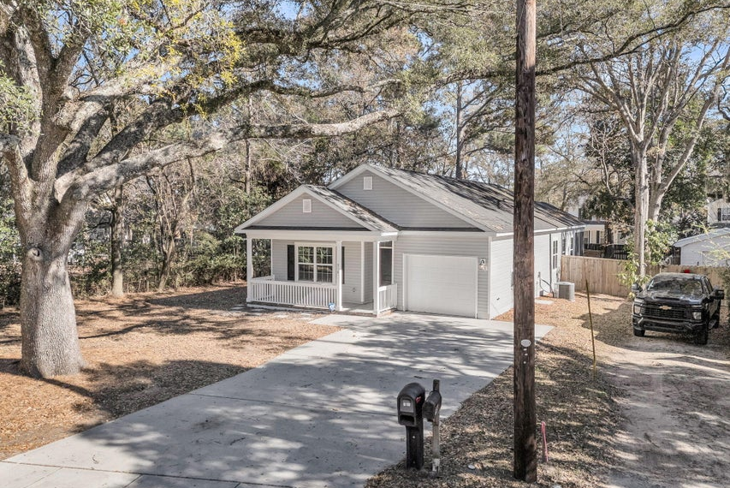
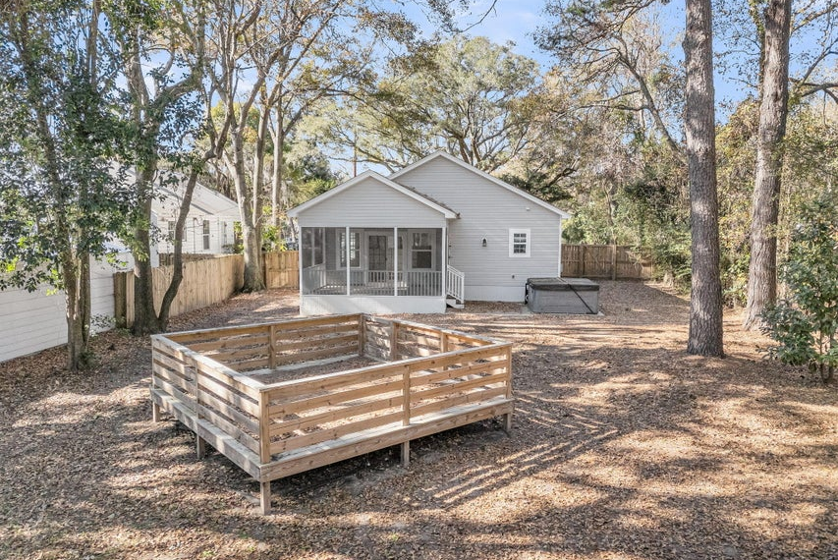
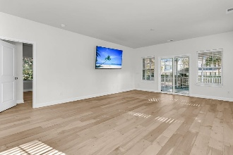
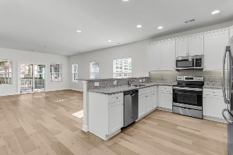
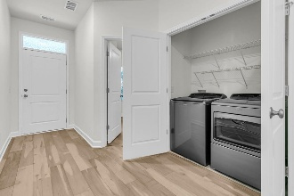
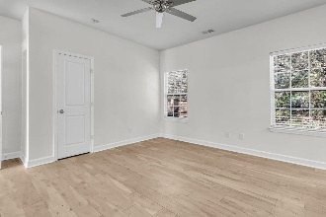
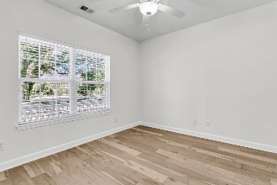

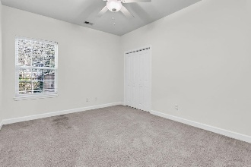
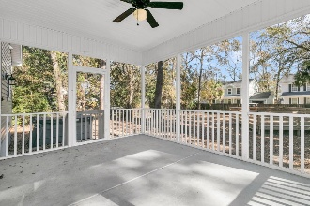
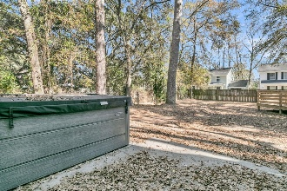
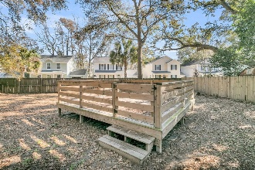
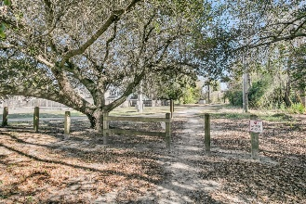
Steps from the Greenway
Newer Home w/ Extra Lot
Debbie Cromer
ABR, RSPS, REALTOR, CRS
(843) 437-6342
debbie@debbiecromer.com
www.debbiecromer.com
510 Stinson Drive
Charleston, SC 29407 | MLS# 26000123 | $540,000
Looking for a newer home in the heart of West Ashley? Look no further! This 2019-built, 3-bedroom, 2-bath ranch sits on over a quarter-acre lot w/ an adjacent .06-acre lot conveying, offering rare space & privacy w/ no HOA. Enjoy relaxing on the welcoming front porch & the 12x16 screened porch overlooking the expansive yard & mature oak trees. Inside, you'll find an open floor plan w/ 9-foot ceilings & a bright, modern kitchen featuring white cabinetry, stainless steel appliances & granite countertops. The spacious owner's suite includes a custom tile walk-in shower, & both bathrooms feature upgraded tile showers. Additional highlights include an electric-vehicle outlet in the garage. Ideally located on the greenway just minutes to I-526, shopping, restaurants & Downtown Charleston—this is West Ashley living at its best!
TAKE A VIRTUAL TOUR | PROPERTY WEBSITE
Century 21 Properties Plus | 1090 Park West Blvd; Ste 103 | Mount Pleasant, SC 29466

