Slide 1
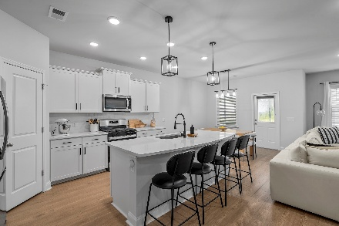
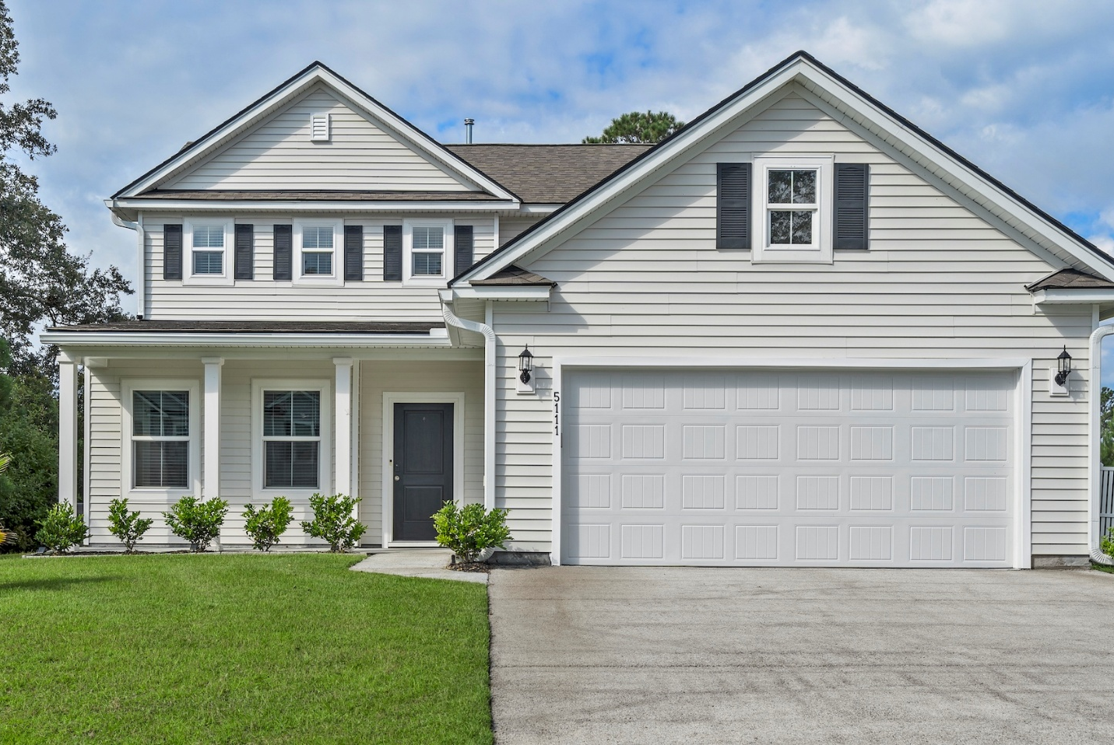
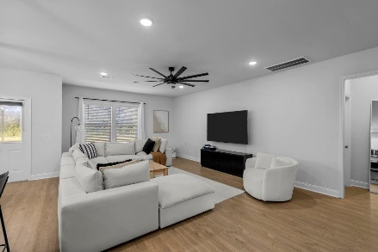
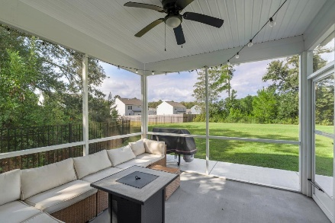
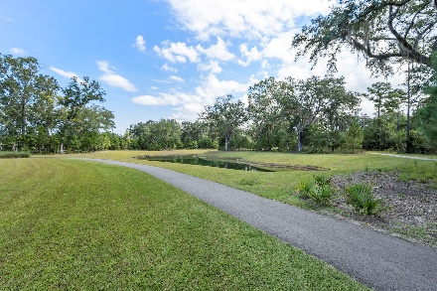
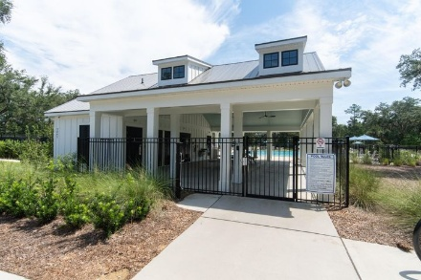
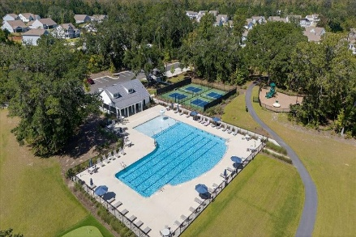
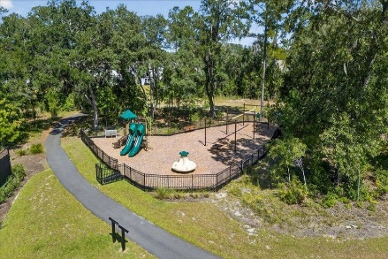


Priced to Sell!
5111 Cranesbill Way
Sea Island Preserve | Johns Island, SC 29455 | MLS# 25027945 | $615,000
THIS HOME WAS BUILT AT THE END OF 2023 AND SHOWS LIKE A MODEL.
IT FEATURES 3 BEDROOMS, 2.5 BATHROOMS, AN OFFICE, AN EXTENDED LIVING AREA, AND AN OVERSIZED FROG.
THE PRICE HAS JUST BEEN REDUCED TO $625,000, MAKING IT THE BEST VALUE IN THE COMMUNITY.
THIS AS A SIGNIFICANT OPPORTUNITY FOR A NEARLY NEW HOME!
Property Highlights:
- Built at the end of 2023 with numerous upgrades
- Spacious open-concept living with natural light
- Primary suite retreat and versatile secondary bedrooms
- Private backyard and extended driveway
Community Features – Sea Island Preserve:
- Gated community on Johns Island spanning 700 acres (360 acres of conservation land)
- Resort-style pool, splash zone, and open-air pavilion
- Pickleball courts, playground, and extensive walking trails
- Oversized homesites with estate-sized lots
This property offers an incredible opportunity for a serene and luxurious lifestyle. Please let me know when the updated draft is ready.
Laura McLain
843-509-7647
laura@lauramclainrealty.com
www.theblvdcompany.com
The Boulevard Company, LLC | 806 Johnnie Dodds Blvd Ste 100 | Mt Pleasant, SC 29464

