Slide 1
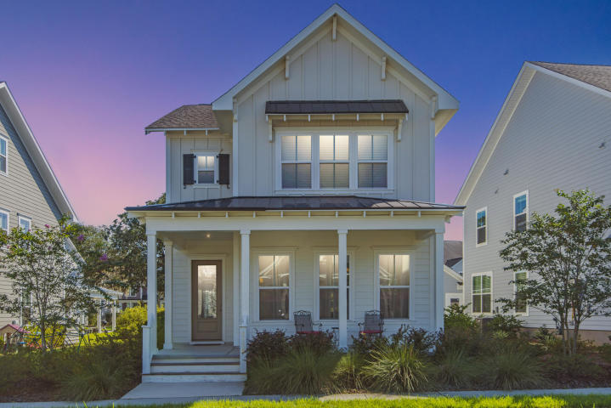
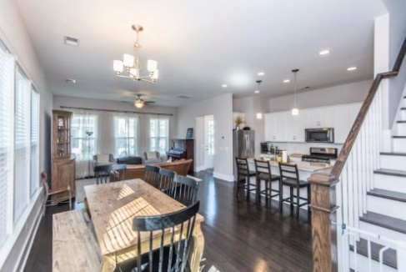
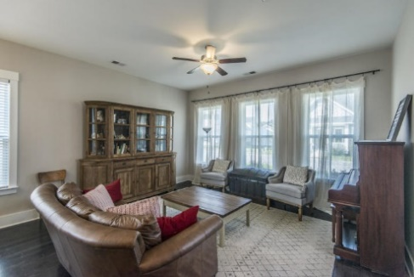
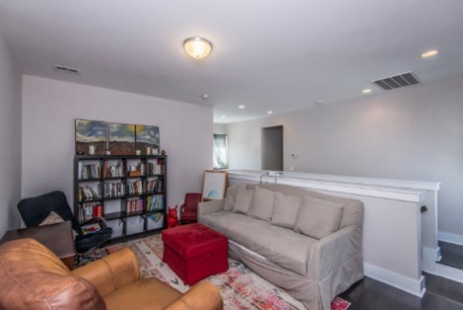
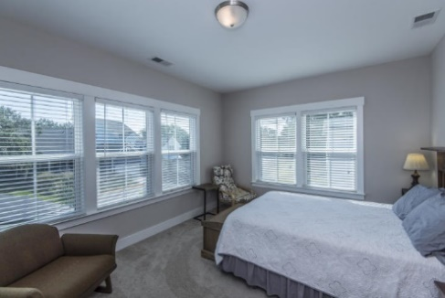
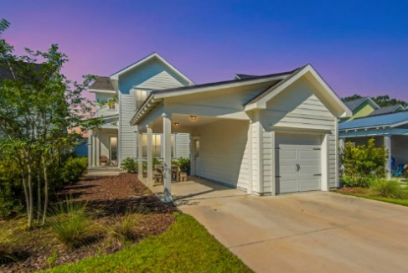
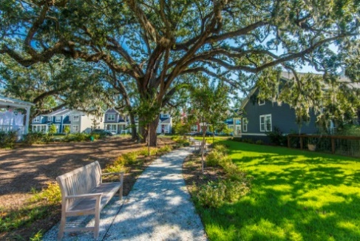


Why wait for new construction?
This Park Circle area home is LESS THAN 2 YEARS!
5116 Celtic Drive
Oak Terrace Preserve
North Charleston, SC 29405
MLS# 18027629
PRICE JUST REDUCED TO $415,000
This Ashton Woods Summerside C home is only ONE year old. With 4 bedrooms and an incredible view of an amazing Grand Oak and pocket park, this house has everything! The master bedroom is downstairs in this home and is the perfect retreat with a large luxurious tiled shower. Upstairs you will find three spacious bedrooms with plenty of light and a loft space. The first floor includes hardwood floors, granite countertops and 10 foot ceilings. Don't forget the covered patio and large front porch!
Check out the virtual tour for more images:
https://my.matterport.com/show/?m=PSL5bt1Z99W
Del Shaffer
843.408.6821
dshaffer@carolinaoneplus.com

