Slide 1
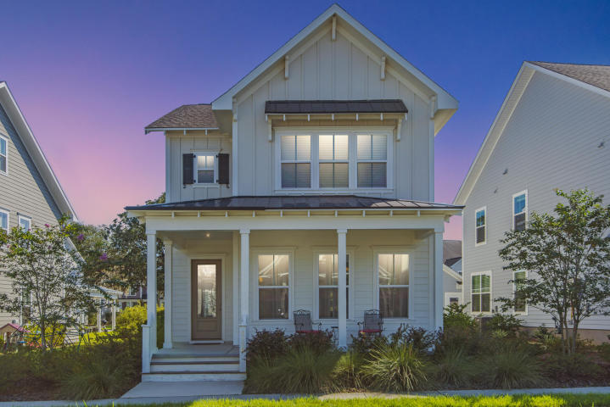
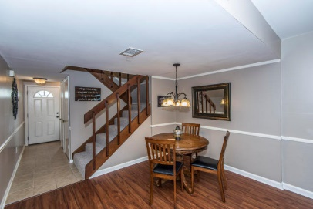
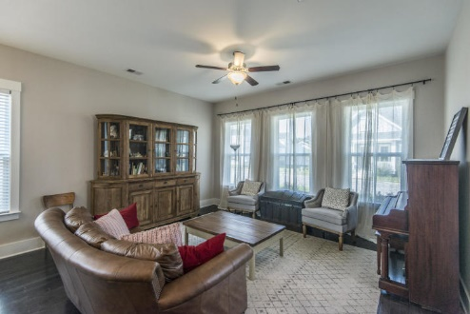
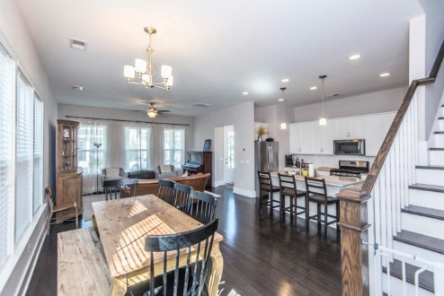
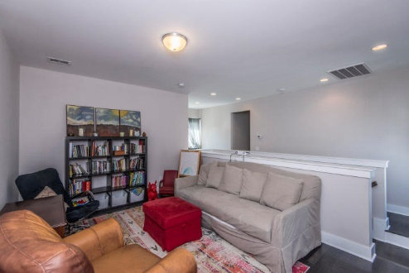
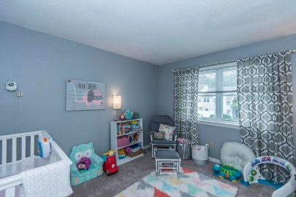
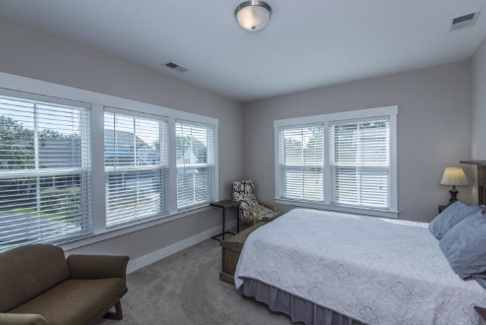
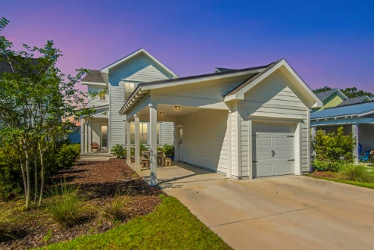
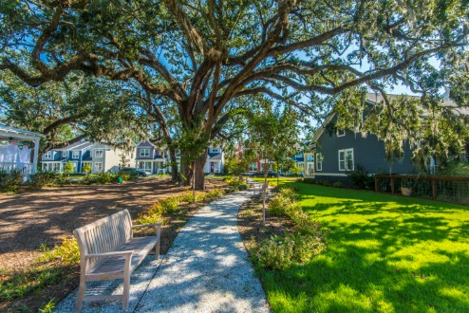


Why wait for new construction?
This Park Circle area home is only 1 year old!
5116 Celtic Drive
Oak Terrace Preserve
North Charleston, SC 29405
MLS# 18027629
$417,000
This townhouse is the perfect LOCATION. You are close to Shem Creek, Trader Joe's and Whole Foods.
This townhouse has been freshly painted and just had a new hot water heater installed. The backyard has been regraded and added new sod and a new fence.
Downstairs has Smartcore luxury vinyl waterproof tile and upstairs has new carpet. Home has been inspected and repairs made. Roof was replaced in 2014 and HVAC in 2012.
This Ashton Woods Summerside C home is only ONE year old. With 4 bedrooms and an incredible view of an amazing Grand Oak and pocket park, this house has everything! The master bedroom is downstairs in this home and is the perfect retreat with a large luxurious tiled shower. Upstairs you will find three spacious bedrooms with plenty of light and a loft space. The first floor includes hardwood floors, granite countertops and 10 foot ceilings. Don't forget the covered patio and large front porch!
Check out the virtual tour for more images:
https://my.matterport.com/show/?m=PSL5bt1Z99W
Del Shaffer
843.408.6821
dshaffer@carolinaoneplus.com

